Slide 1
Community Garden Project
May 2, 2019
Leadership Montgomery Legacy Class XXV -- Team Five

Slide 2
Client
Image Source: www.thedesignwork.com
Legacy Class XXV, Team Five

Slide 3
Problem
Image Source: https://thespoon.tech/plentiful-is-a-free-sms-based-reservation-system-for-food-pantry-visitors/
Legacy Class XXV, Team Five
Notes:
The realization of a community garden is what Forrest Park Ministry hopes to bring to its East Anne Street property. Currently a "Client Choice" food pantry resides on this site. This is a place where those in need can purchase various food items. Before this project, a variety of items were available, but families did not have choices that included fresh produce.

Slide 4
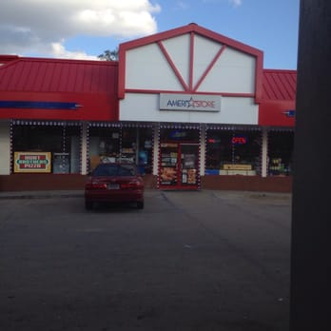
Planning & Partners
Image Source: http://www.bubbasmaterials.com/; https://www.yelp.com/biz/major-oil-company-inc-citgo-montgomery-5; https://www.mgmc3.com/; https://www.ehbconline.com/
Legacy Class XXV, Team Five
Notes:
Surveying the space, proposing a design and gaining stakeholder feedback & securing donated materials and services
Bubba's Materials and Major Oil Company each donated ten yards of topsoil.
The Montgomery Clean City Commission donated a garbage truck for debris removal on the first work day and provided the use of tools for volunteers who were clearing the garden space of overgrowth and debris.

Slide 5
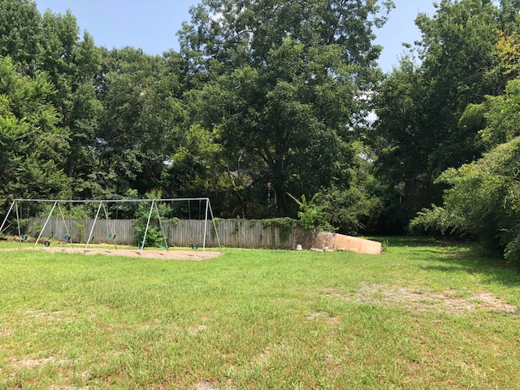
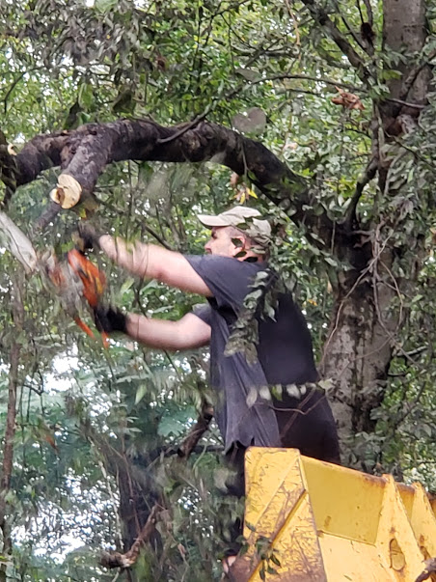
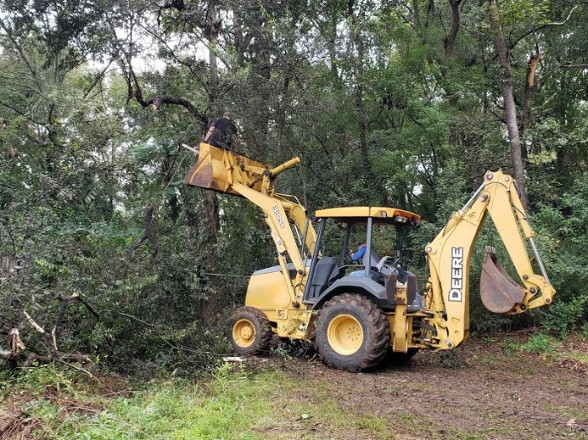
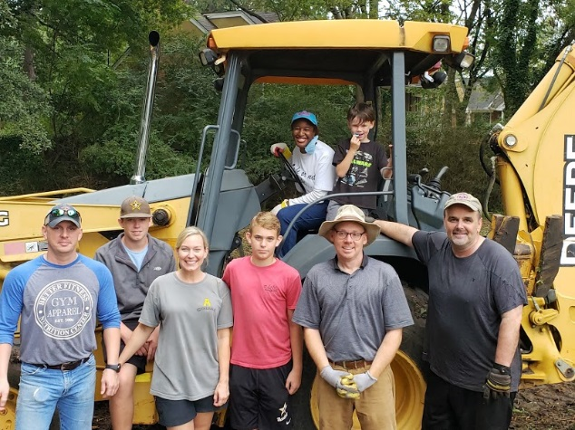
Solution
Legacy Class XXV, Team Five
Notes:
Clearing and preparing the space for the garden; using donated materials and volunteers to help prep the space

Slide 6
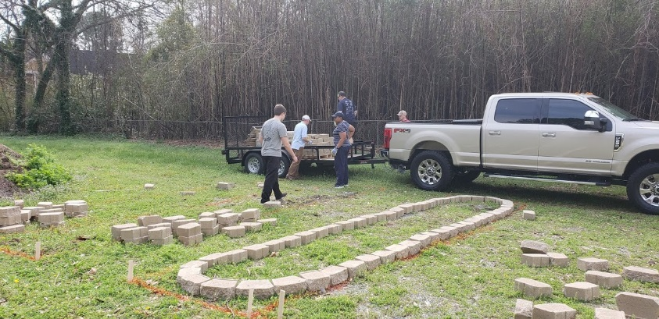
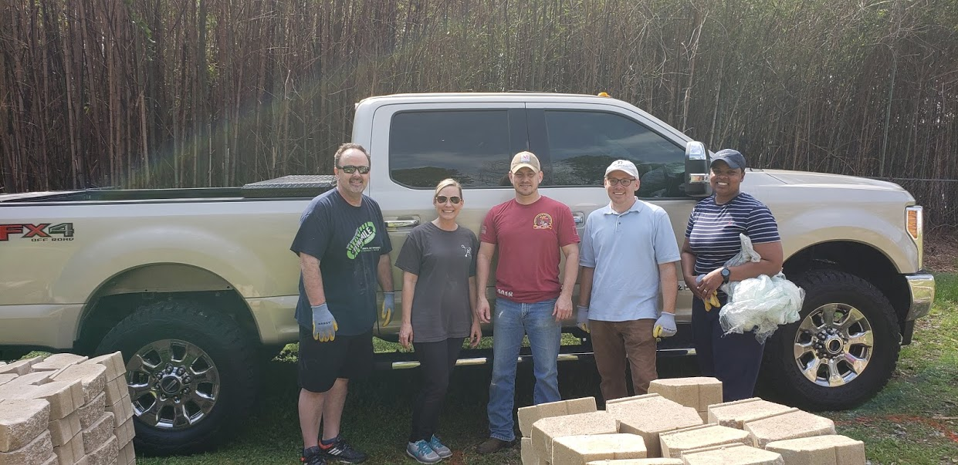
Build
Legacy Class XXV, Team Five
Notes:
Finalizing the types of seeds to plant, constructing the garden beds; planting the garden; securing donated materials and/or funds for the construction of the garden. Several work days to construct the garden beds and plant the garden

Slide 7
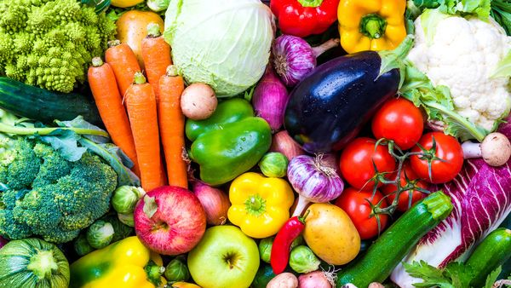
A Harvest for Montgomery's Future
Before this project, a variety of items were available, but families did not have choices that included fresh produce.
Approximately 1000-2000 people will benefit from the fresh food grown in the garden.
Eastern Hills Baptist Church will maintain the community garden.
Image Source: https://coach.nine.com.au/2017/02/14/10/27/fruit-vegetable-intake-boosts-mood
Legacy Class XXV, Team Five
Notes:
The realization of a community garden is what Forrest Park Ministry hopes to bring to its East Anne Street property. Currently a "Client Choice" food pantry resides on this site. This is a place where those in need can purchase various food items. Before this project, a variety of items were available, but families did not have choices that included fresh produce.
The project team and our partners selected the rear of the property for the location for the garden. A total of ten (10) raised beds were installed. The raised beds are four-feet wide by fifteen-feet long providing, six hundred square feet of fresh harvest soil.
Once the project completes, Eastern Hills Baptist Church will maintain the community garden. To ensure that the design and scope of the garden aligns with Eastern Hills' ability to maintain the garden, the team worked collaboratively with a representative from the church. Members of the Eastern Hills church joined the team during its initial work day, trimming trees and helping to clear the space in various ways.
Approximately 1000-2000 people will benefit from the fresh food grown in the garden.

