Slide 1


Slide 2







Slide 3
School Rallies

Slide 4
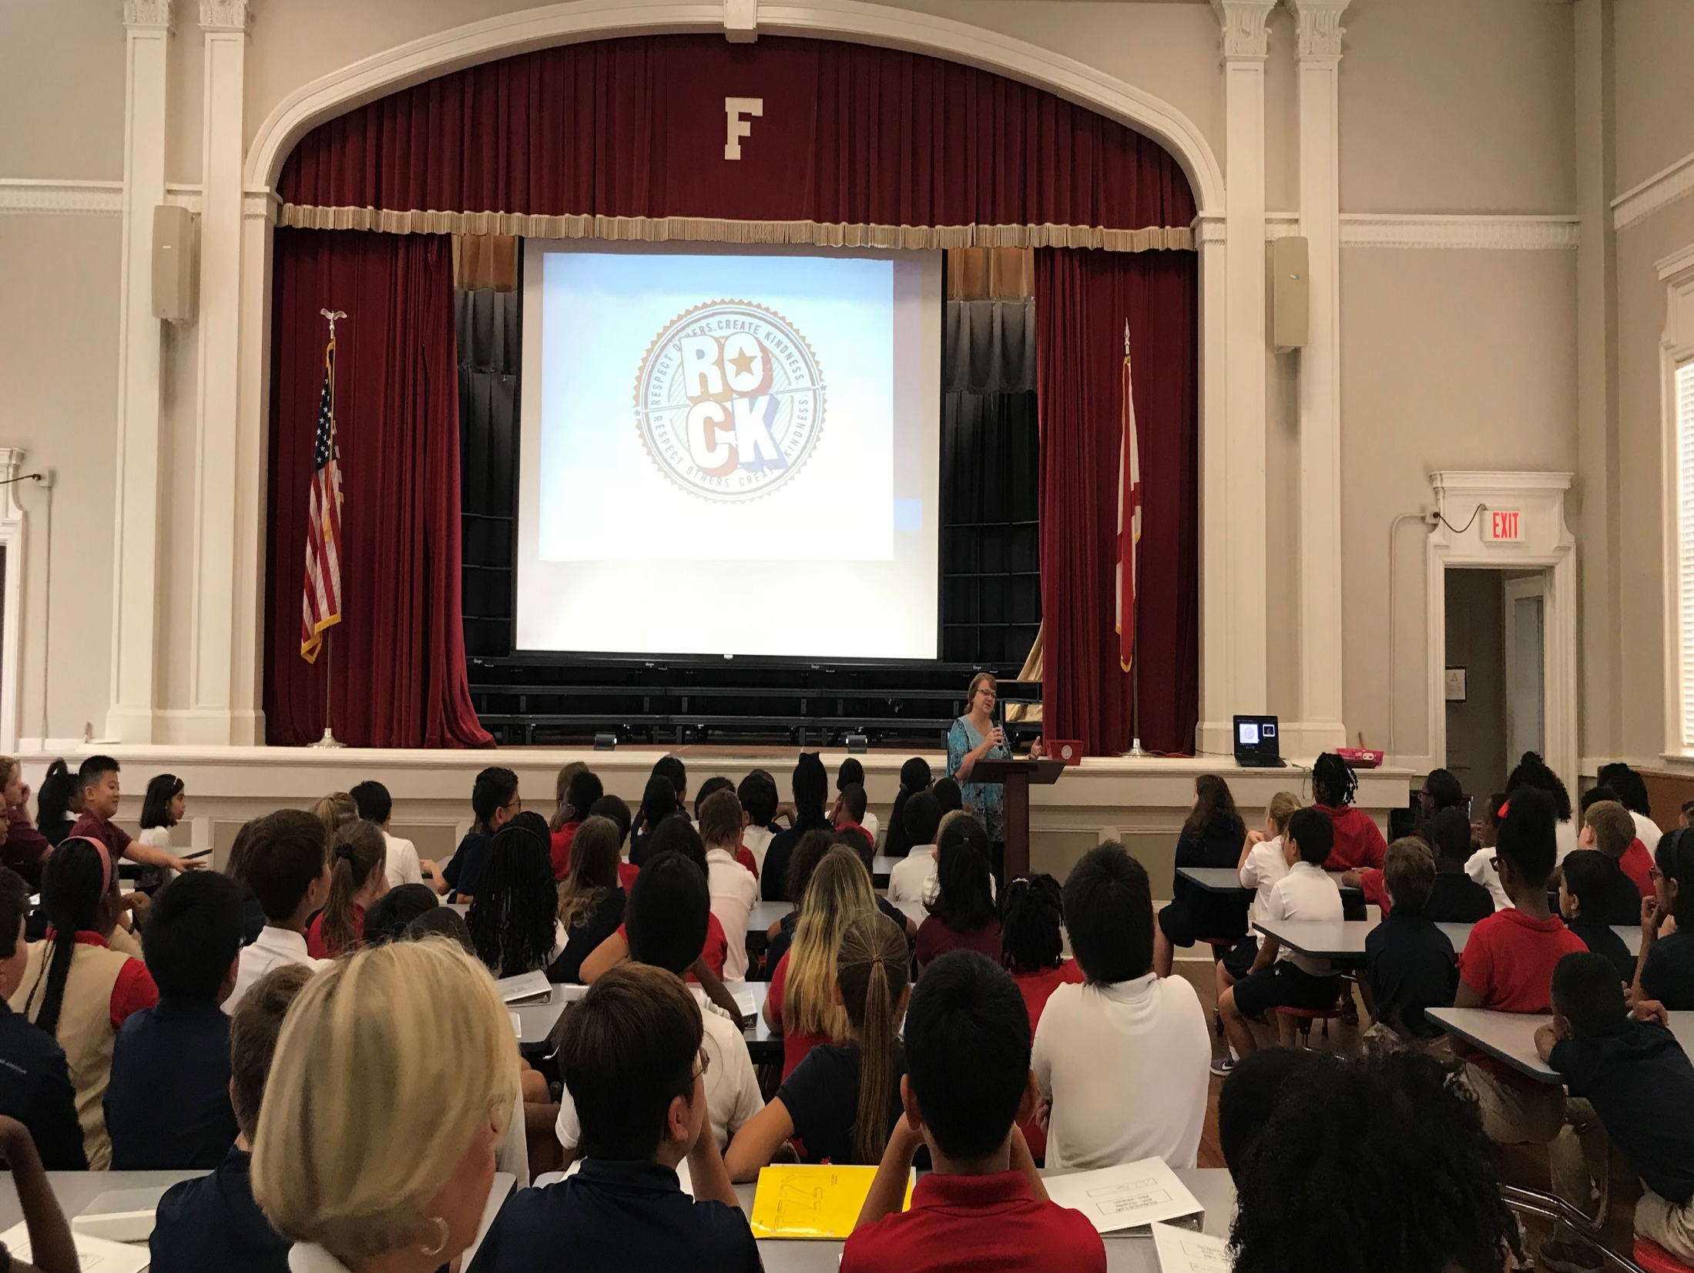

Slide 5
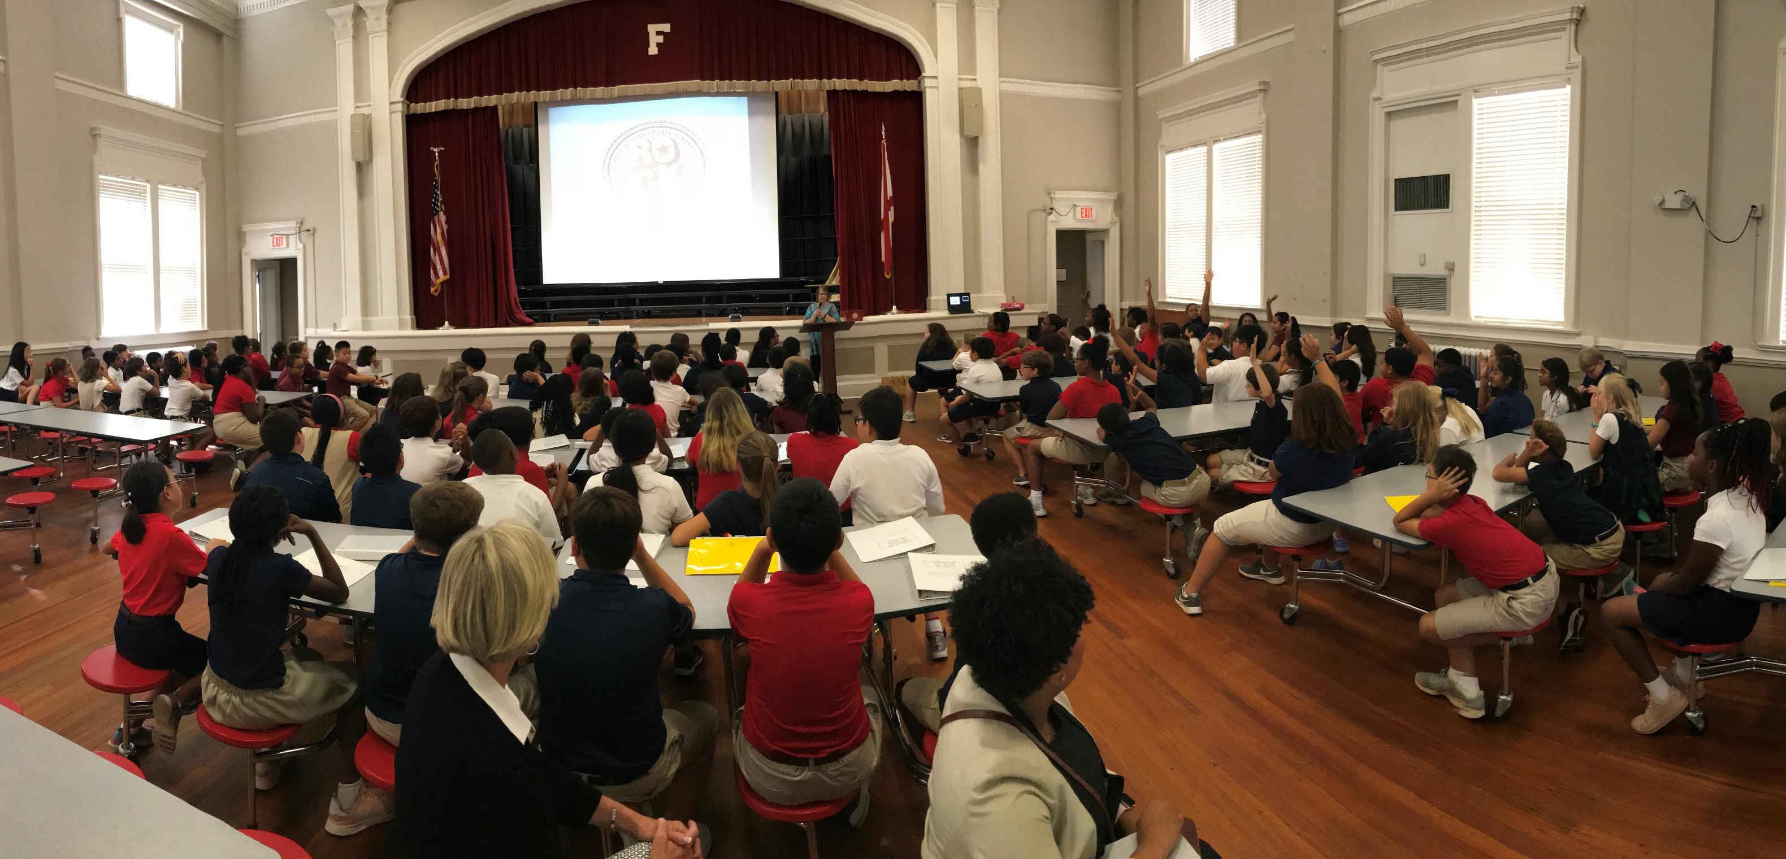

Slide 6
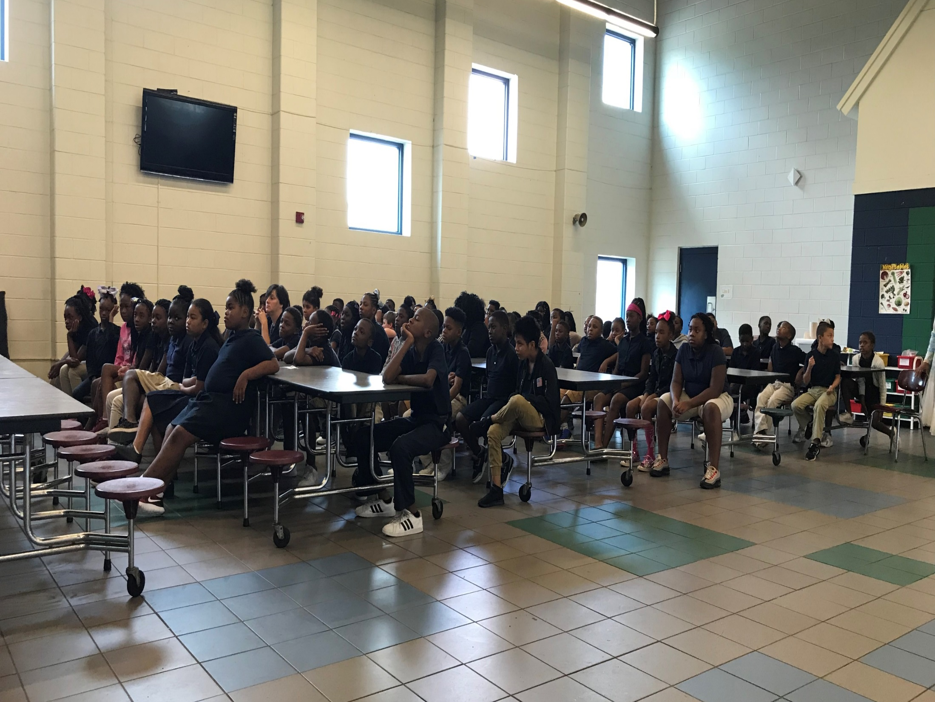

Slide 7
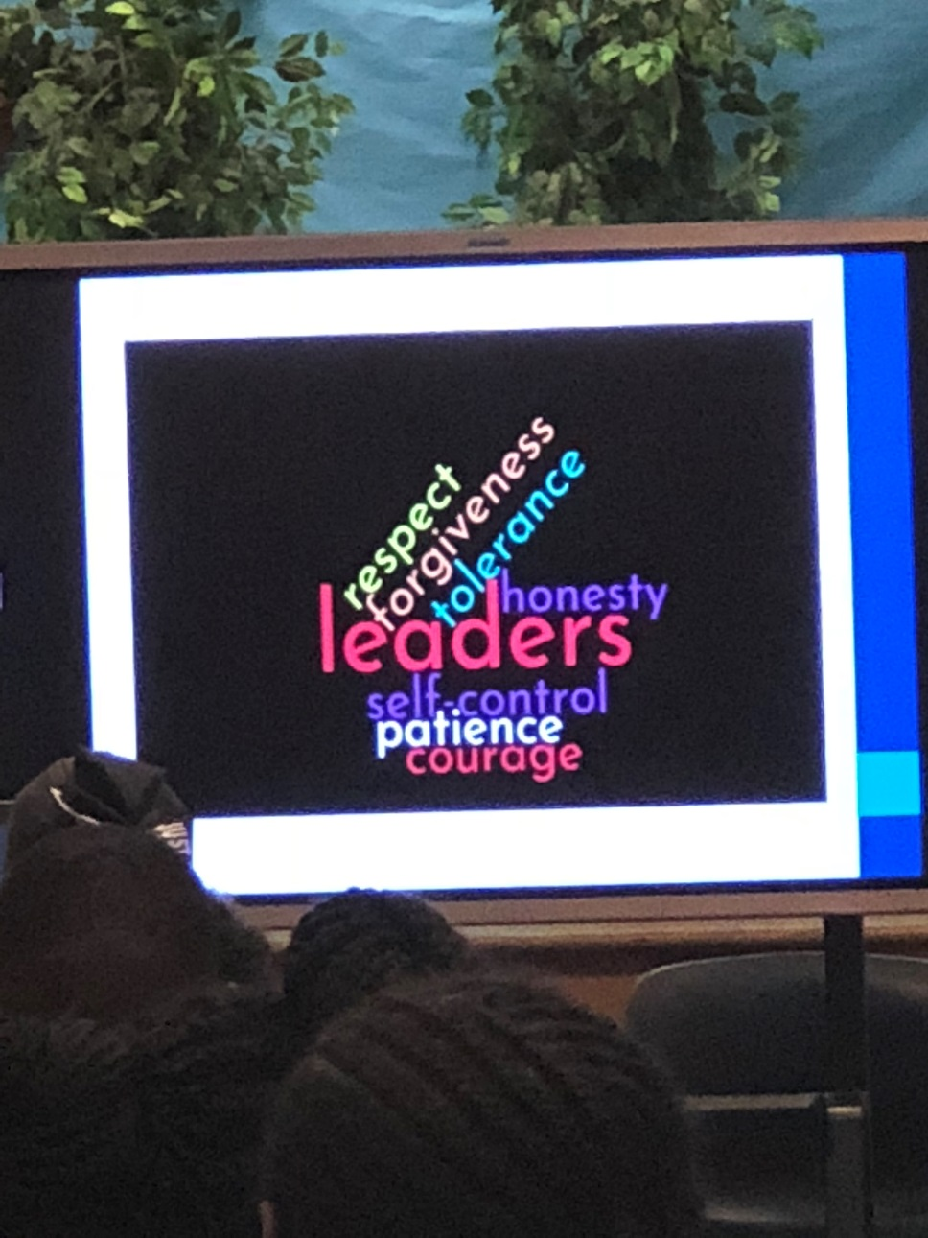
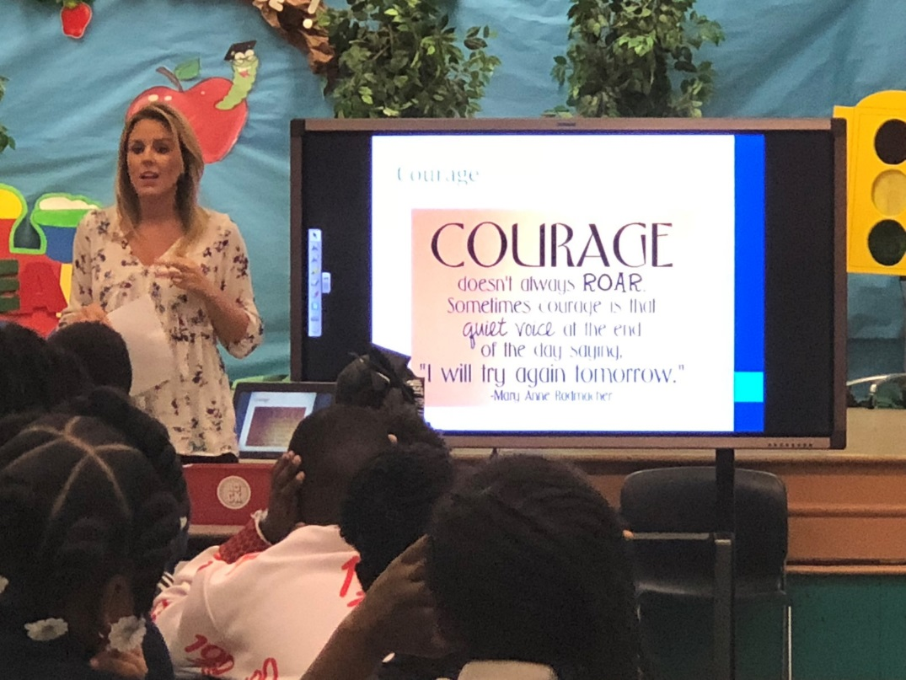

Slide 8
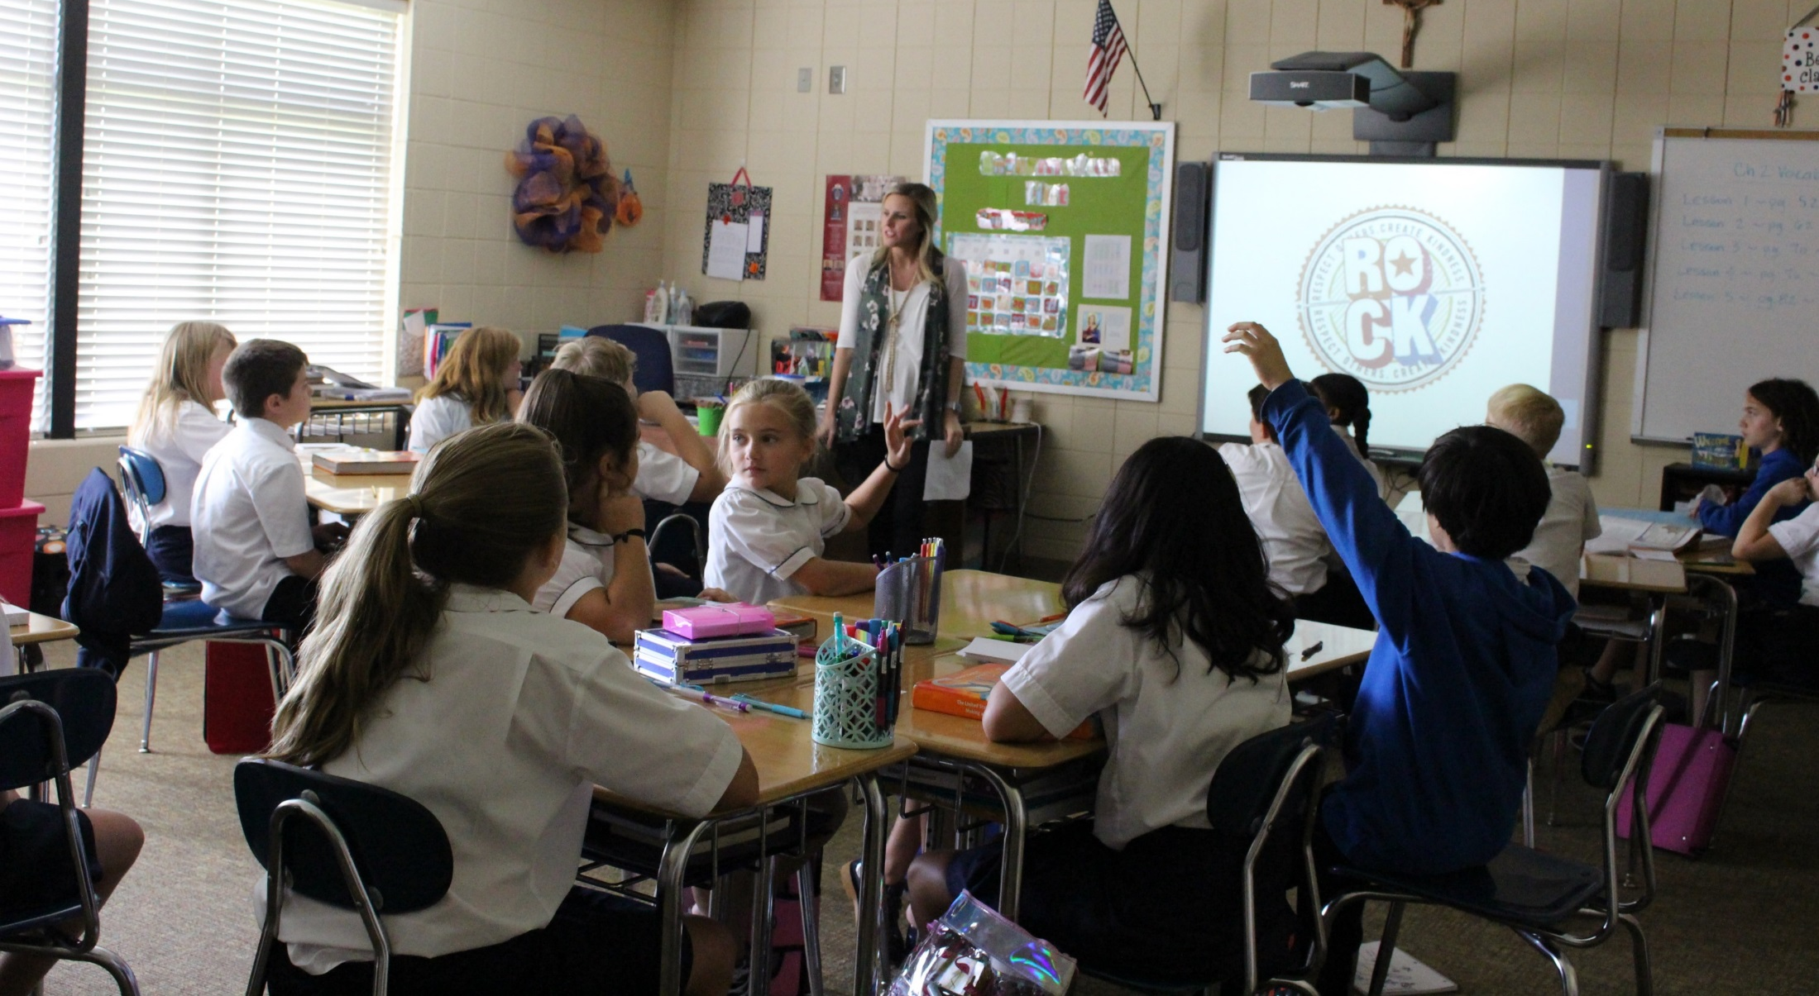

Slide 9
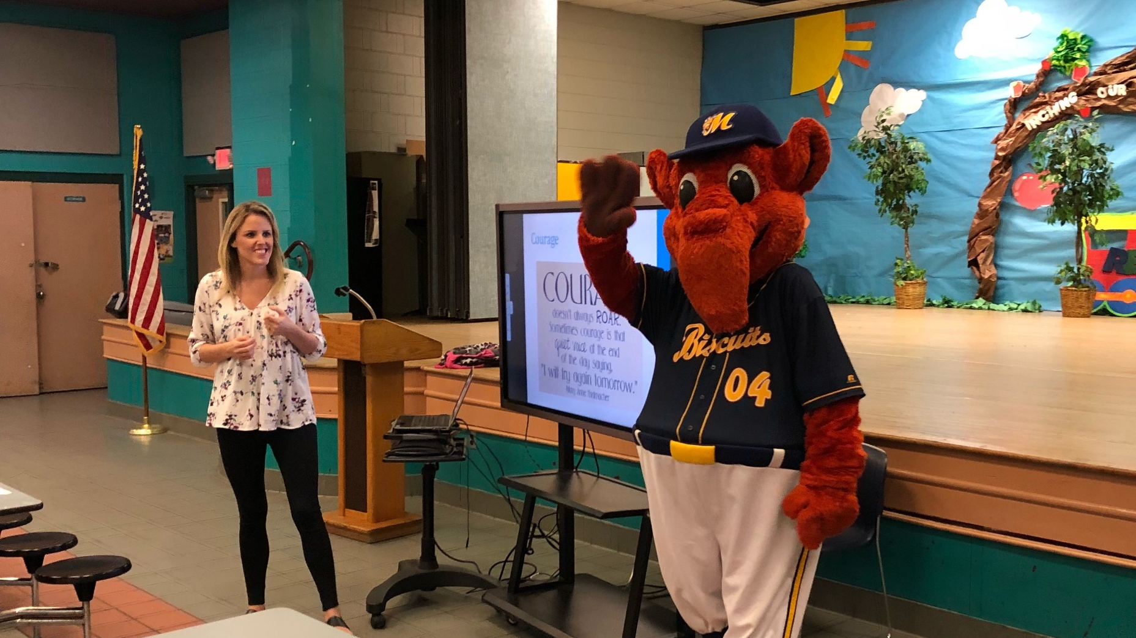

Slide 10
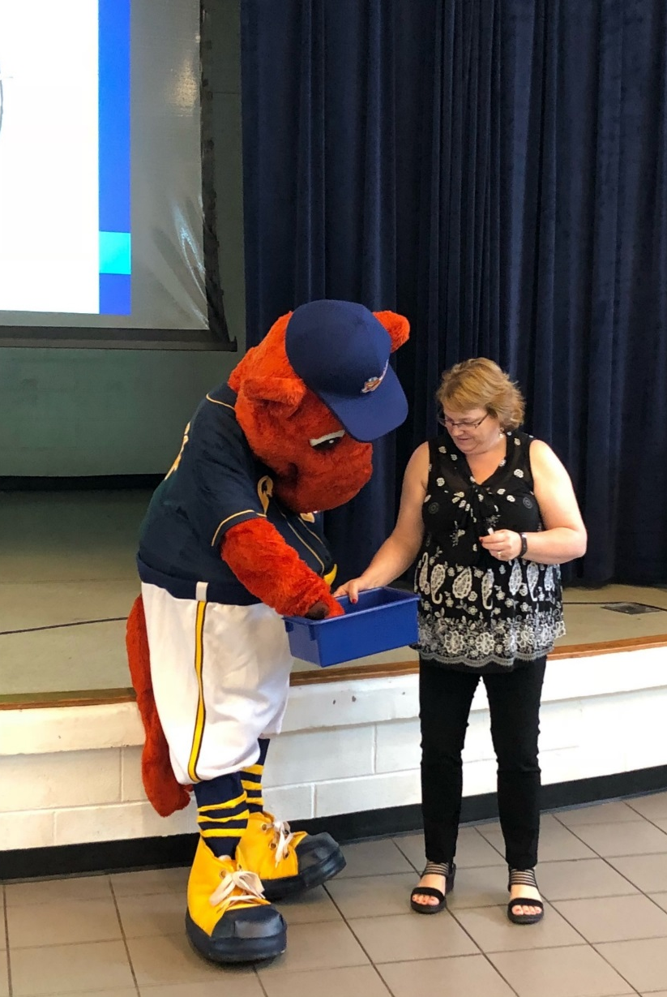
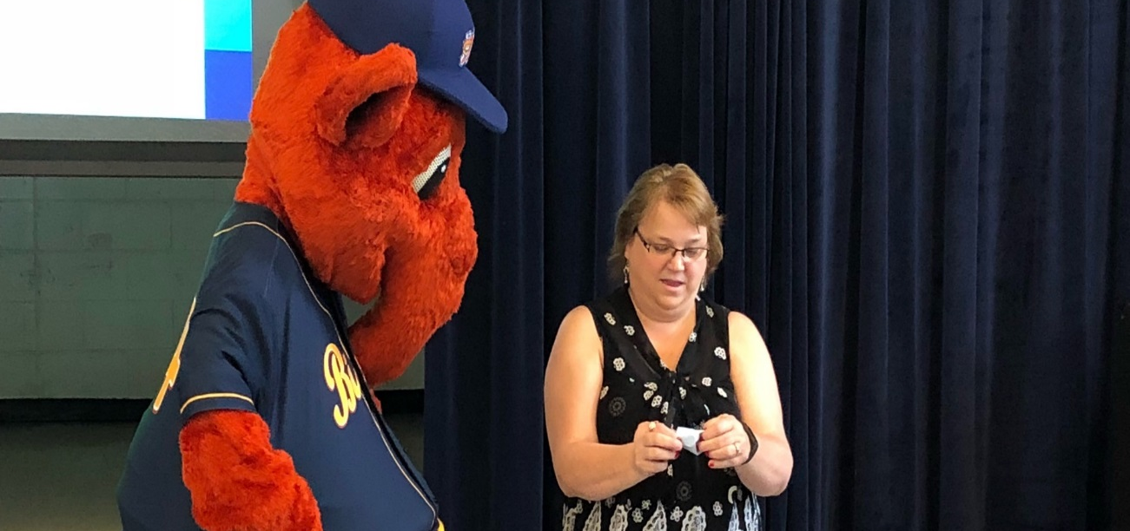
And the Winning Class is…

Slide 11
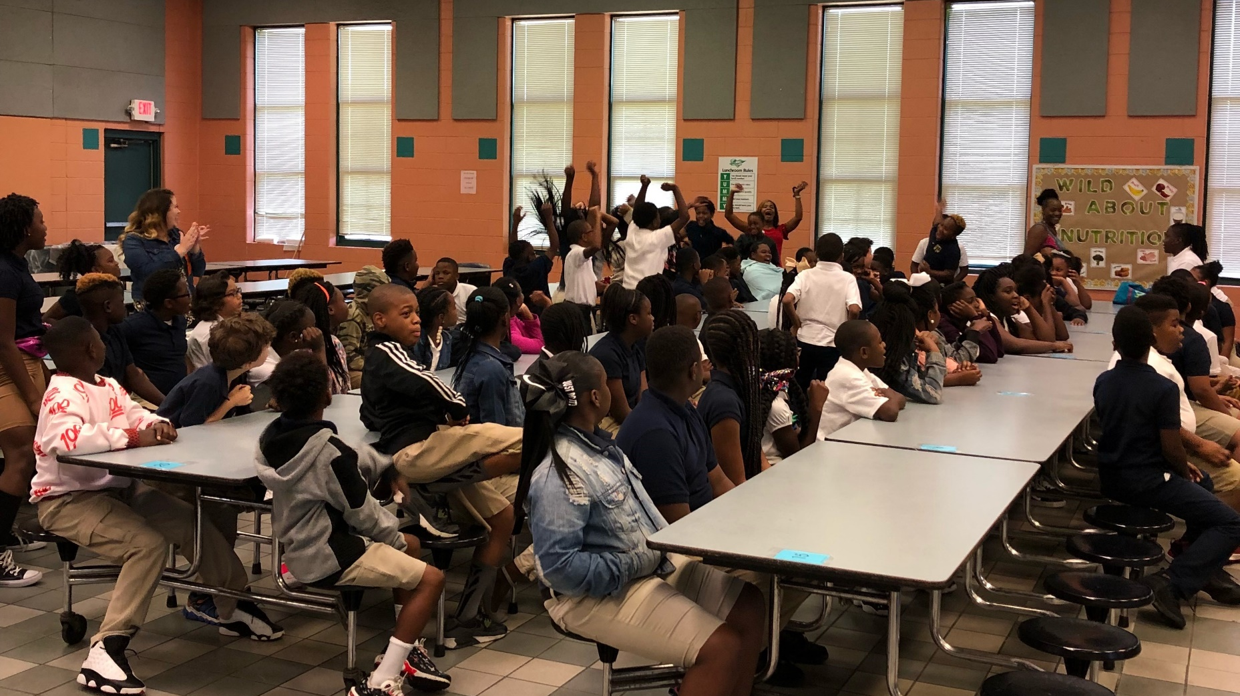

Slide 12
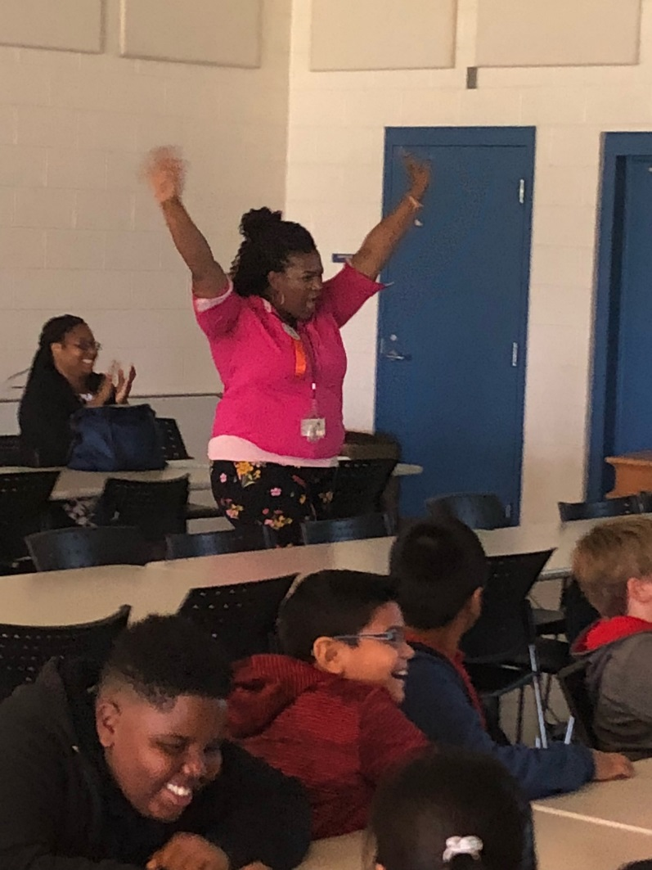
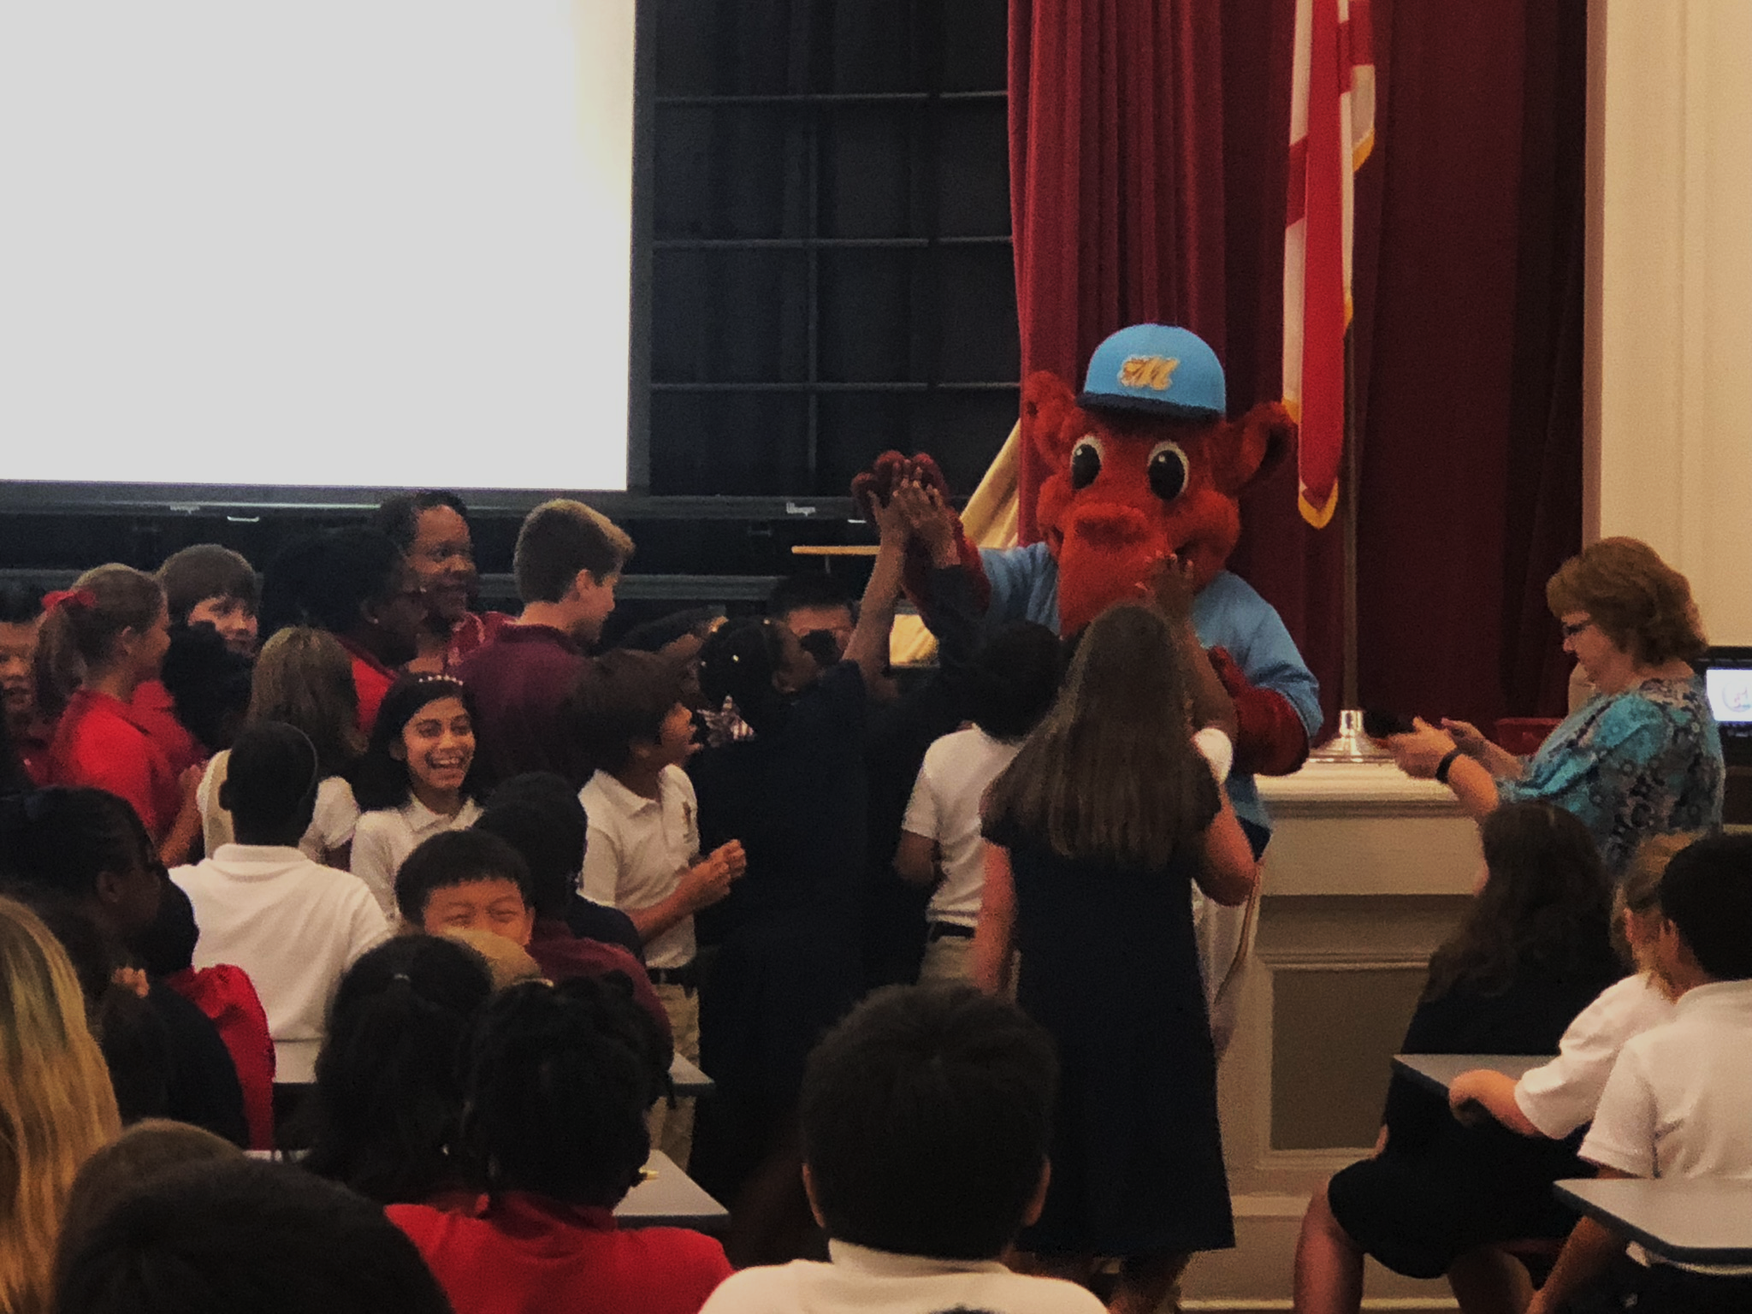

Slide 13
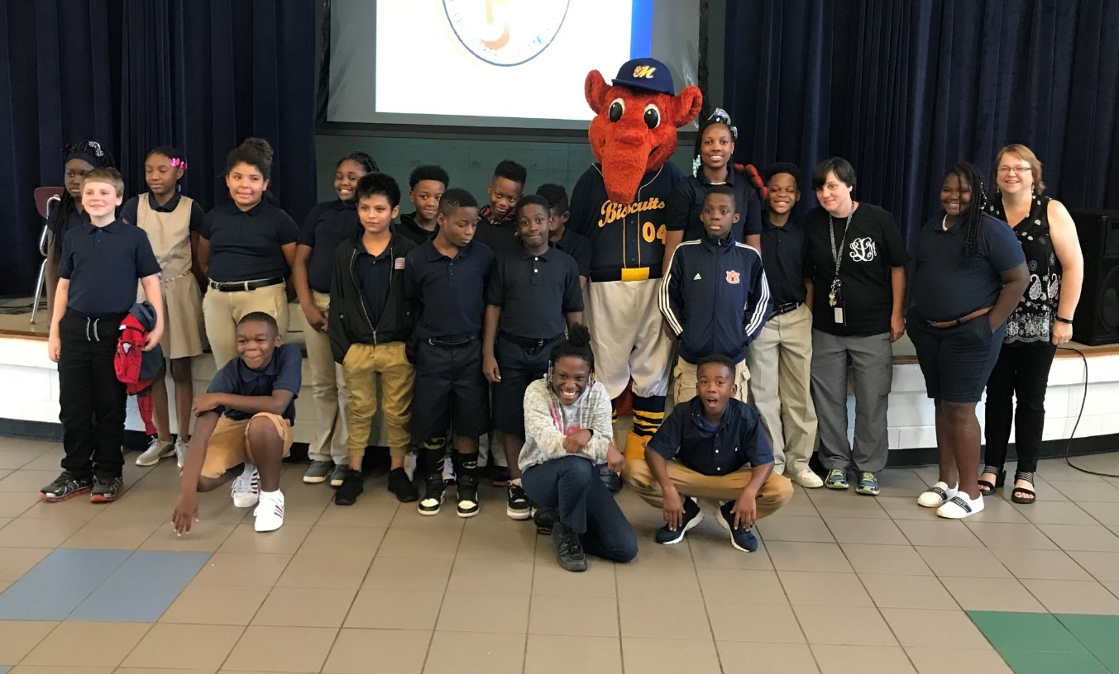
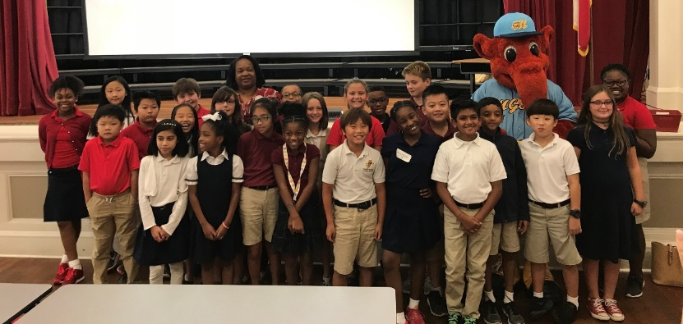
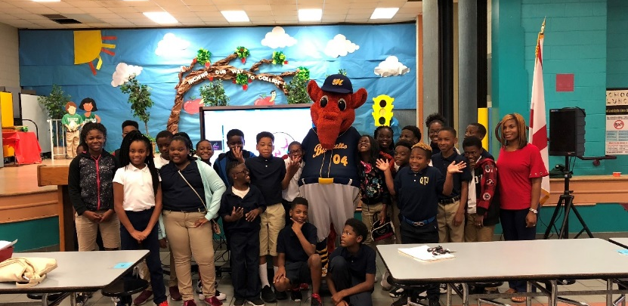
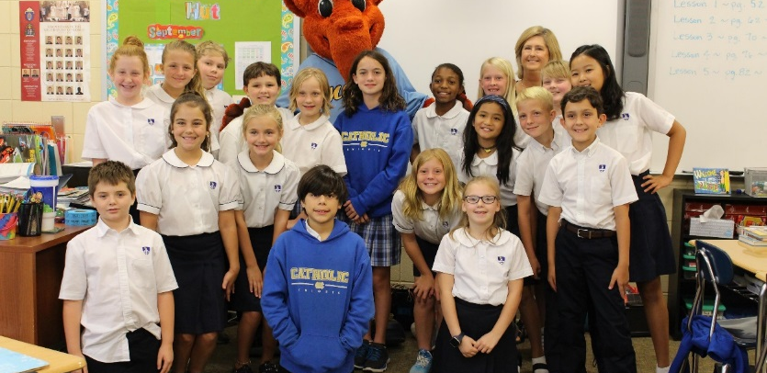
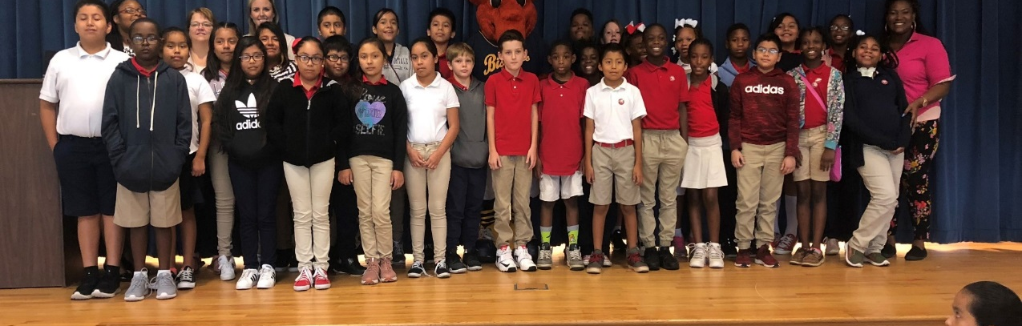

Slide 14
Field Day Prep

Slide 15
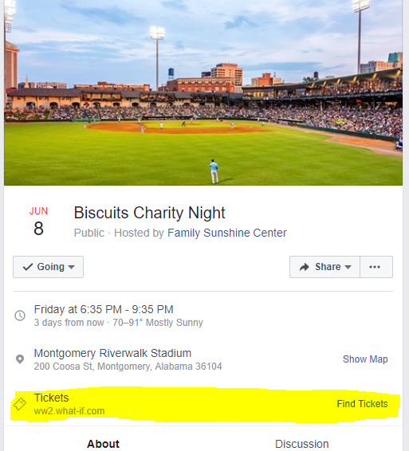
Biscuits Charity Night

Slide 16
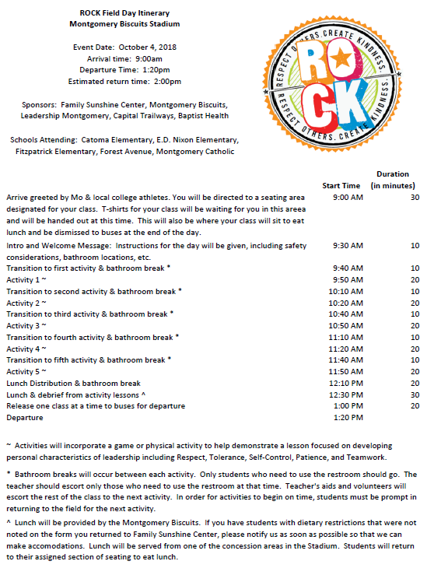

Slide 17
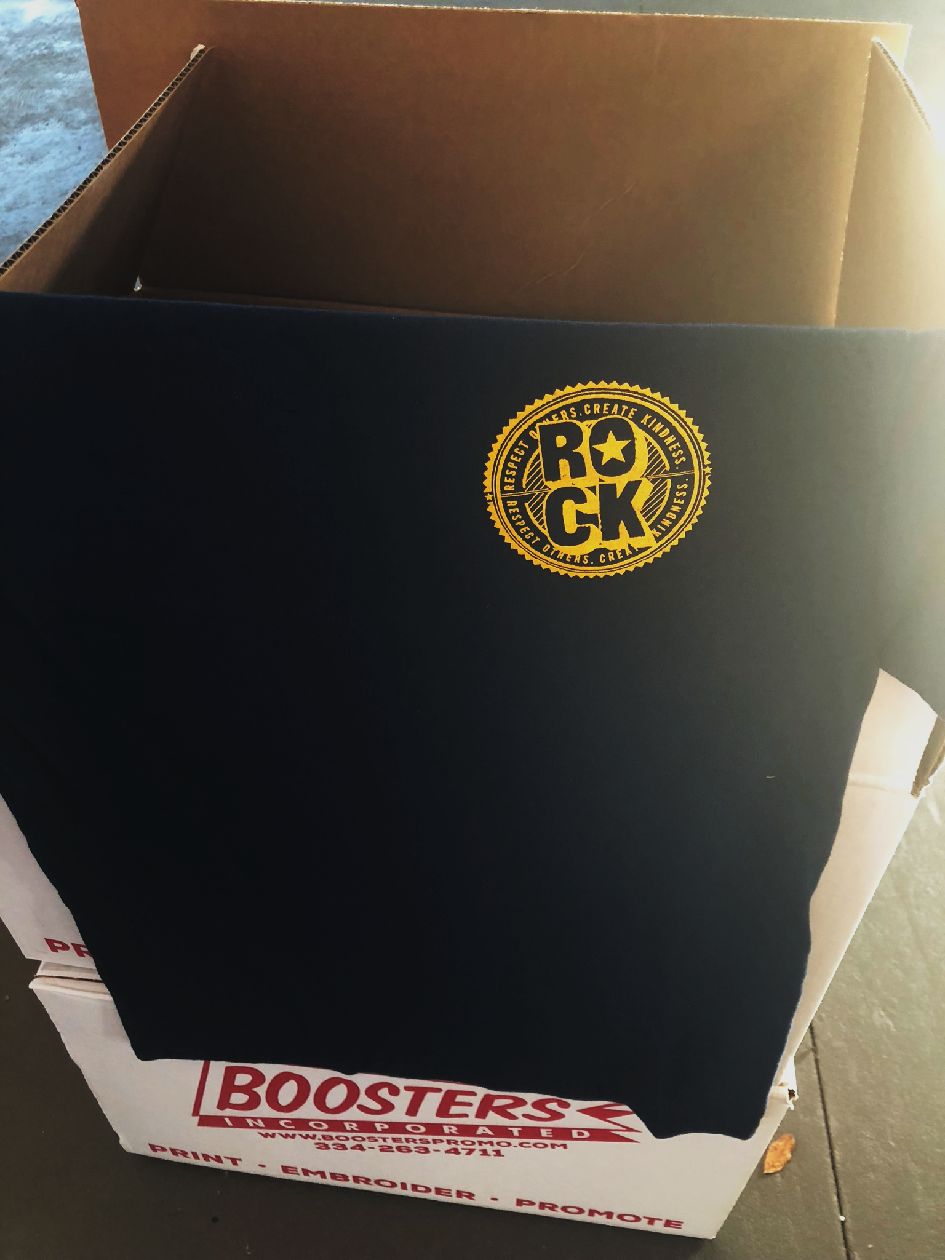
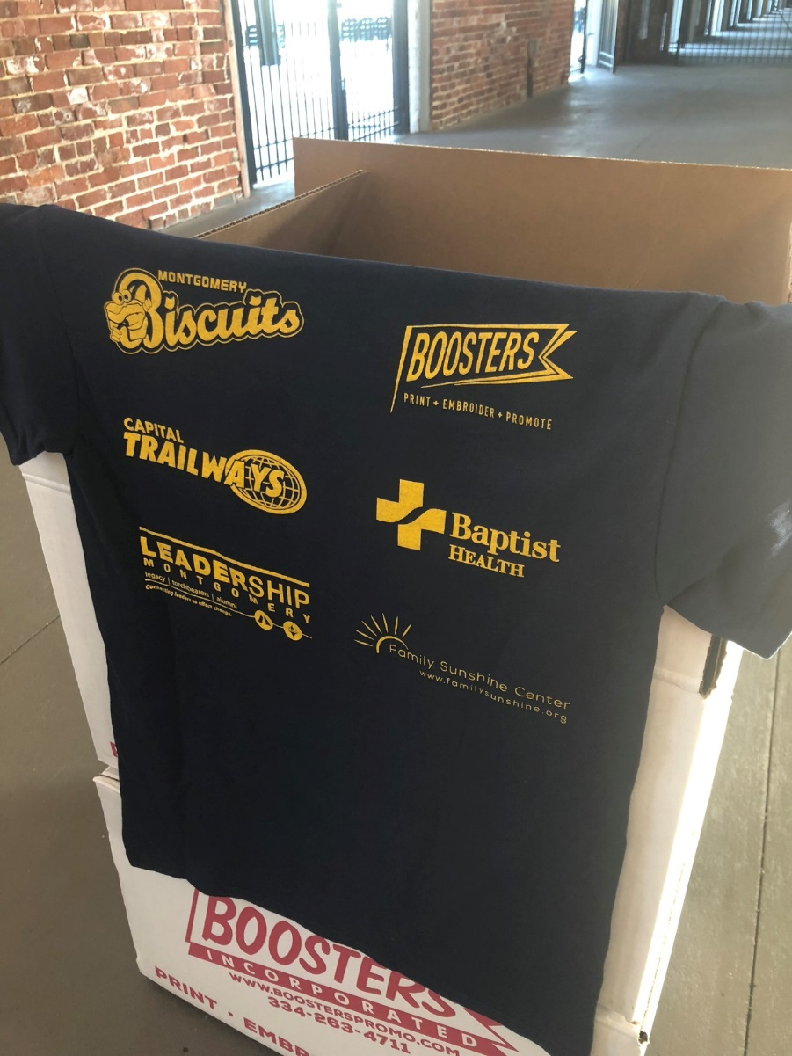
T-Shirts by Boosters, Courtesy of Baptist Health

Slide 18
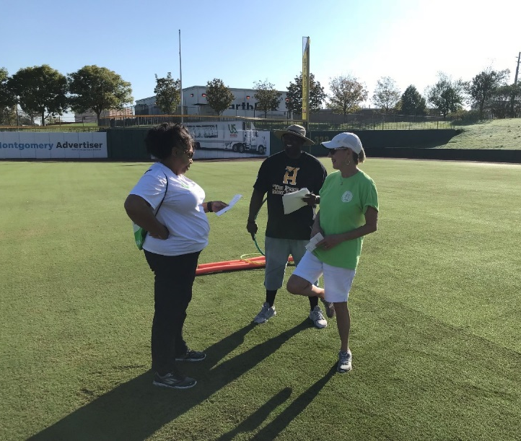
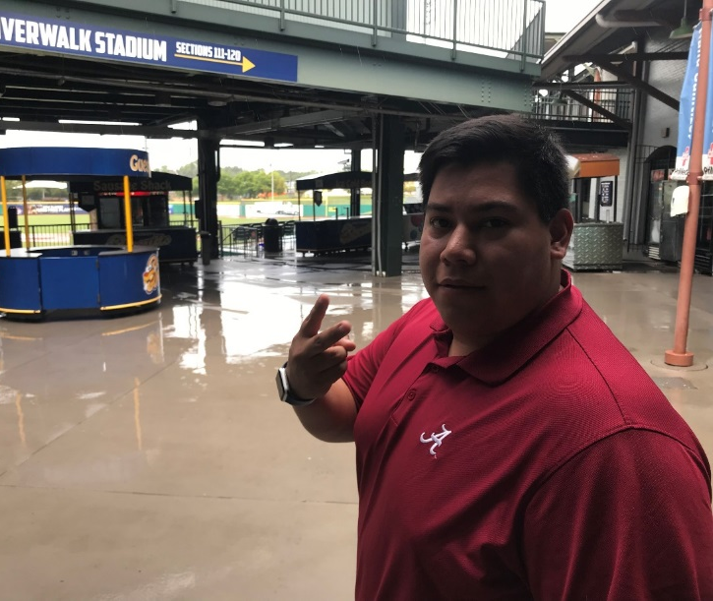
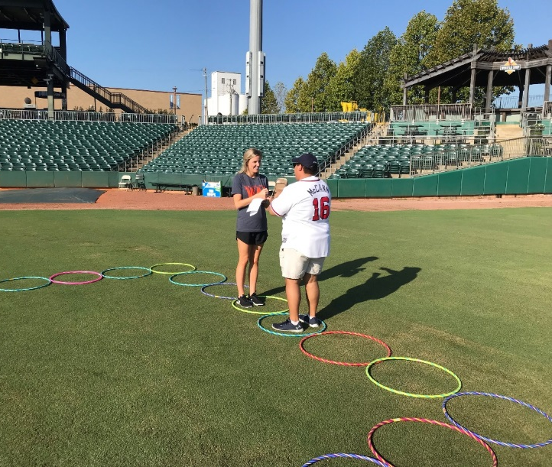
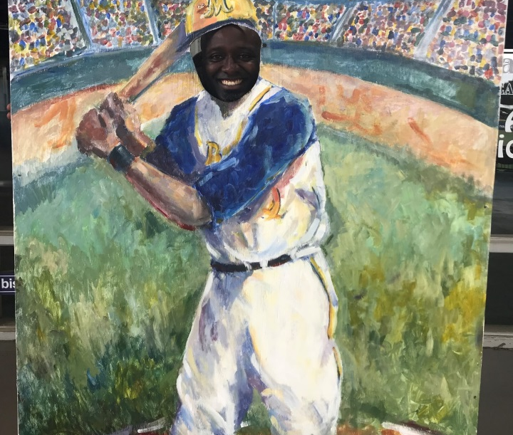
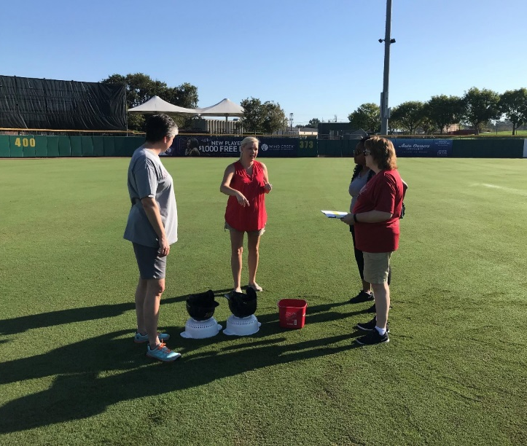
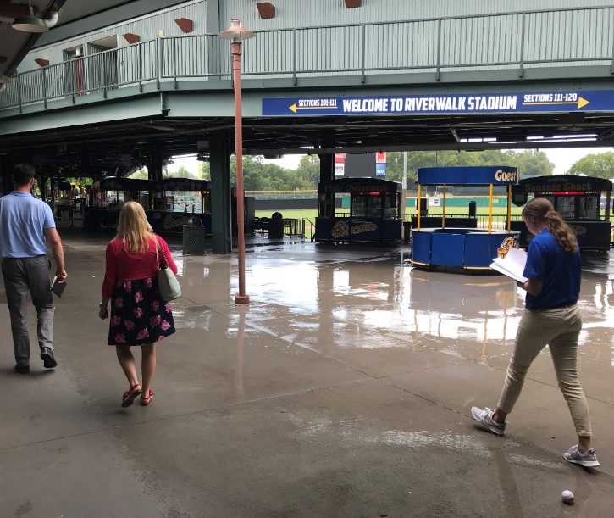

Slide 19
Field Day Visitors

Slide 20
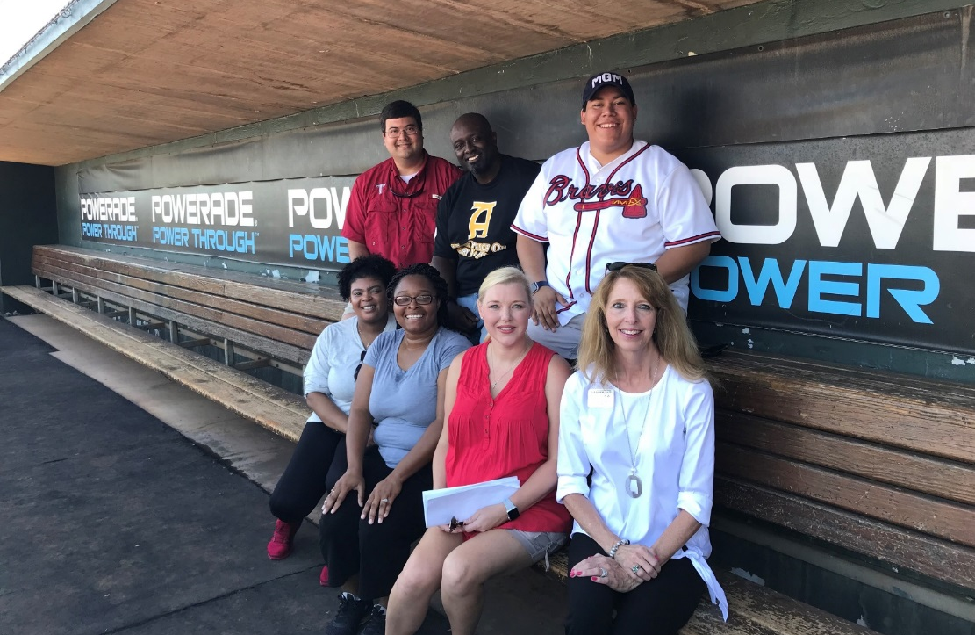
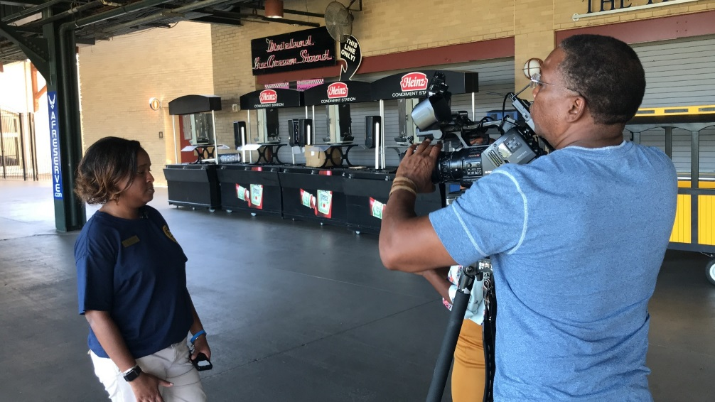
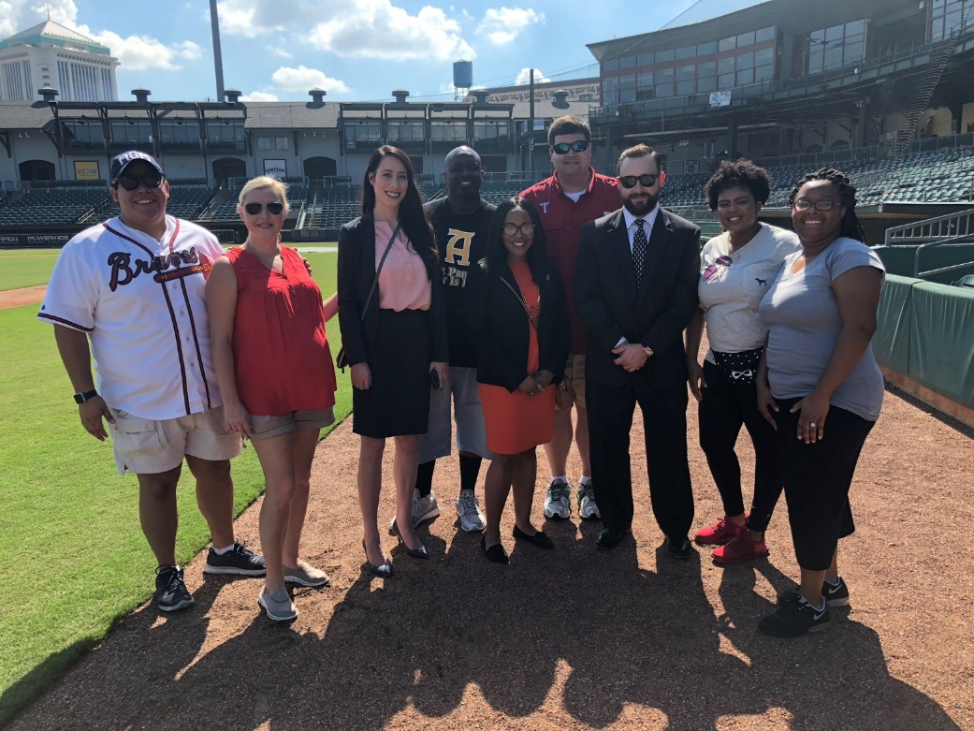
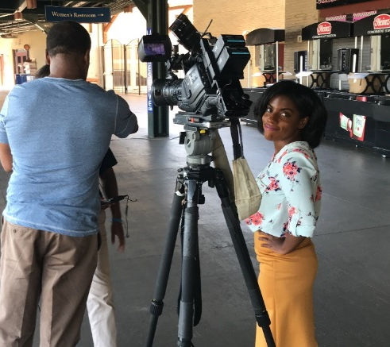
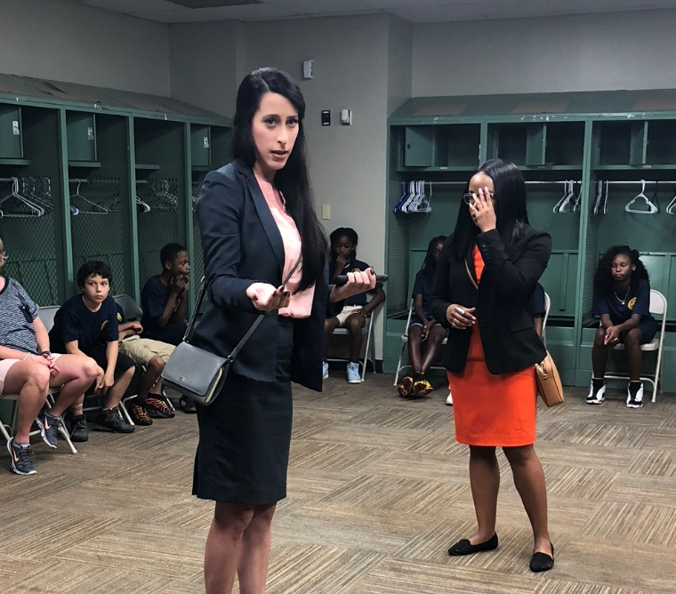
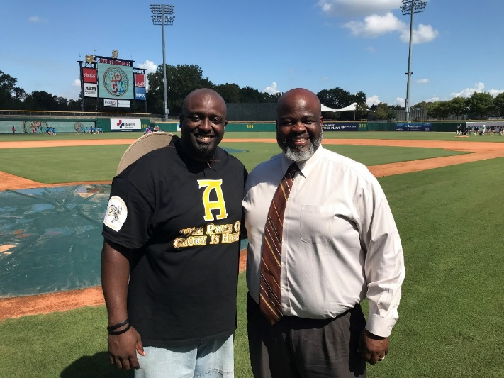

Slide 21
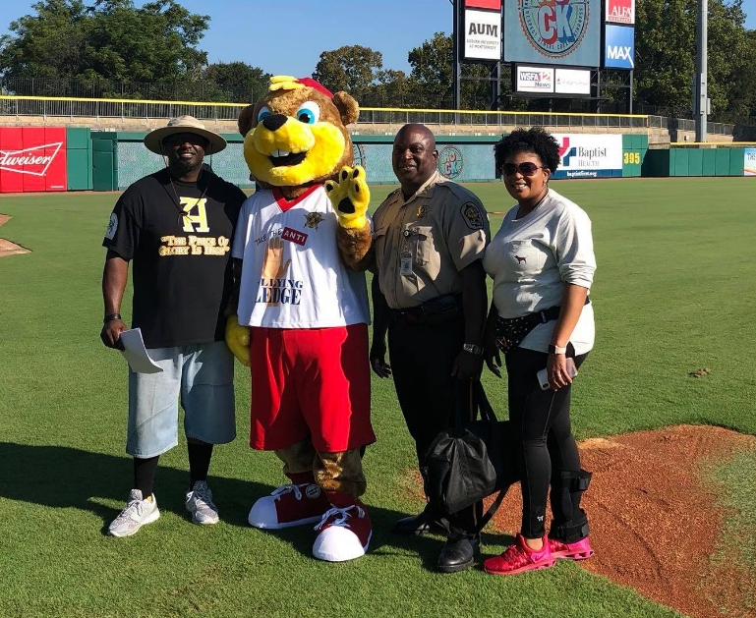
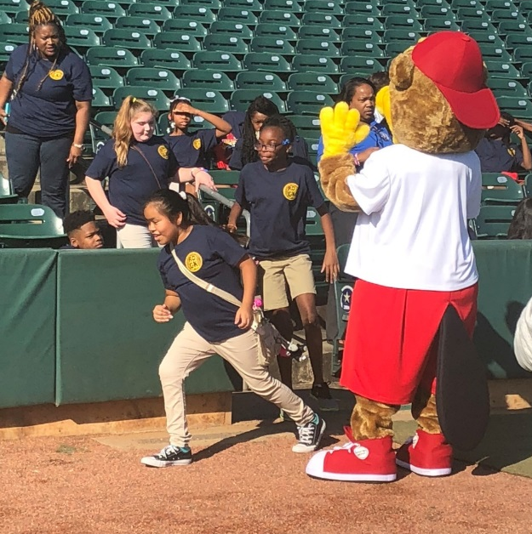
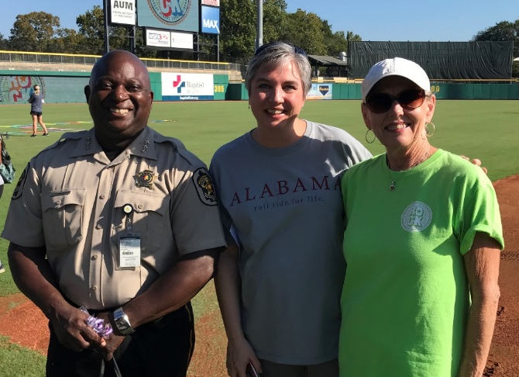
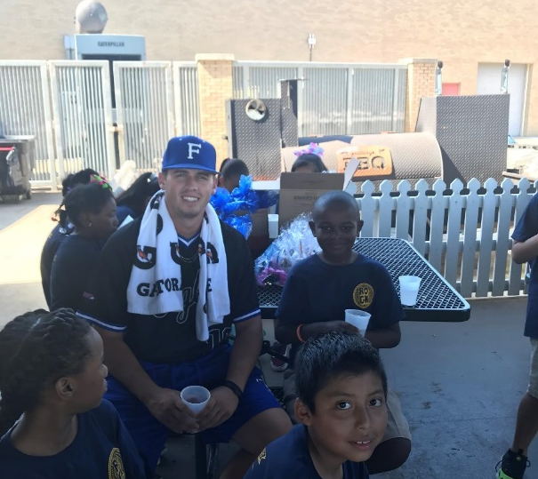
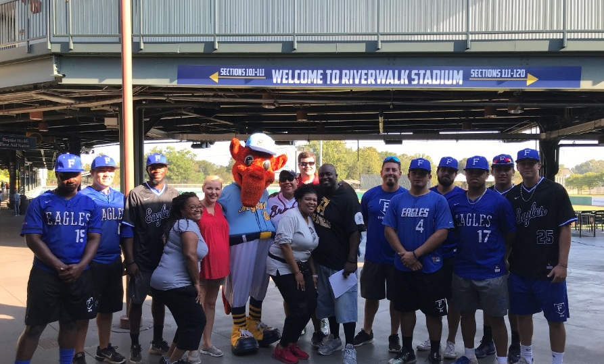
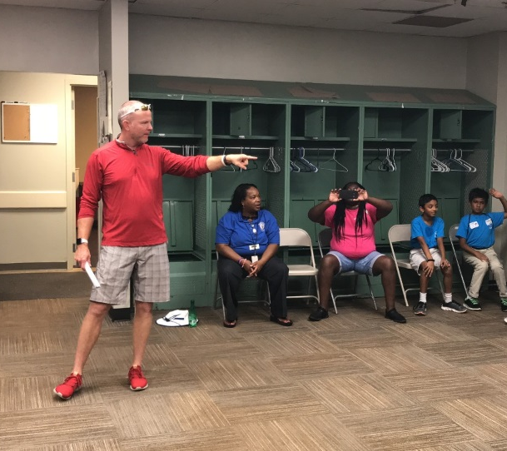

Slide 22
Field Day Activities

Slide 23
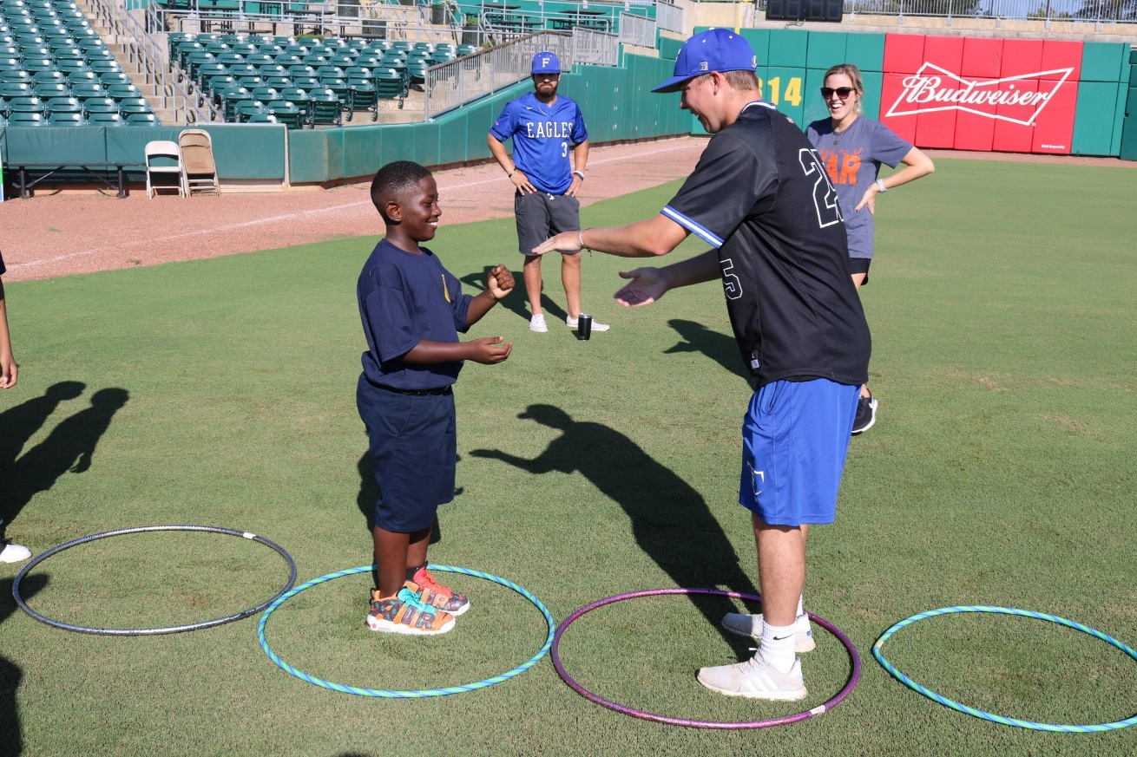
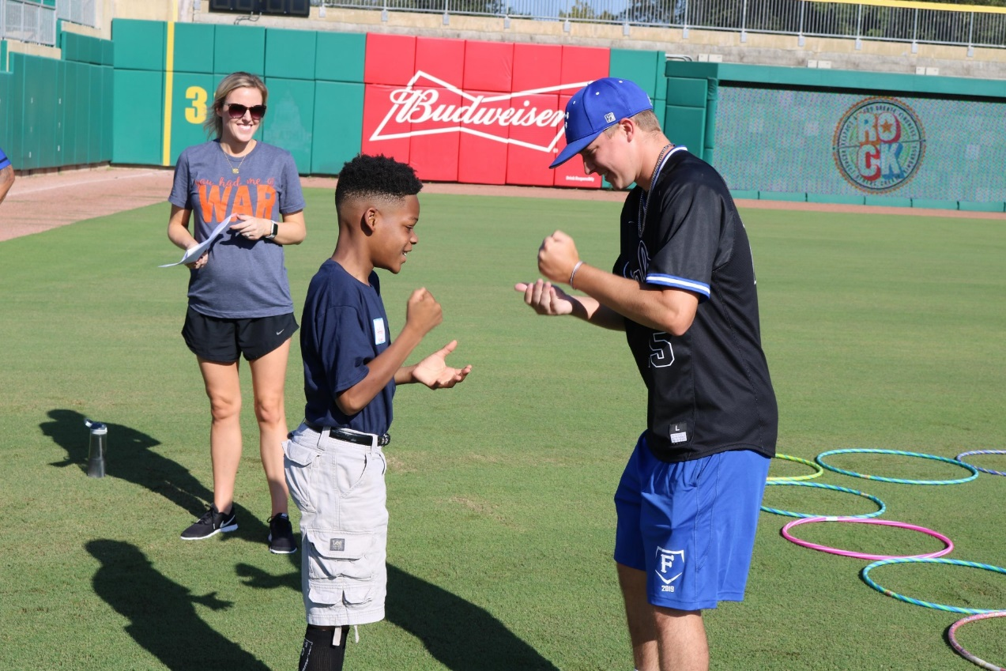
Activity: Hoop Hop Showdown
Lesson: Self - Control
Lesson Intro: It takes self-control to do what is right, even when we don’t feel like it.
It is tough to claim a victory in this game because as you get closer you need to get on a winning streak against multiple opponents!
Debrief: Was it hard for you to wait until the completion of a showdown to start hopping? Athletes make a lot of sacrifices in order to reach their goals. Can you think of ways athletes show self-control or self-discipline? Why is it important to do what is right, even when you don't feel like it? What could happen to someone who has very little self-control? What are some examples of times when we may need to use self-control... at school, at home, with our siblings, with our friends?

Slide 24
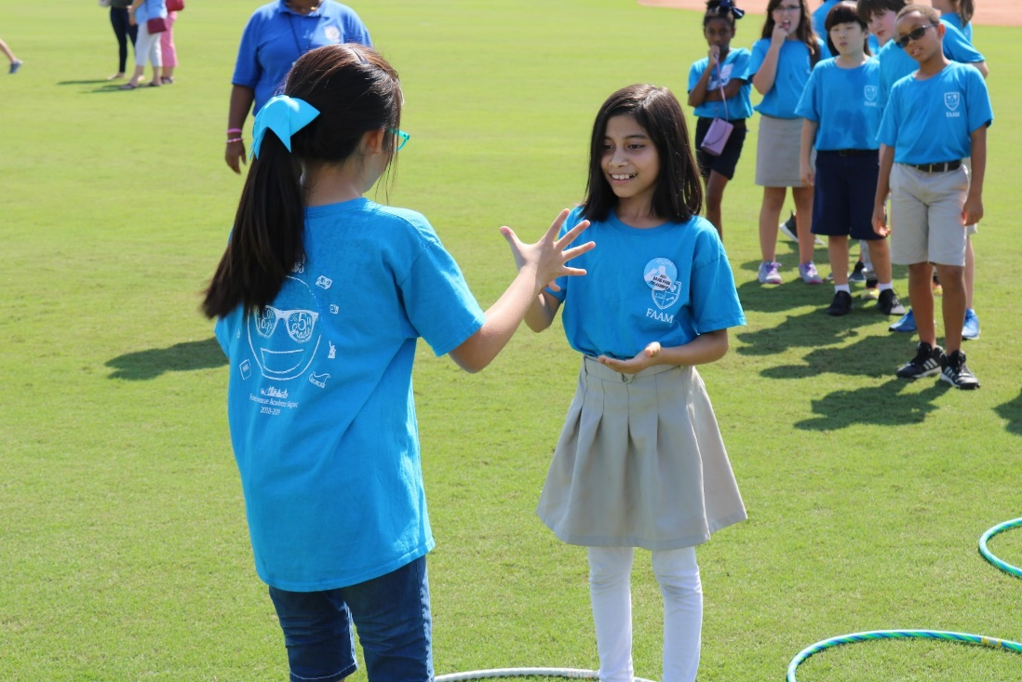
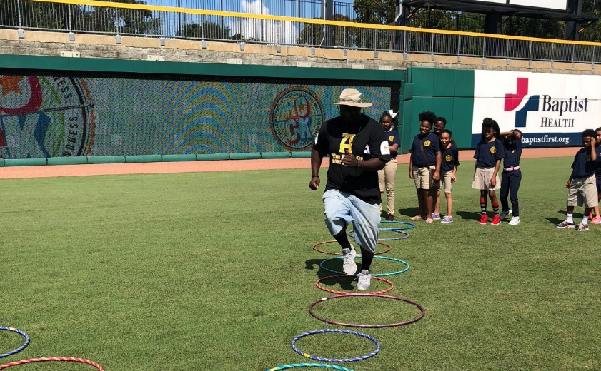
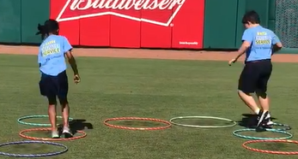
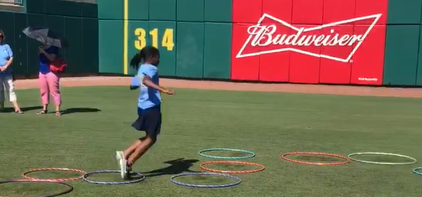

Slide 25
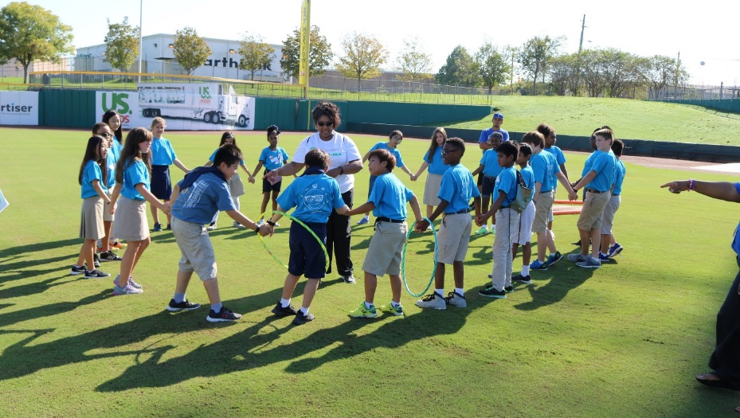
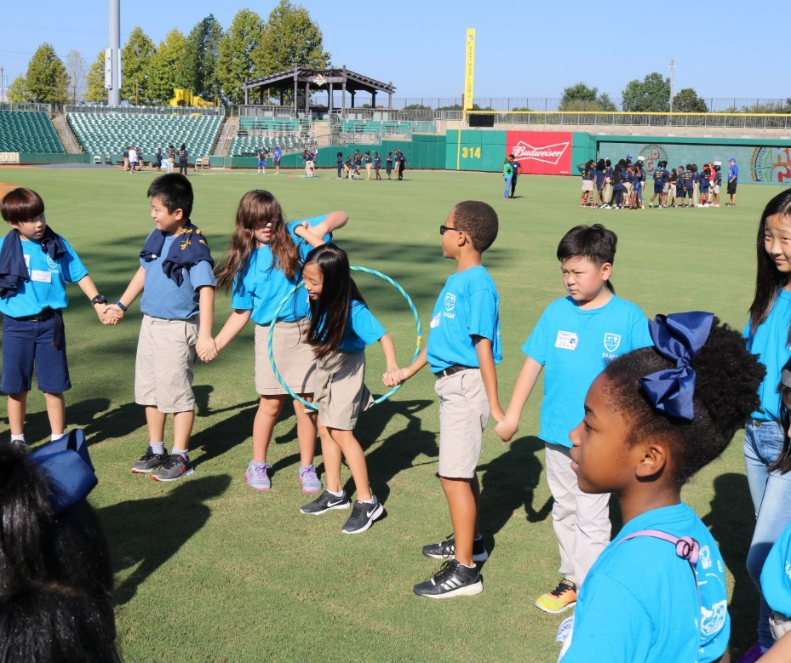
Activity: Hula Hoop Chain
Lesson: Respect
Lesson Intro: Respect means to treat others the way we want to be treated. How do we show respect for adults? How do we show respect for each other? Teamwork, encouragement, listening, helping others, being sensitive to someone else's feelings, following directions, etc.
Debrief: How did you see respect demonstrated by others during this activity? How did you demonstrate respect to your teammates?

Slide 26
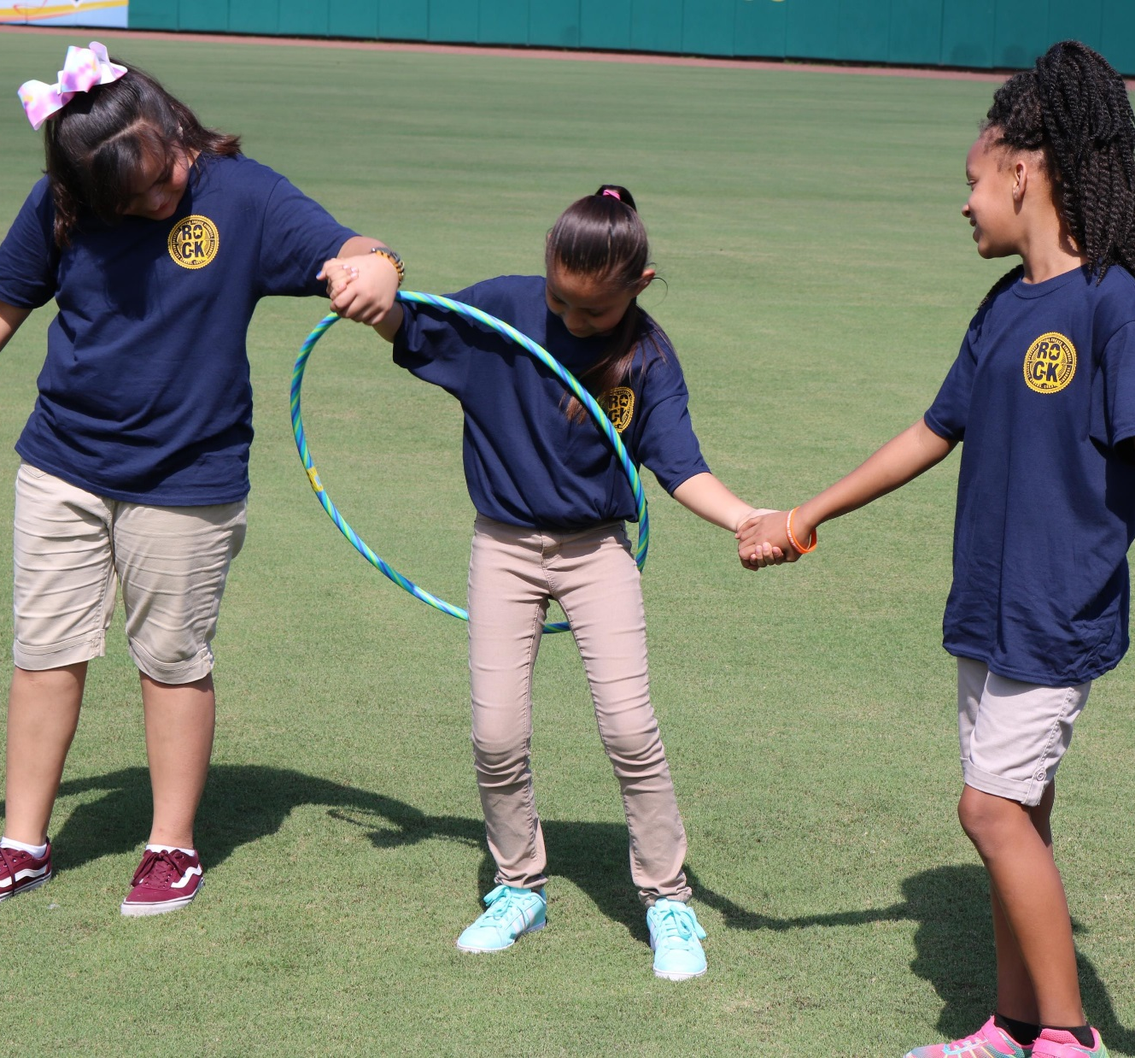
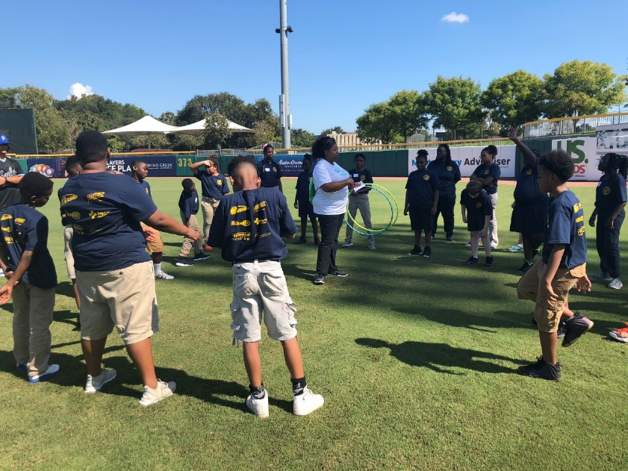
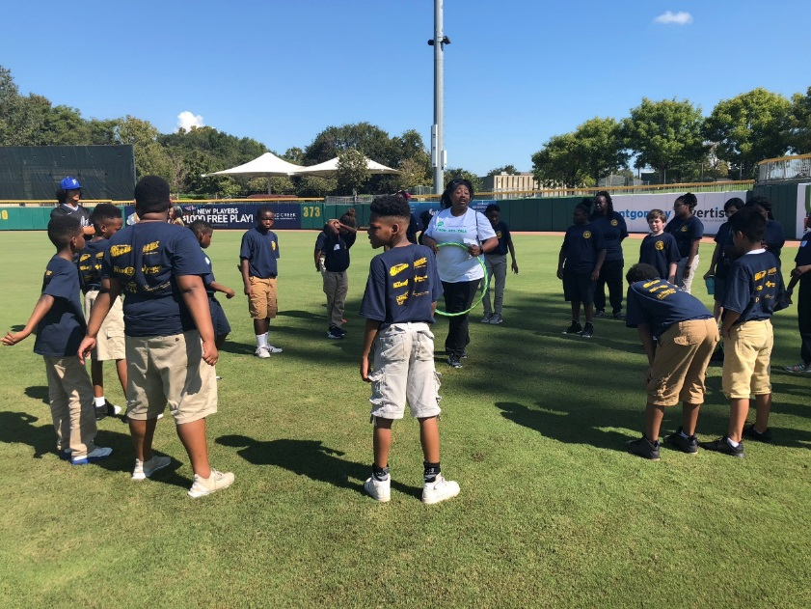

Slide 27


Activity: DugOut Divide
Lesson: Tolerance
Lesson Intro: Tolerance is “showing respect for others who are different than me.” The opposite of tolerance is prejudice, basing our feeling about someone based on the way they look, dress, or where they are from. Tolerance is important. Sometimes we may need to look past someone’s character flaws or bear with those who irritate you. But we must also be respectful of those who are different from us. Tolerance isn’t always easy. Sometime it means being kind to someone who is really irritating. But it is important that we treat everyone with respect. Look for ways to connect with others. We can always find something we have in common with others.
Debrief: Did you have a hard time deciding between any of the choices? Were you surprised by other people's choices? Do you have some things in common with some classmates that you didn't realize?

Slide 28


Do you prefer…?

Slide 29

Activity: Helmet Toss
Lesson: Patience
Lesson Intro: We live in an age of instant everything. We want what we want and we want it now! We have instant coffee, high-speed internet, microwave ovens, fast cars, self-serve checkouts, and fast-food. We may have instant this and quick that, but what we don’t have is patience. Patience means waiting without getting upset, continuing to work at something without giving up. We are going to play a game that requires patience. You may get frustrated, you may begin to think you can’t do it, but I don’t want you to give up.
Debrief: Did it take patience to catch the bean bag in the helmet? What motivated you to keep going when you were frustrated and tempted to give up? What does patience look like… in the classroom…on the playground…in the cafeteria…at home? Patience is waiting without getting upset or giving up, even when it is hard.

Slide 30




Slide 31



Locker Room Tour and Motivational Discussion with Coach McCarthy, Faulkner Head Baseball Coach
T.E.A.M. = Together Everyone Accomplishes More

