Slide 1
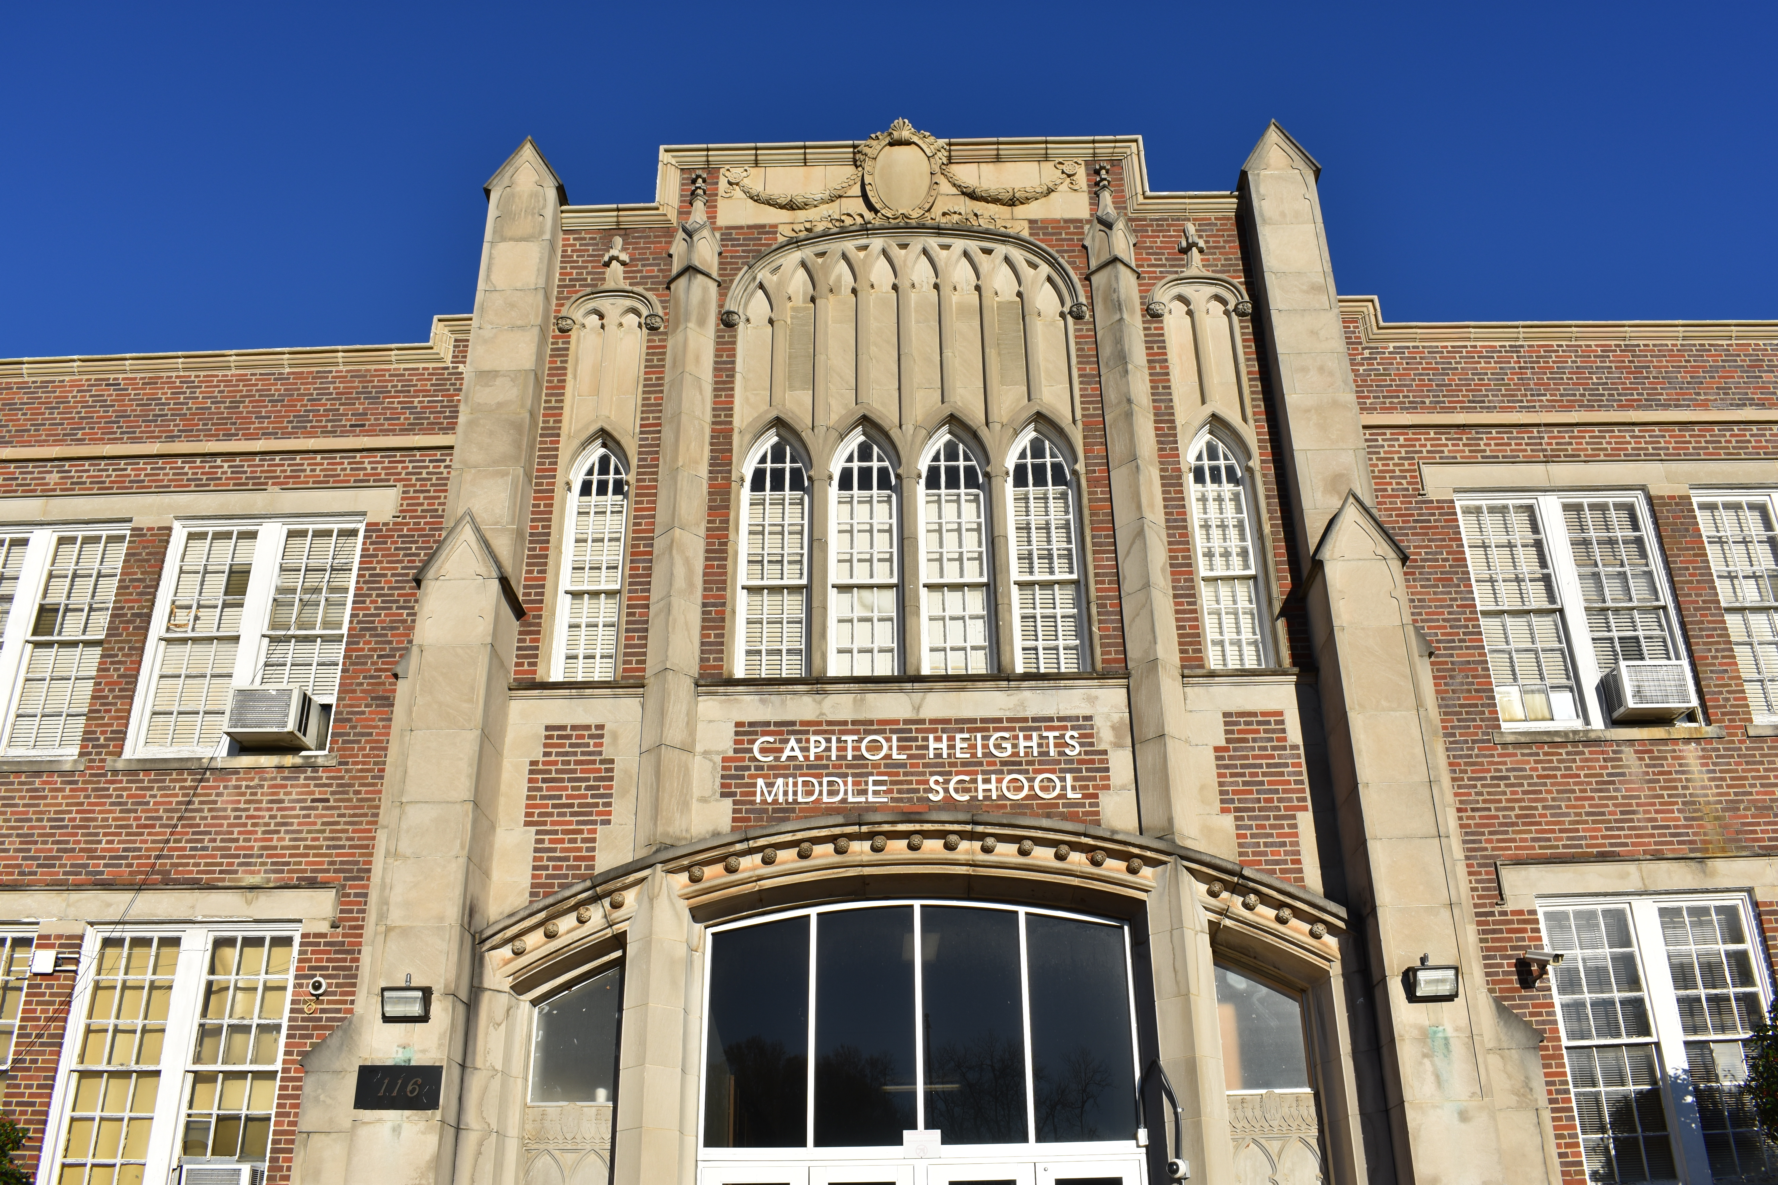
Project 6: Capital Heights Middle School
Mona Hurston, Dick Meinert, Brian Miller,
Carol Potok, Greg Sellers, and Shanta Varma

Slide 2
The Why
The ask: An up-date for the teacher workroom
Meeting with Camille Anderson-Finley (project contact), Cheryl Fountain (principal), and the CHMS teachers
Priority Shift
Research
Notes:
Mona – 2 mins
I will talk about what they asked for in the room
I will briefly talk about the shift in our priorities once we saw the room
I will mention the research connecting the condition of the learning environment with student achievement and teacher output

Slide 3
What We Found
Moldy carpet and torn linoleum
Worn and broken furniture
Extensive damage to the walls with peeling paint and crumbling concrete
Wood rot in the window frames and missing panes of glass
Missing flooring in men’s room (once linoleum was removed)
Notes:
Dick - 3 mins

Slide 4
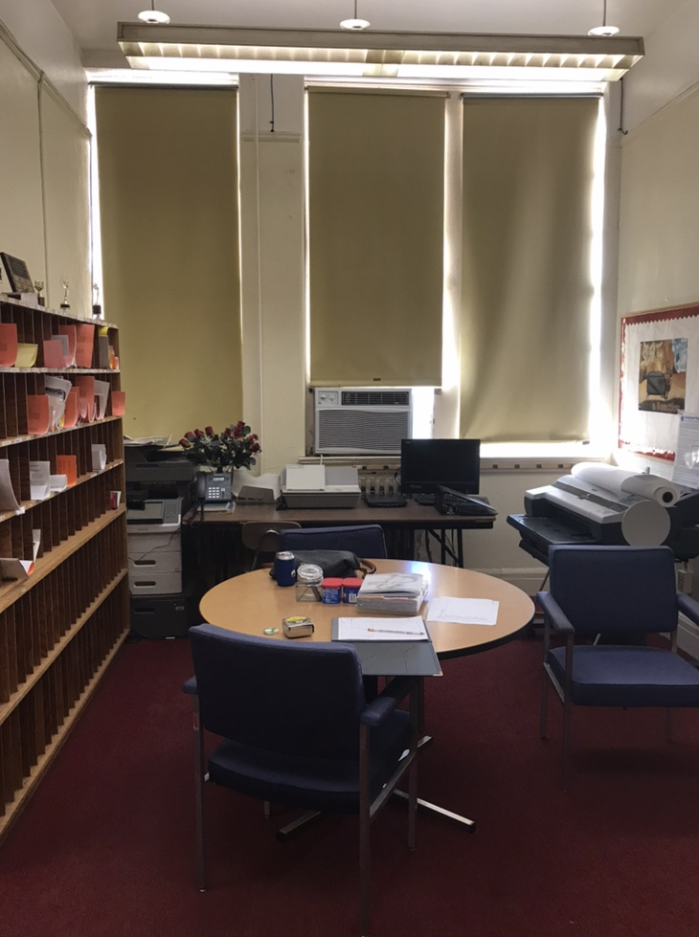
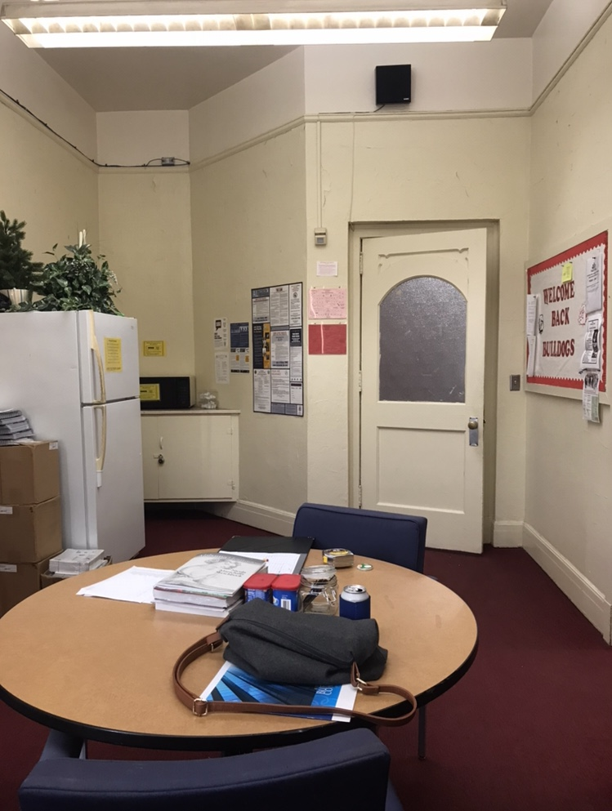
What We Found

Slide 5
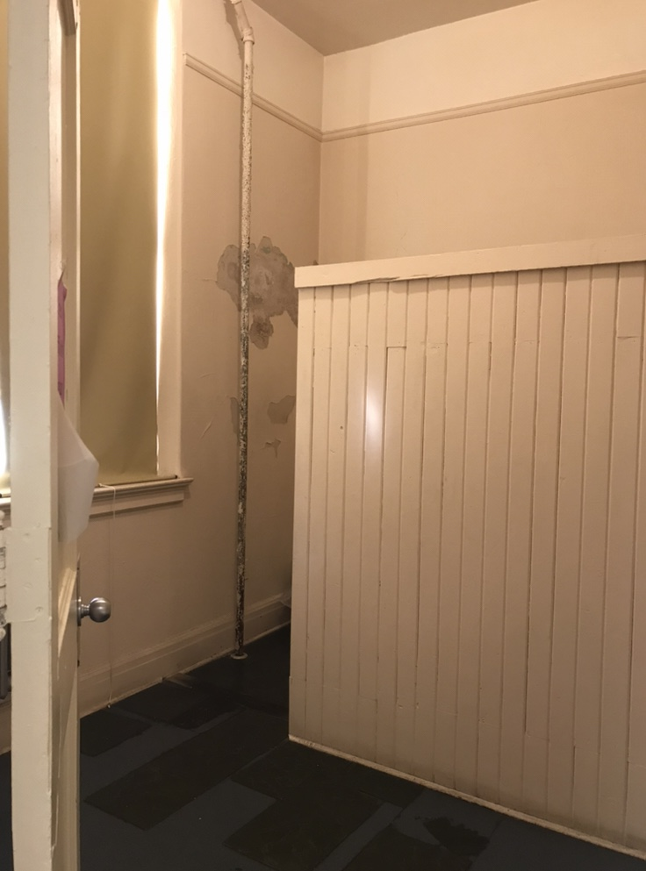
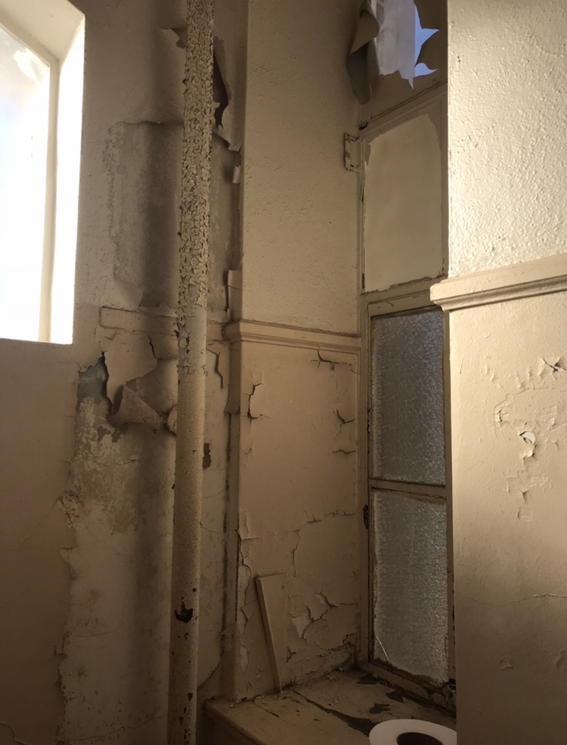
What We Found

Slide 6
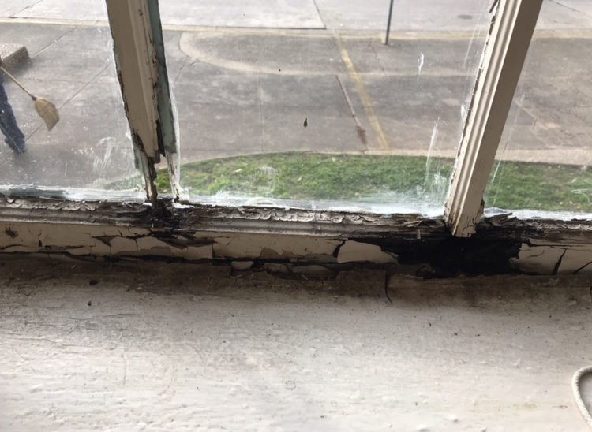
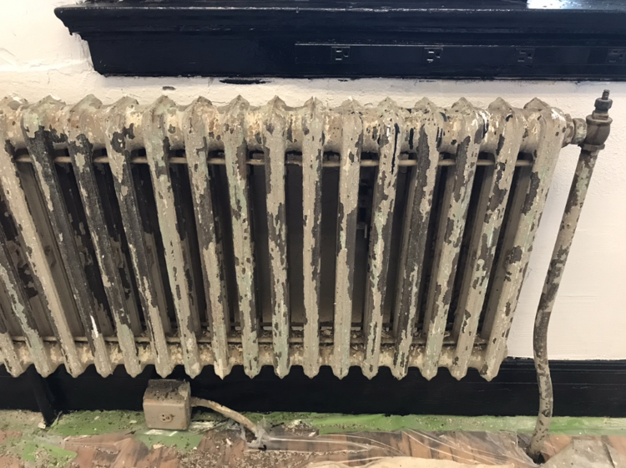
What We Found

Slide 7
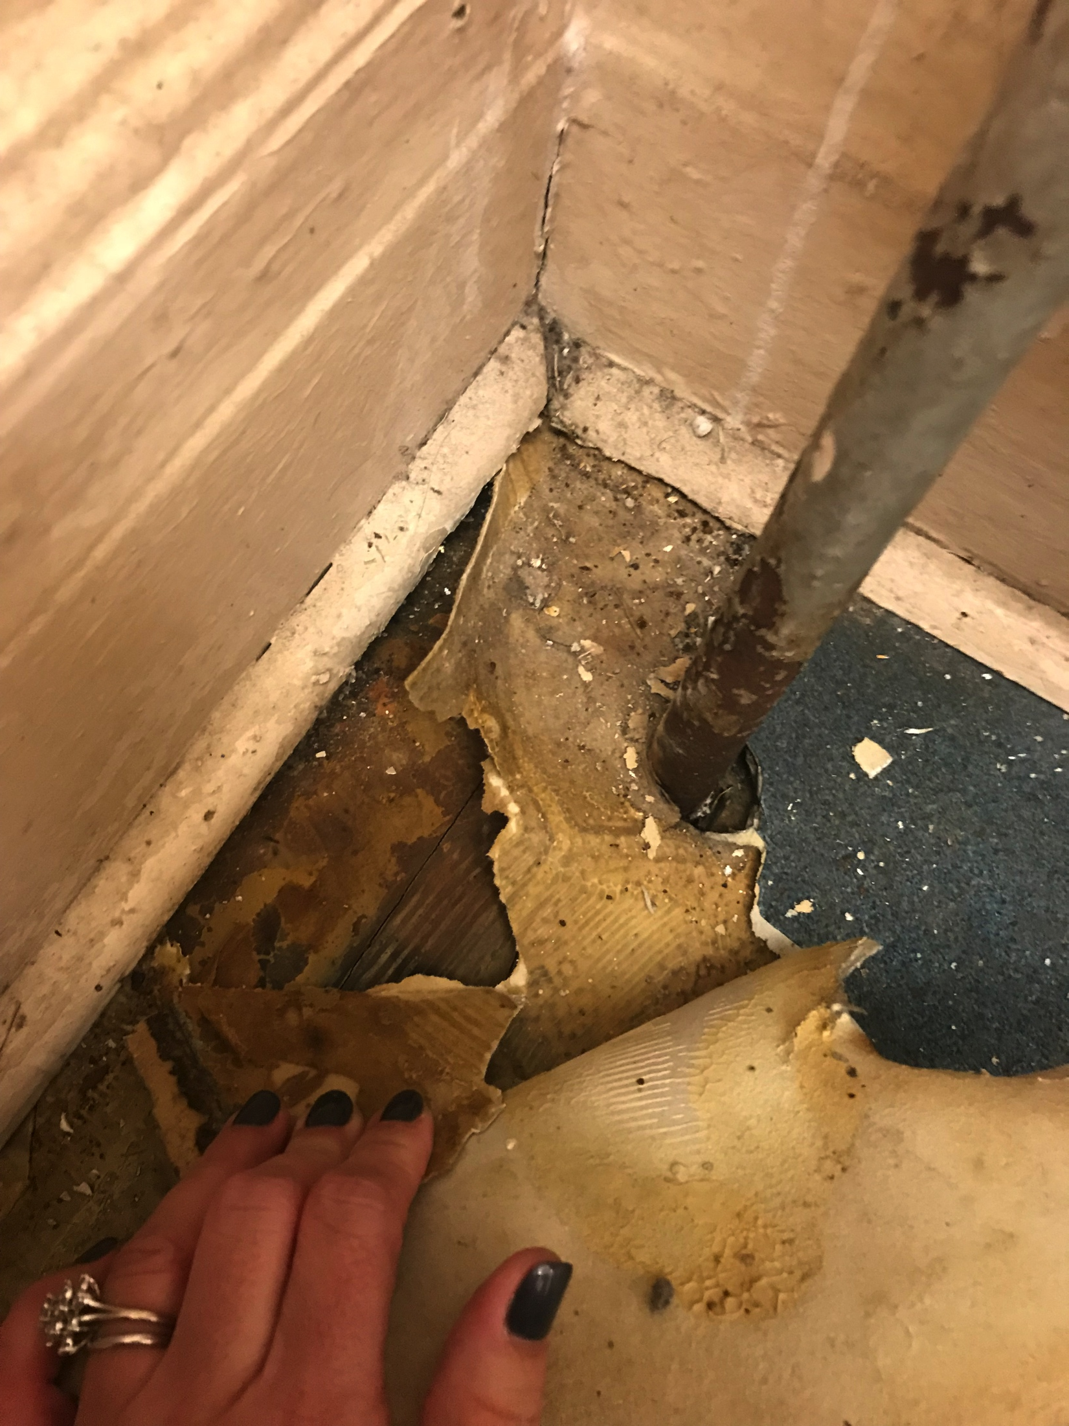
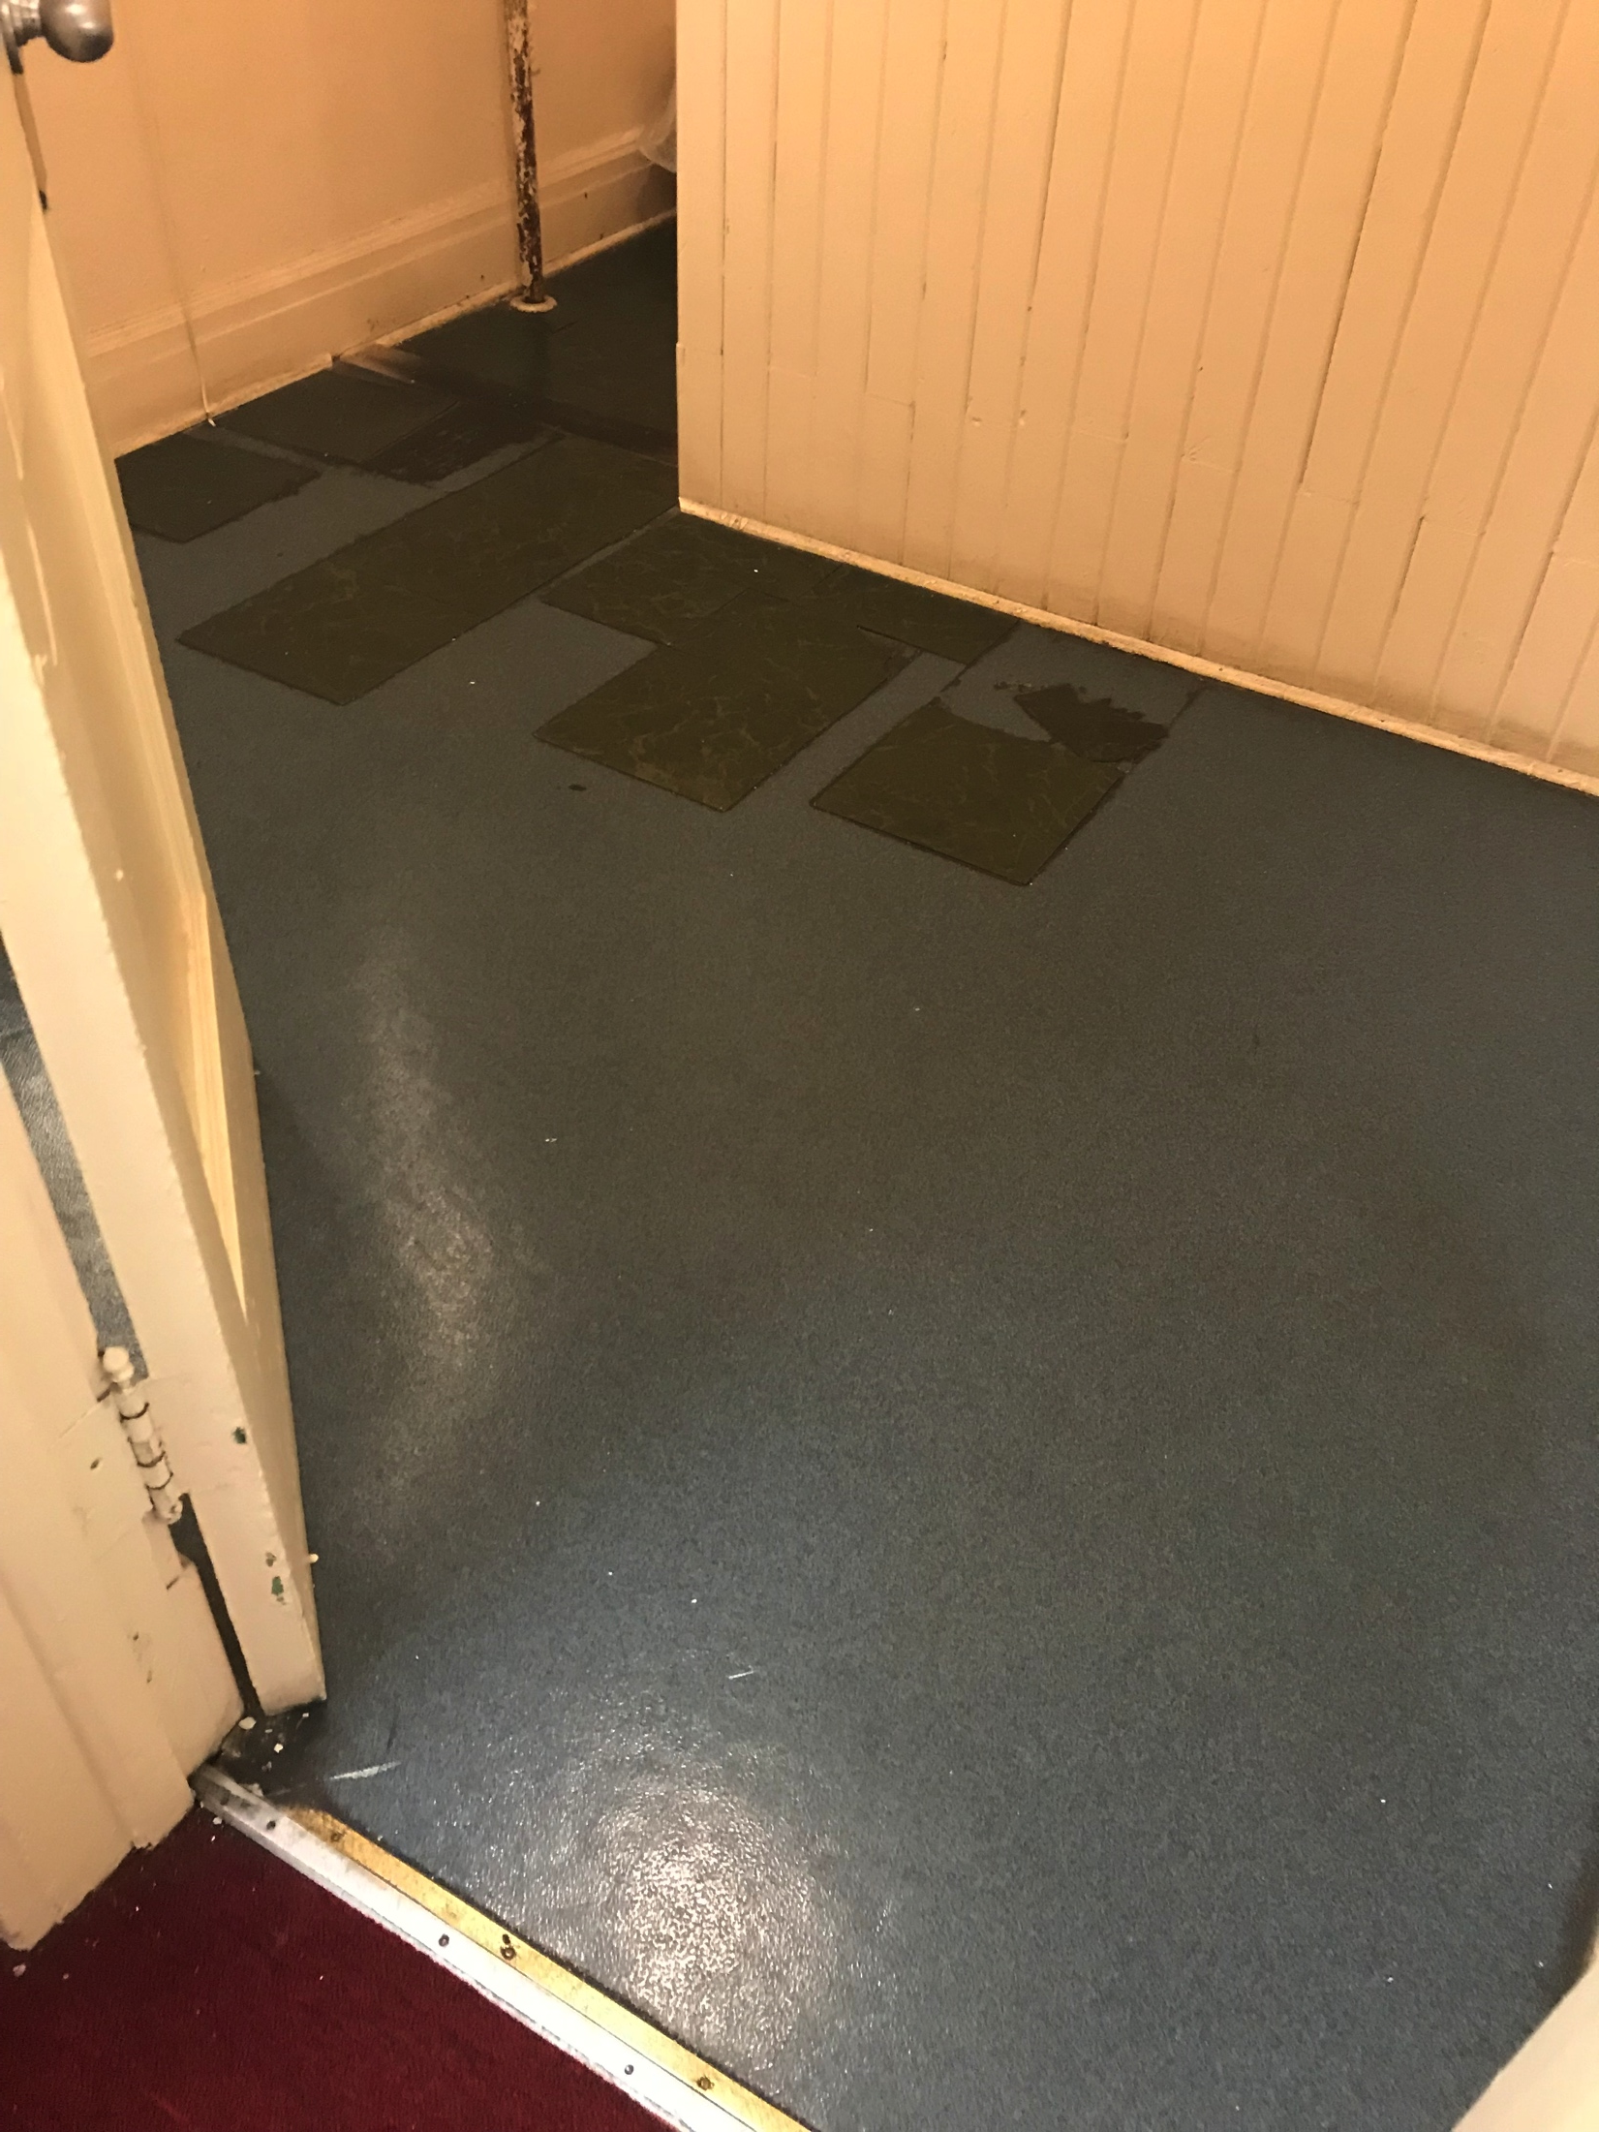
What We Found

Slide 8
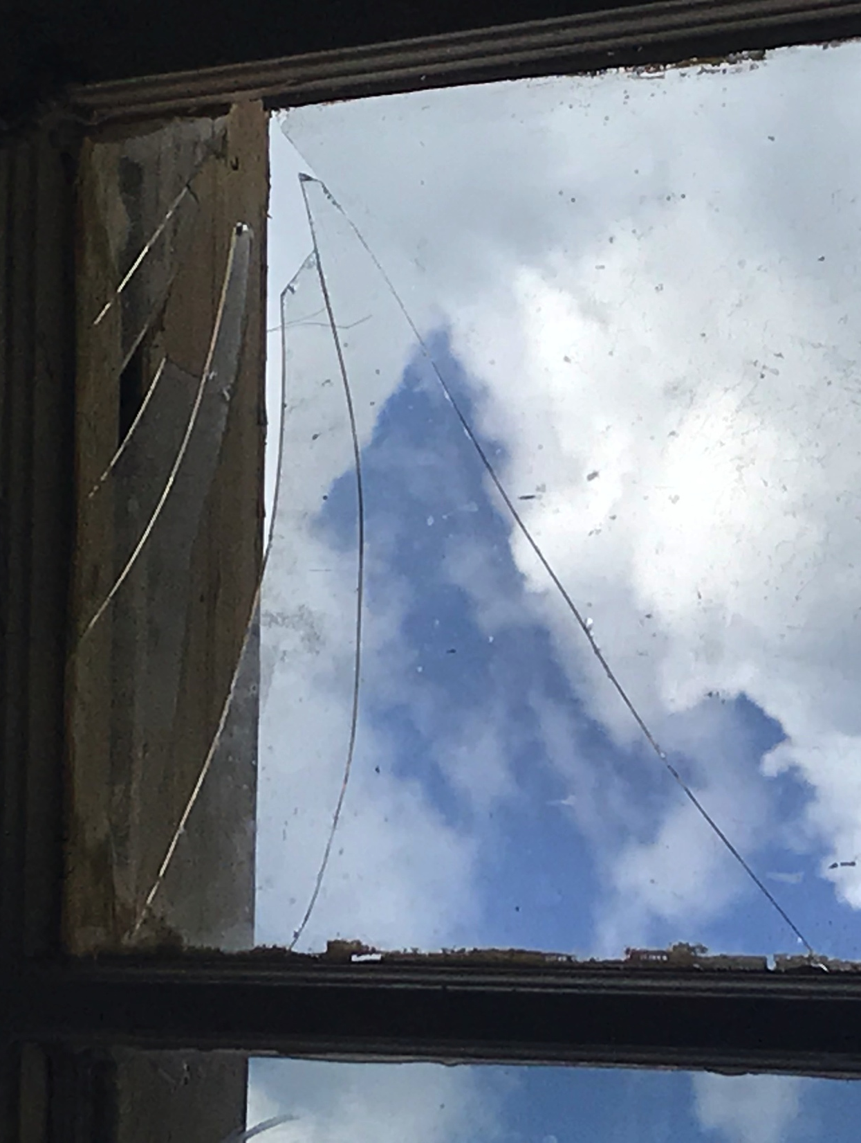
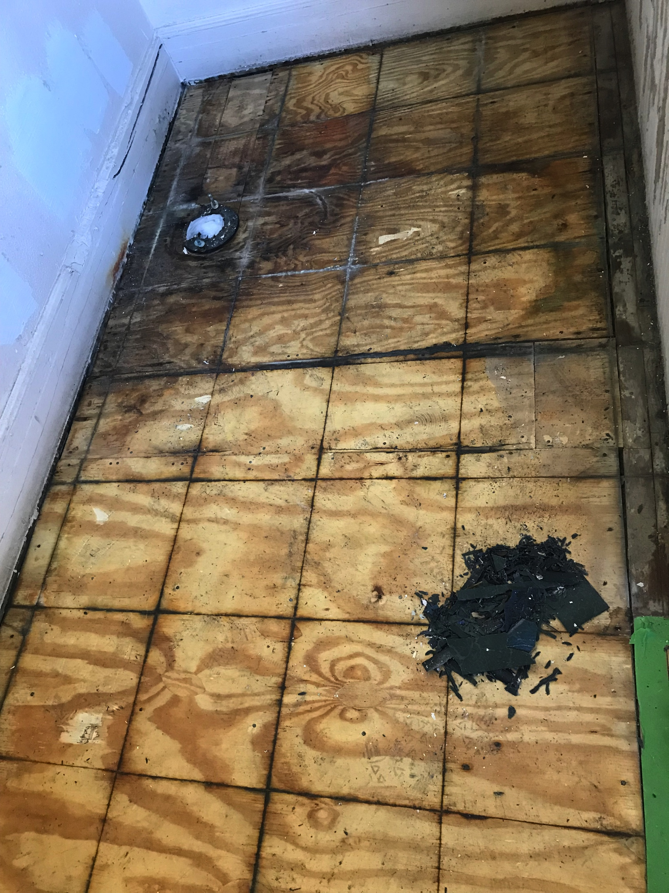
What We Found

Slide 9
What We Did
Put together a plan
Got bids
Created a budget
FUND RAISING!
Took out the carpet
Hired flooring company and reparative painters
Bought furniture, small appliances, office supplies, and accessories
Finishing touches
Notes:
Carol – 4 mins

Slide 10
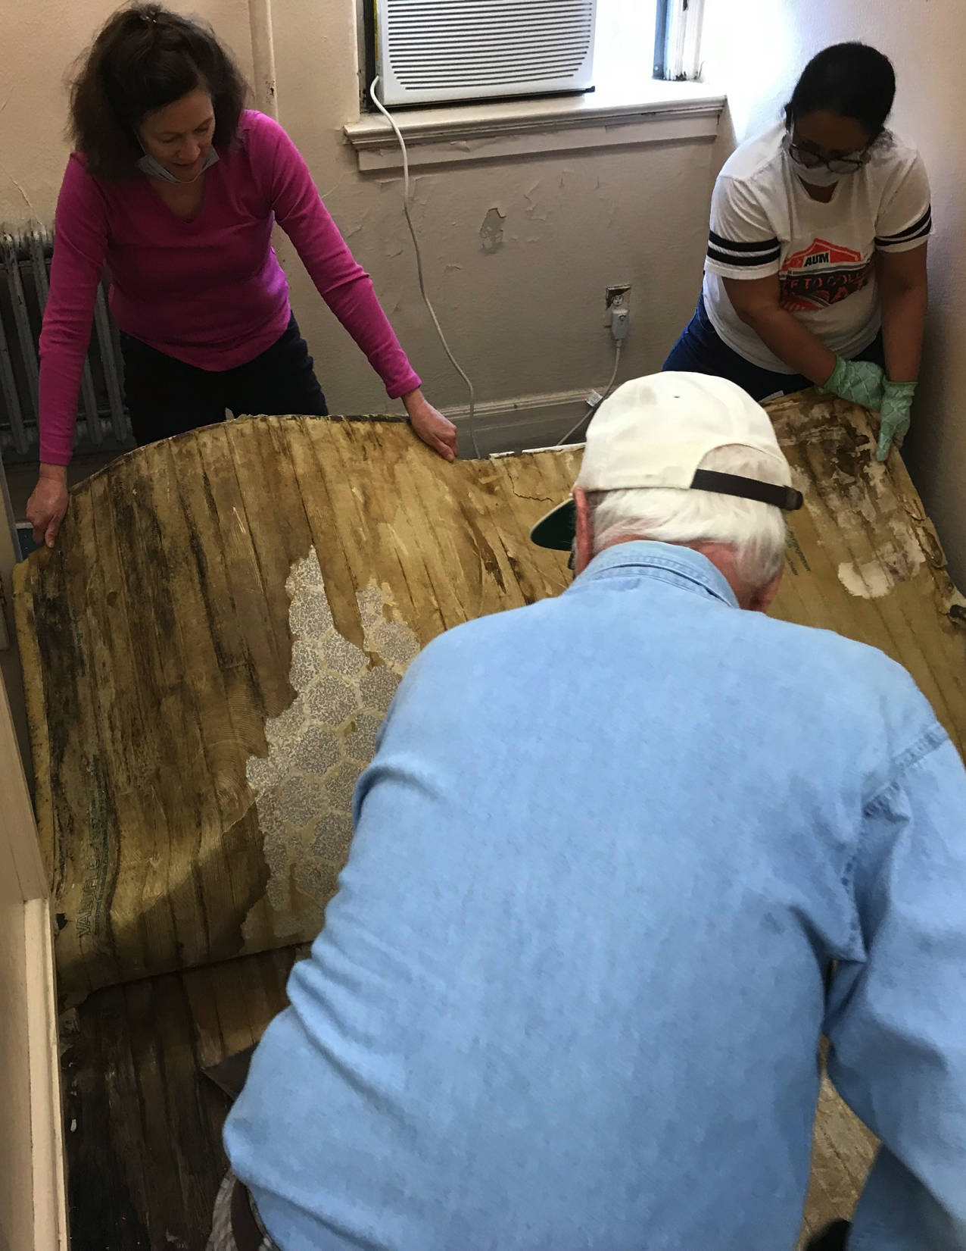
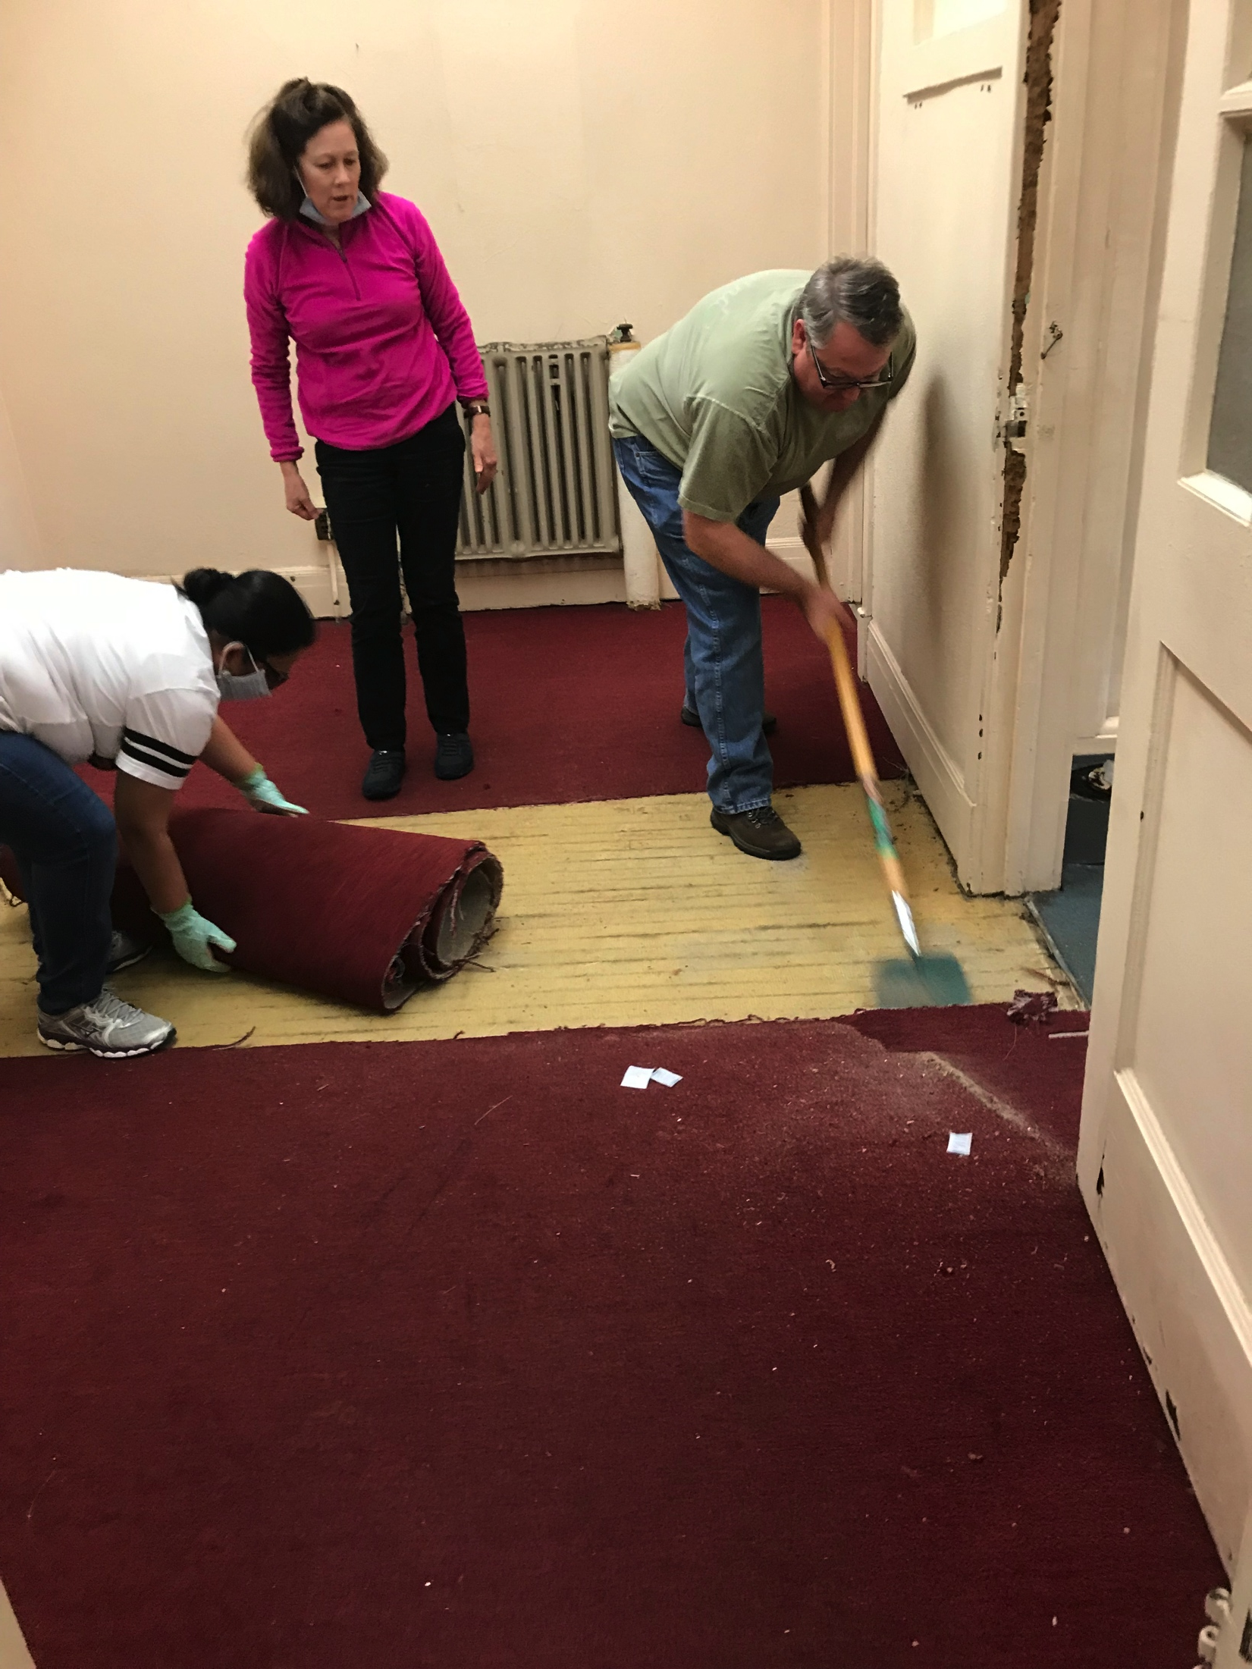
What We Did – Removed Flooring

Slide 11
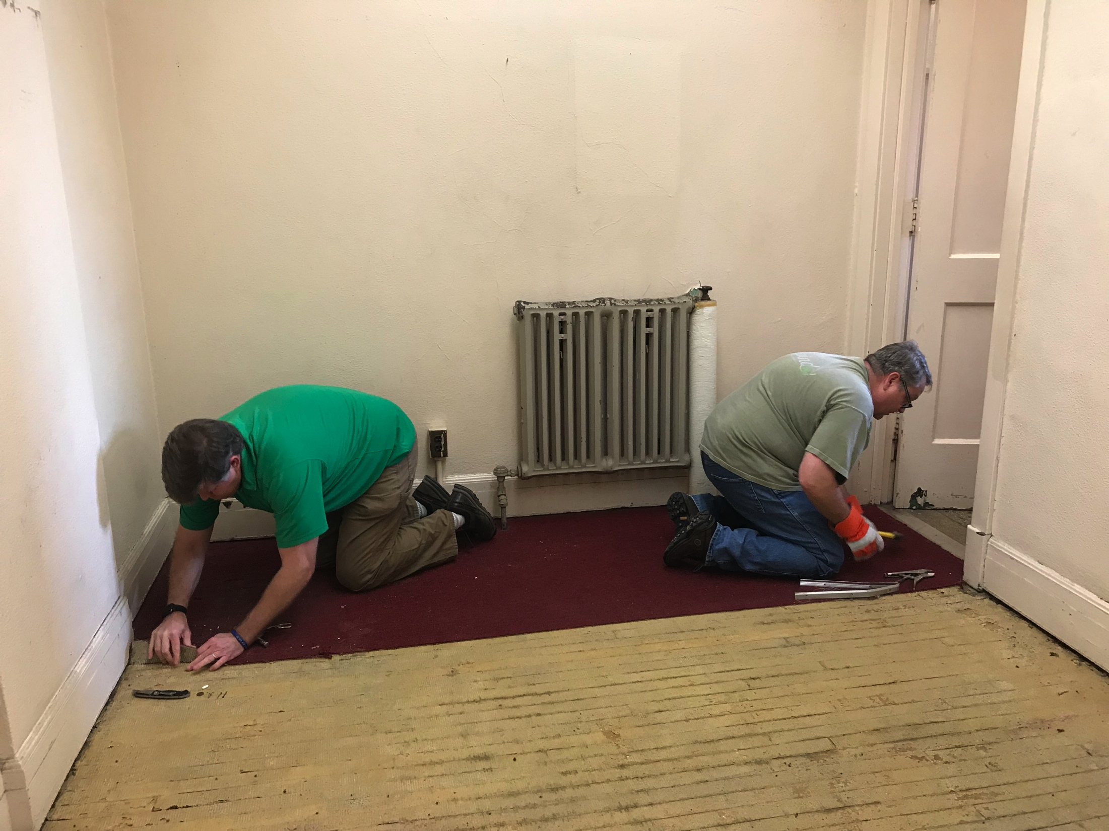
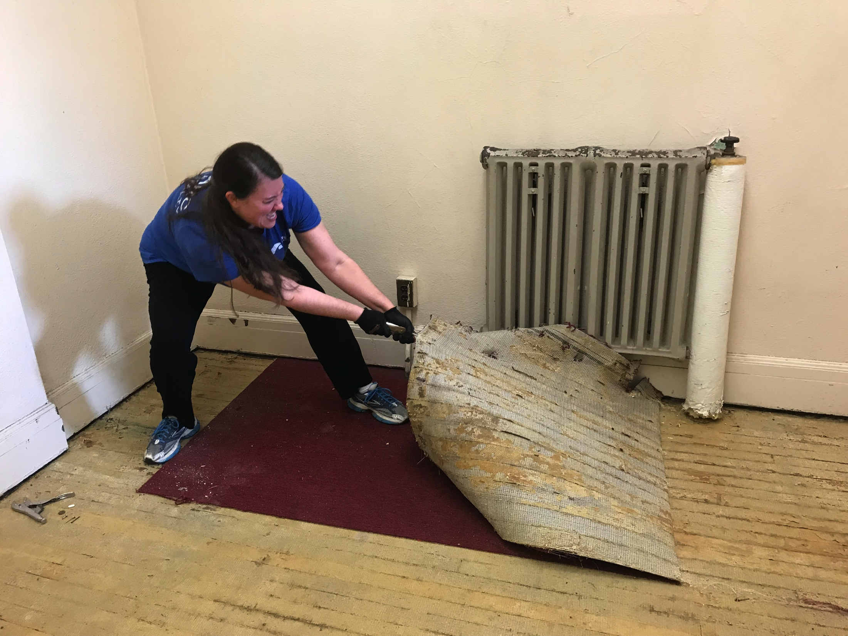
What We Did – Removed Flooring

Slide 12
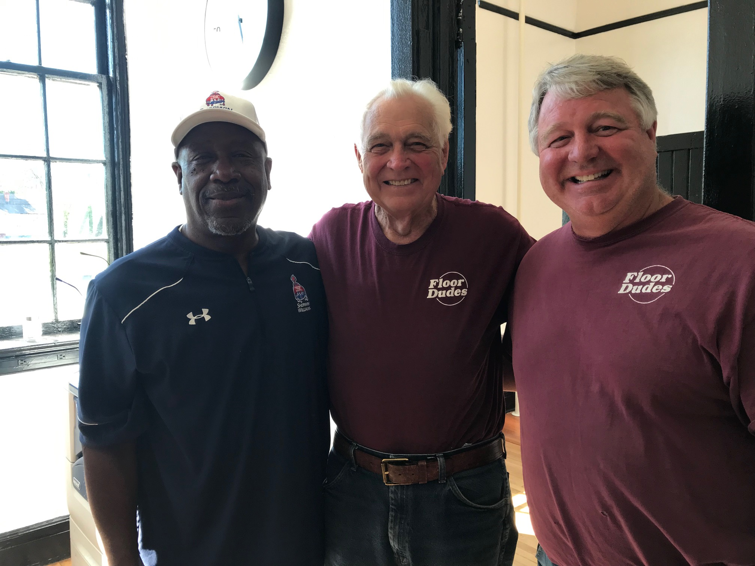
What We Did – Hired These Guys

Slide 13
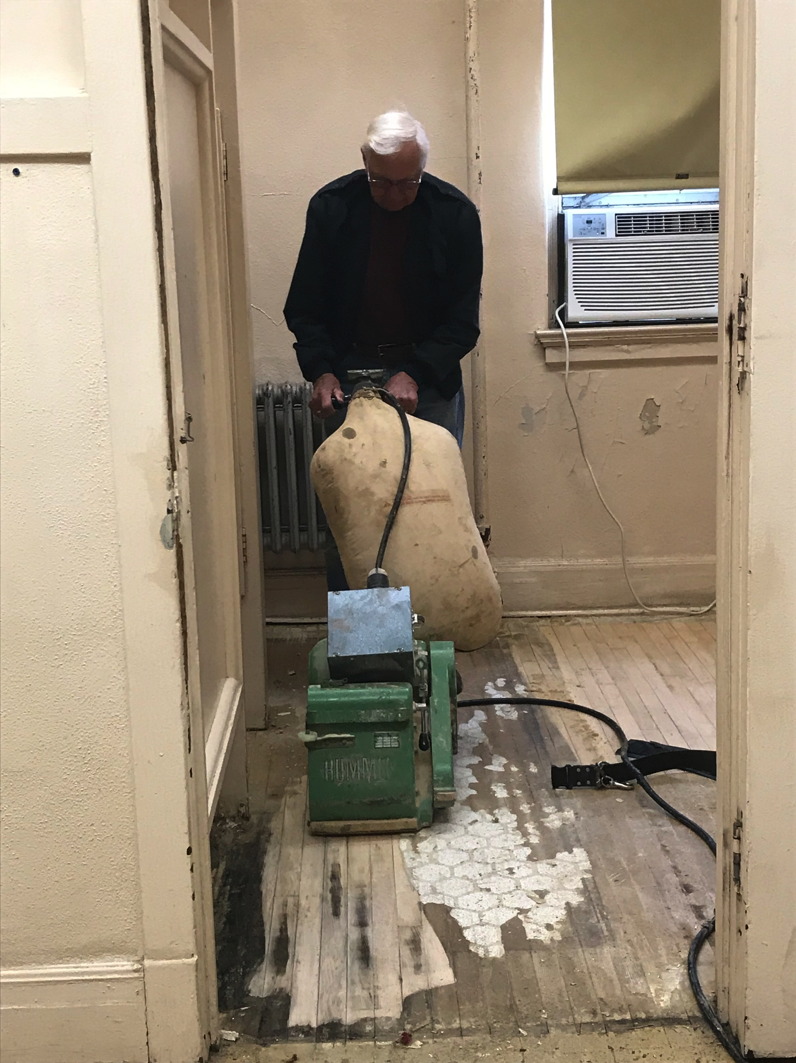
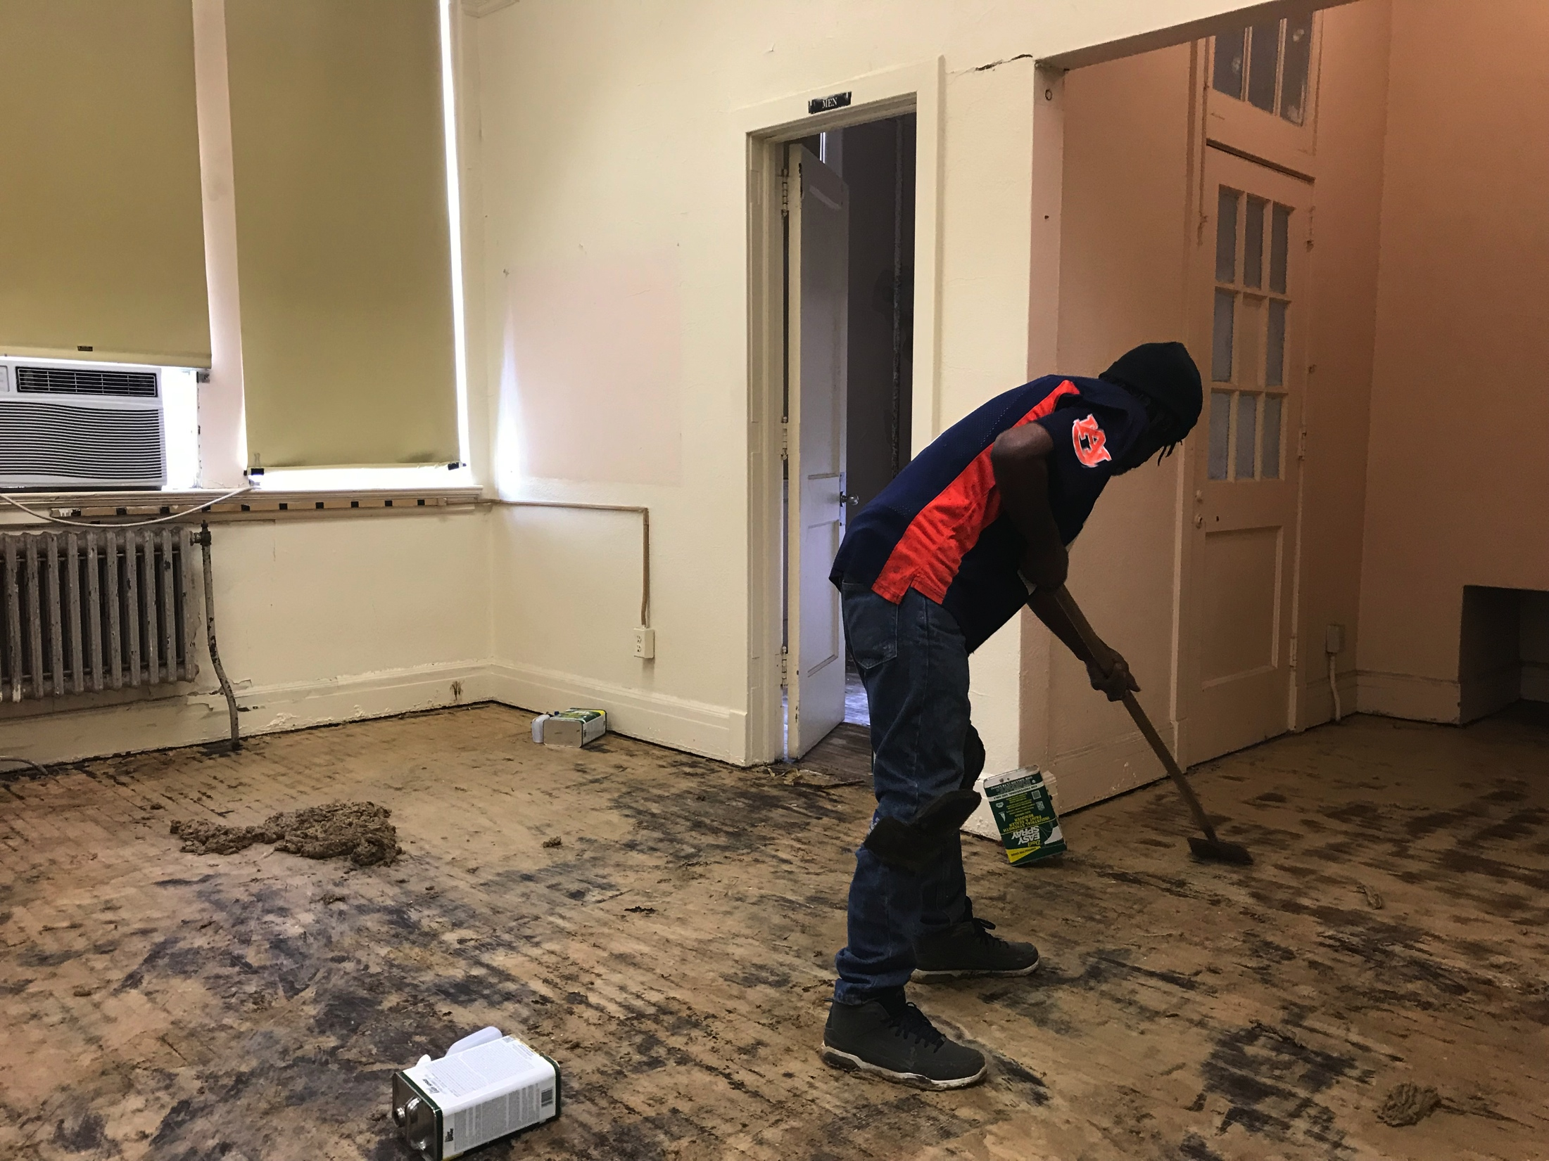
What We Did - Flooring

Slide 14
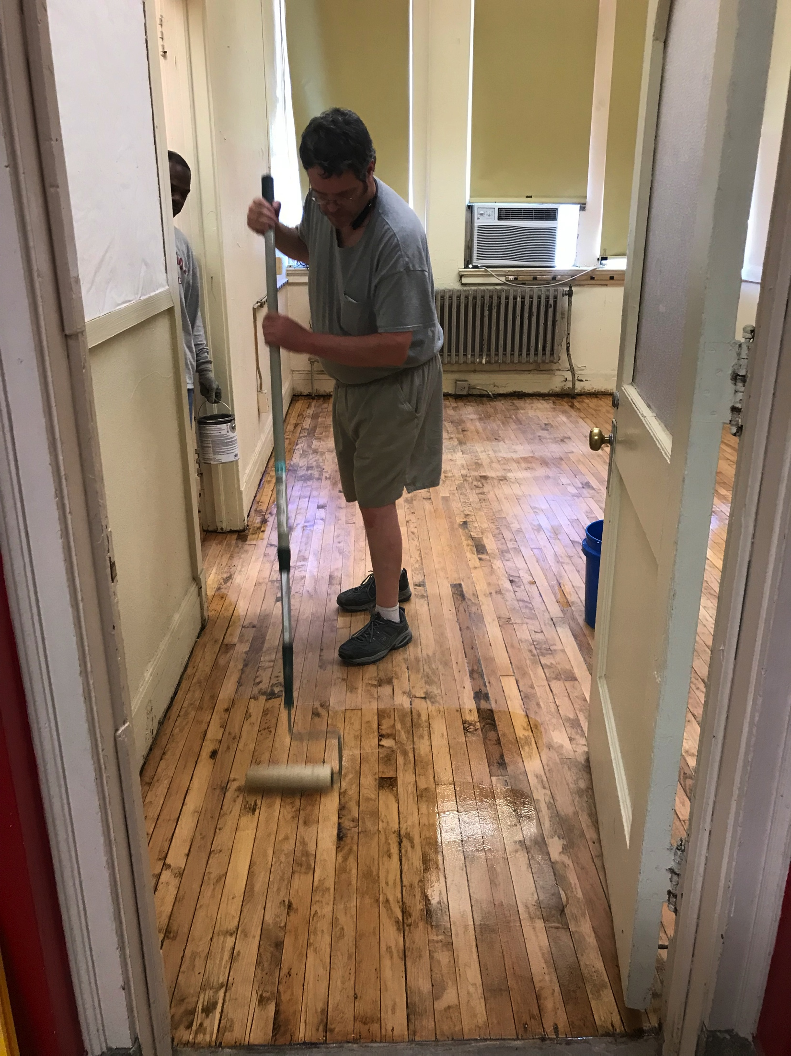
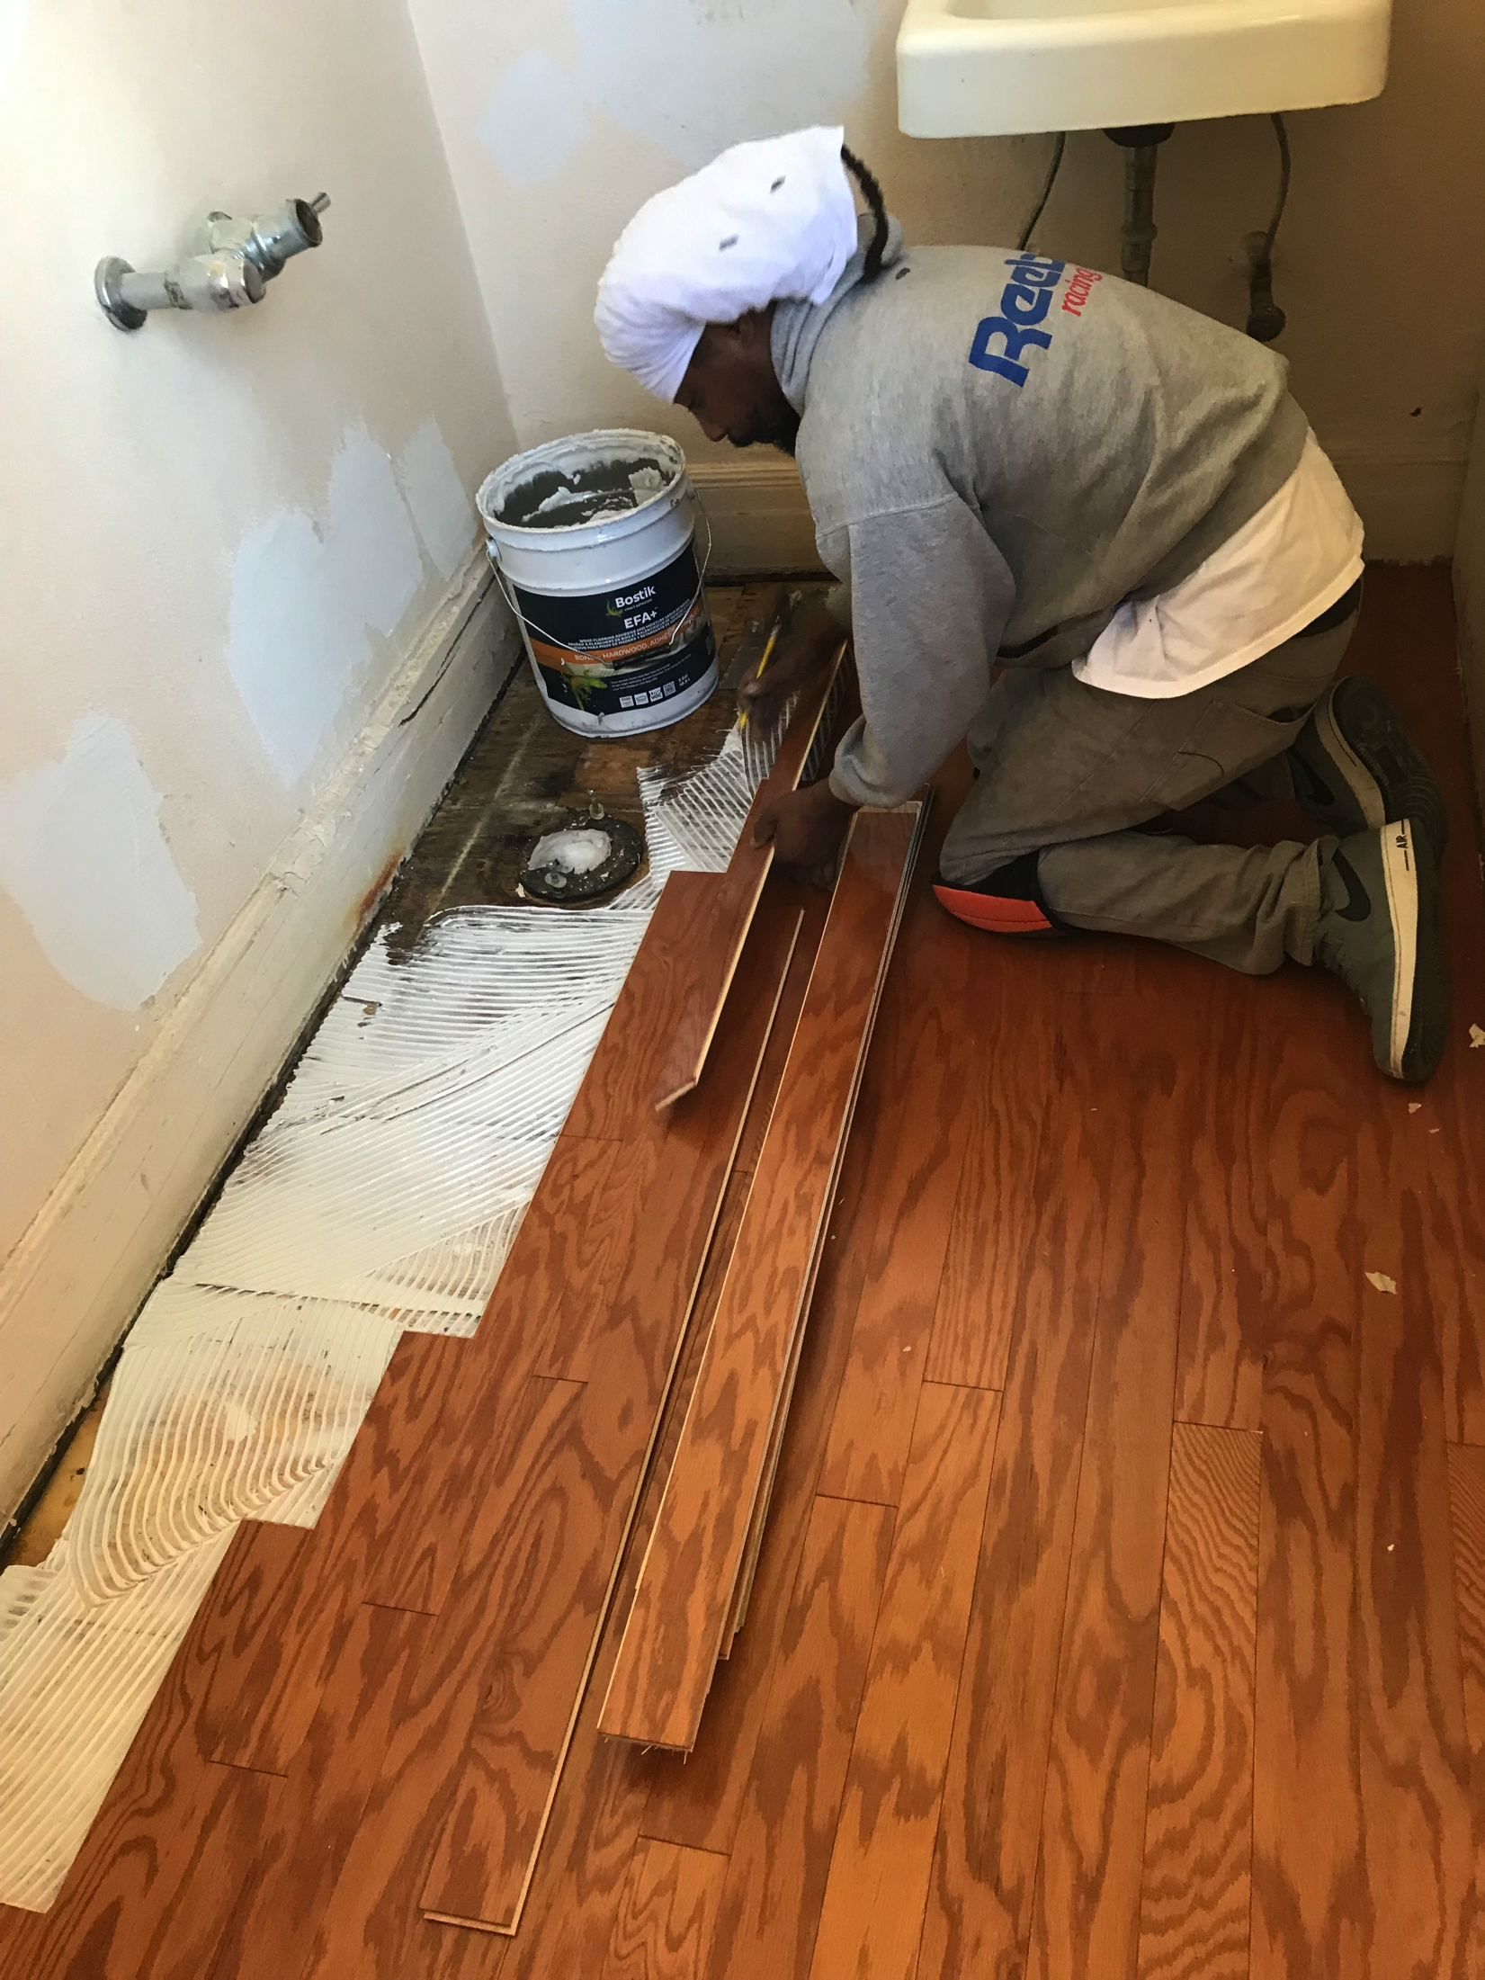
What We Did - Flooring

Slide 15
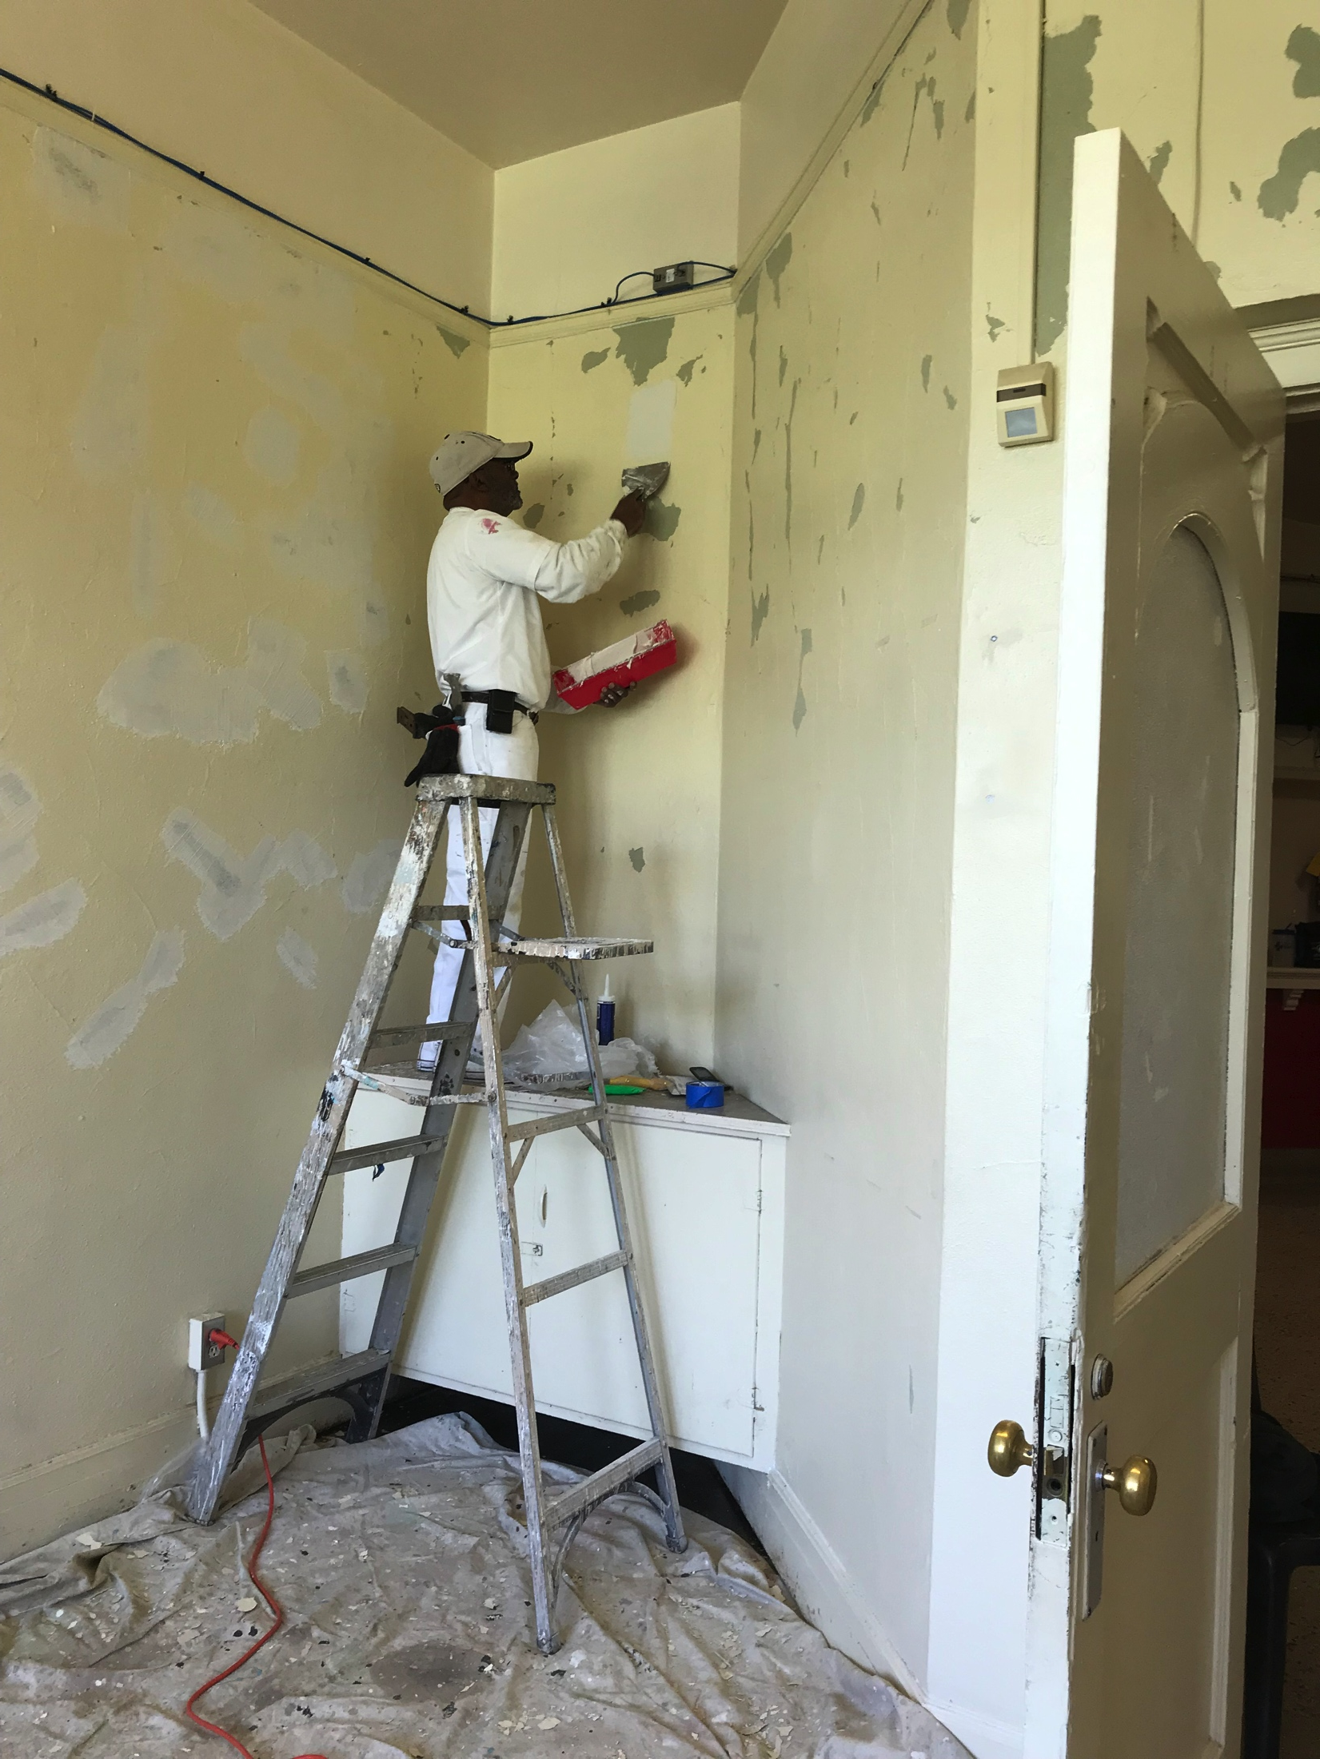
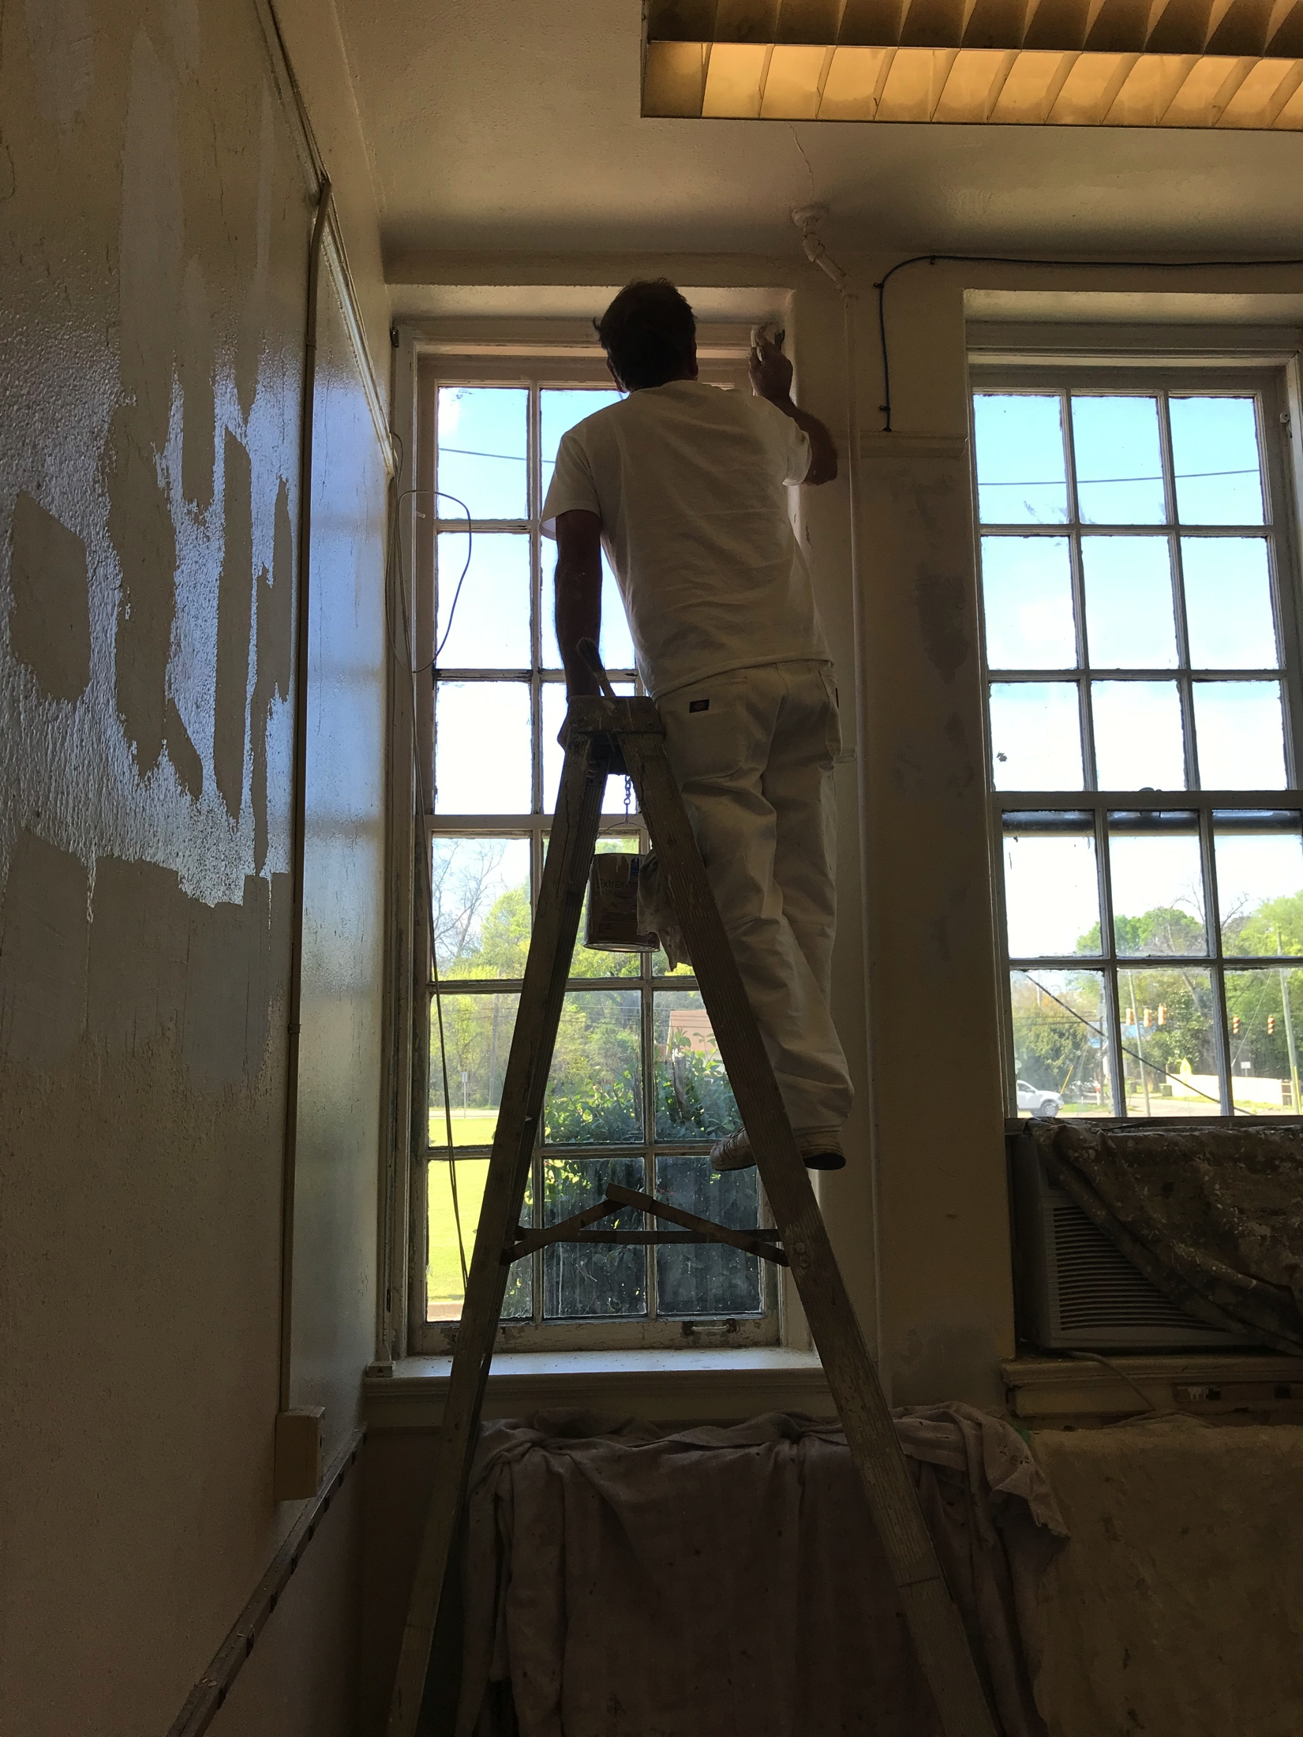
What We Did – Repair & Painting

Slide 16
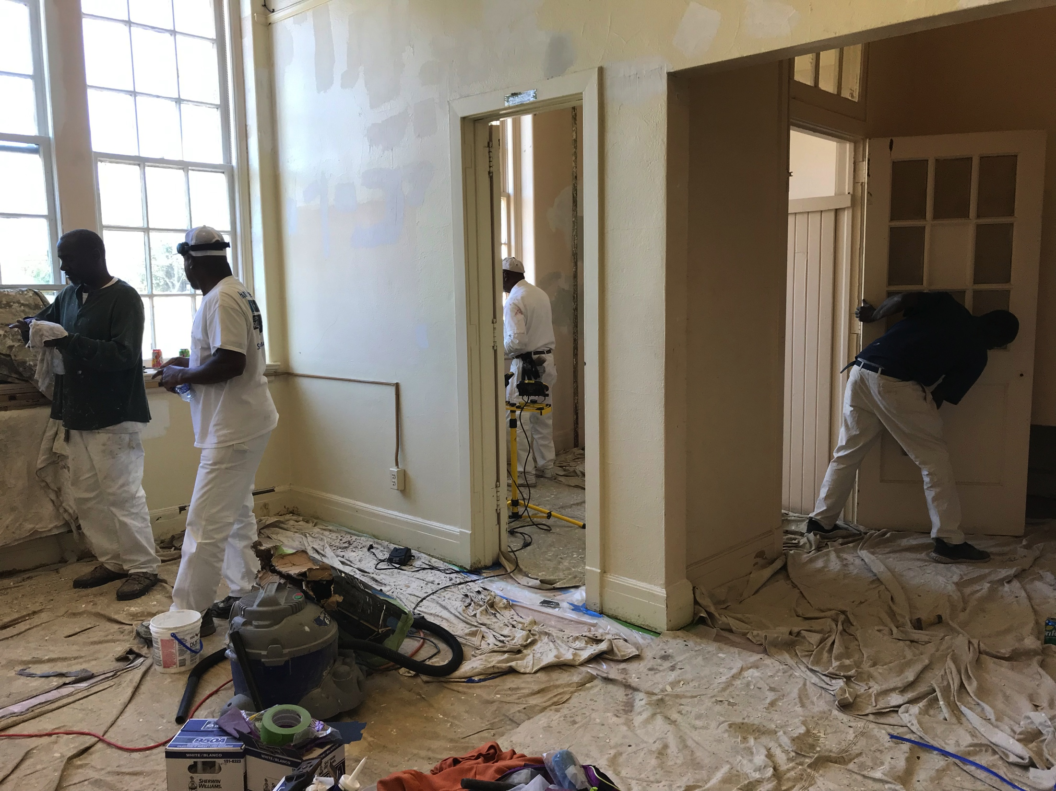
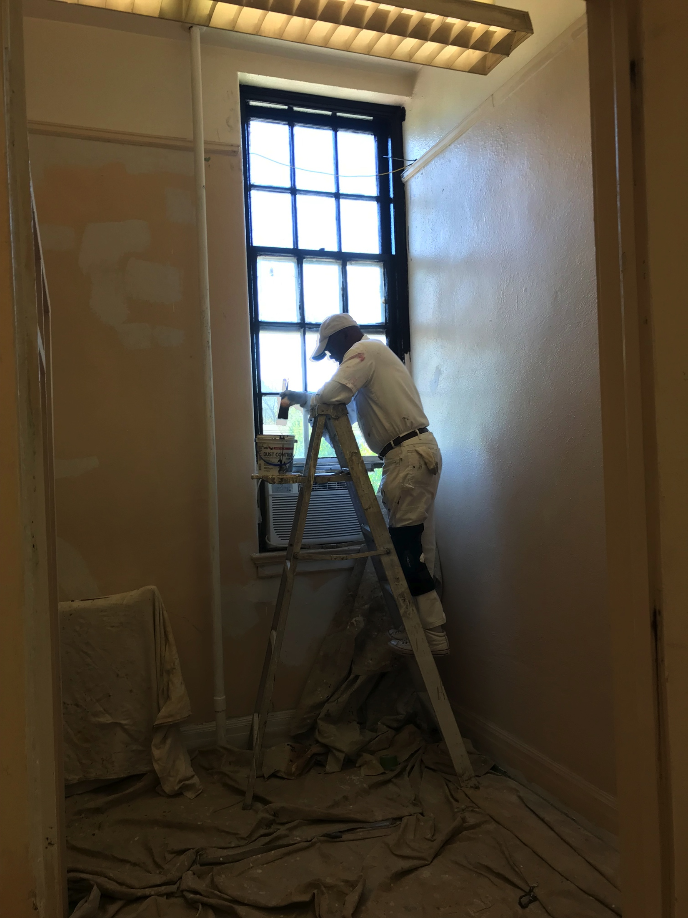
What We Did – Repair & Painting

Slide 17
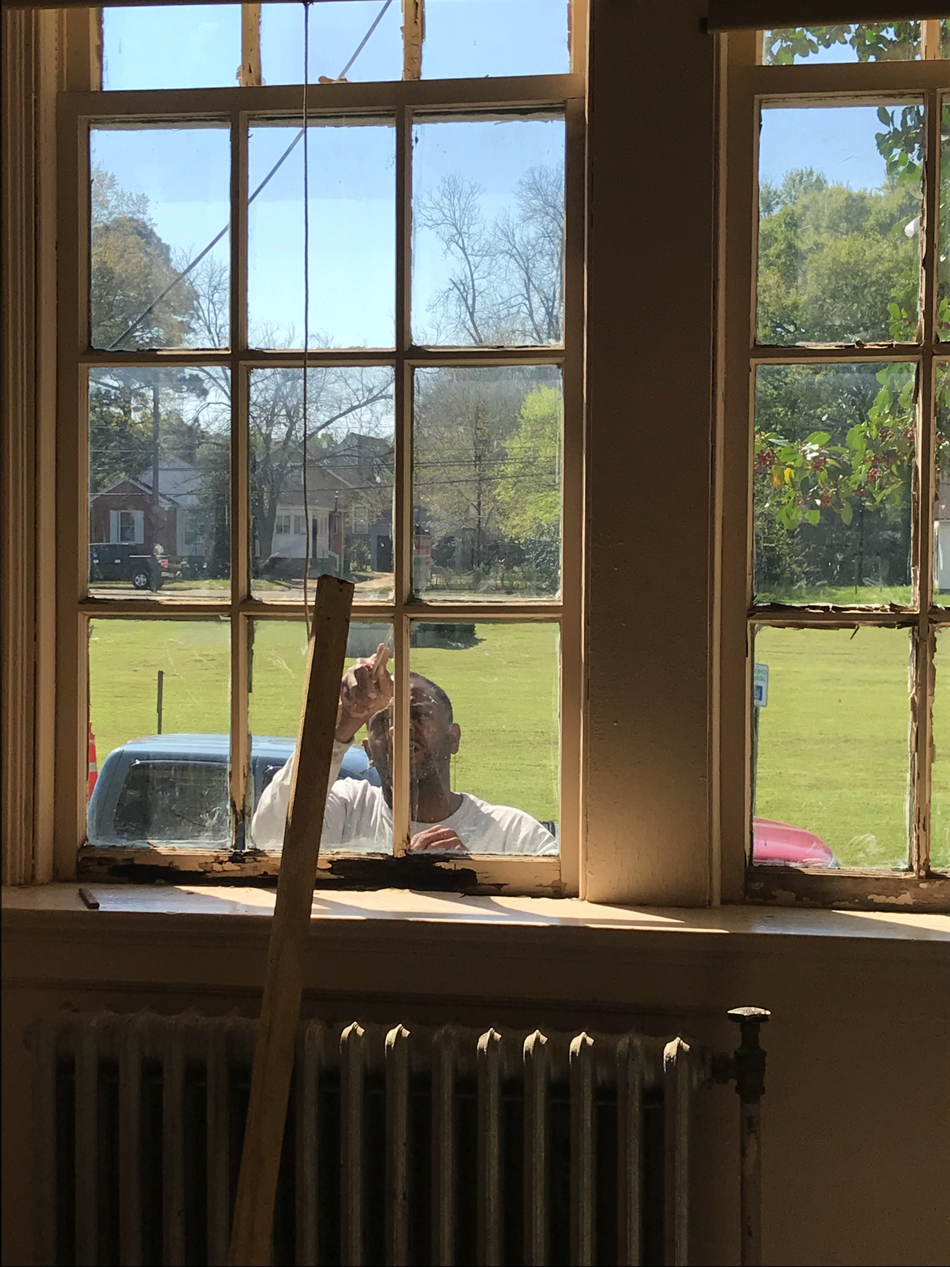
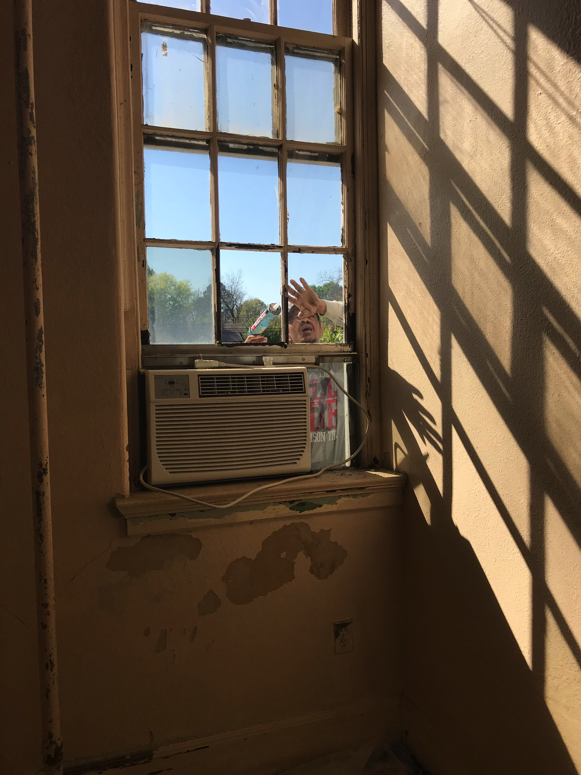
What We Did –Window Repair

Slide 18
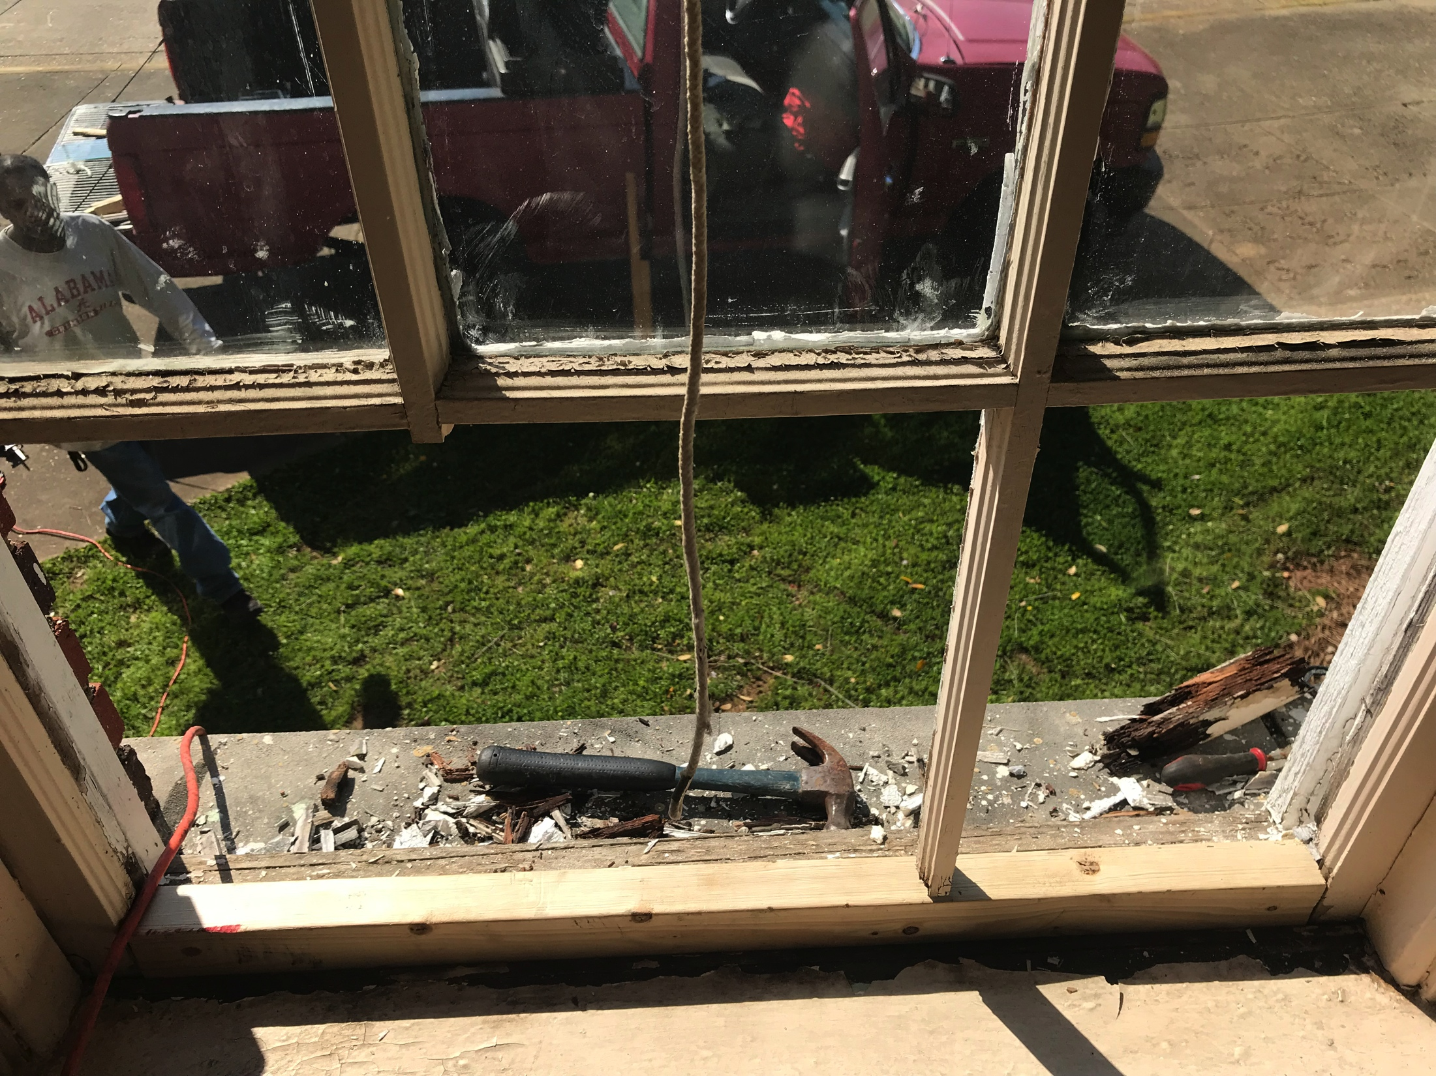
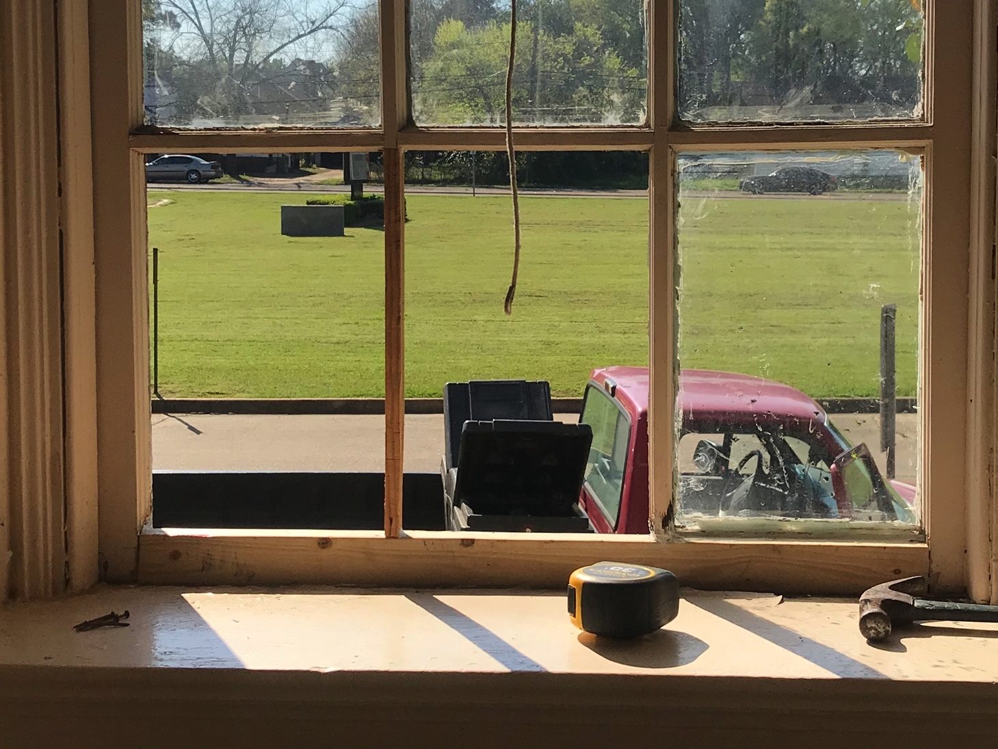
What We Did –Window Repair

Slide 19
How We Did It Business & Public Service Donors
Notes:
Shanta – 3 mins
It might be nice here to talk about how the donors and community partners are connected to us or the school. I can help you with info.

Slide 20
How We Did It Individual Donors
Sheila Austin
Mona & Wade Hurston
Phill Johnson
Bonnie & Jerry Moore
Karen Riley
Diane Sams
Norman Schlemmer
Greg Sellers

Slide 21
How We Did It Community Partners
Angelica Rojas
Robert Evans Paint Service

Slide 22
The Budget – Restoration Costs
Paint, Wall and Window Repair, Floor Refinishing and Replacement, and Door Knob Replacement - $8,929.75
Flooring was $2,156
Sanding and refinishing - $2,031
Labor for new flooring in men’s room (Birdwood Floors donated the wood) - $125
Reparative painting is $6,458.75
Repairs to windows $240
Replaced missing door knob $75
Notes:
Greg – 2 mins

Slide 23
The Budget – Décor Cost
Furniture and accessories $1,913.40
Furniture $1,185
Microwave, Coffee Pot, and Coffee Supplies $137.06
Target Room Accessories $73.65
Hobby Lobby Containers, Bulletin Board Supplies and Room Accessories $161.44
Office Depot Supplies $40.65
Gallery Photos $137.03
Amazon Accessories and Office Supplies $178.57

Slide 24
Total Donations & Expenditures
Total Expenditures: $10,843.15
Total Donations & Pledges: $10,850

Slide 25
Beyond the Donation

Slide 26
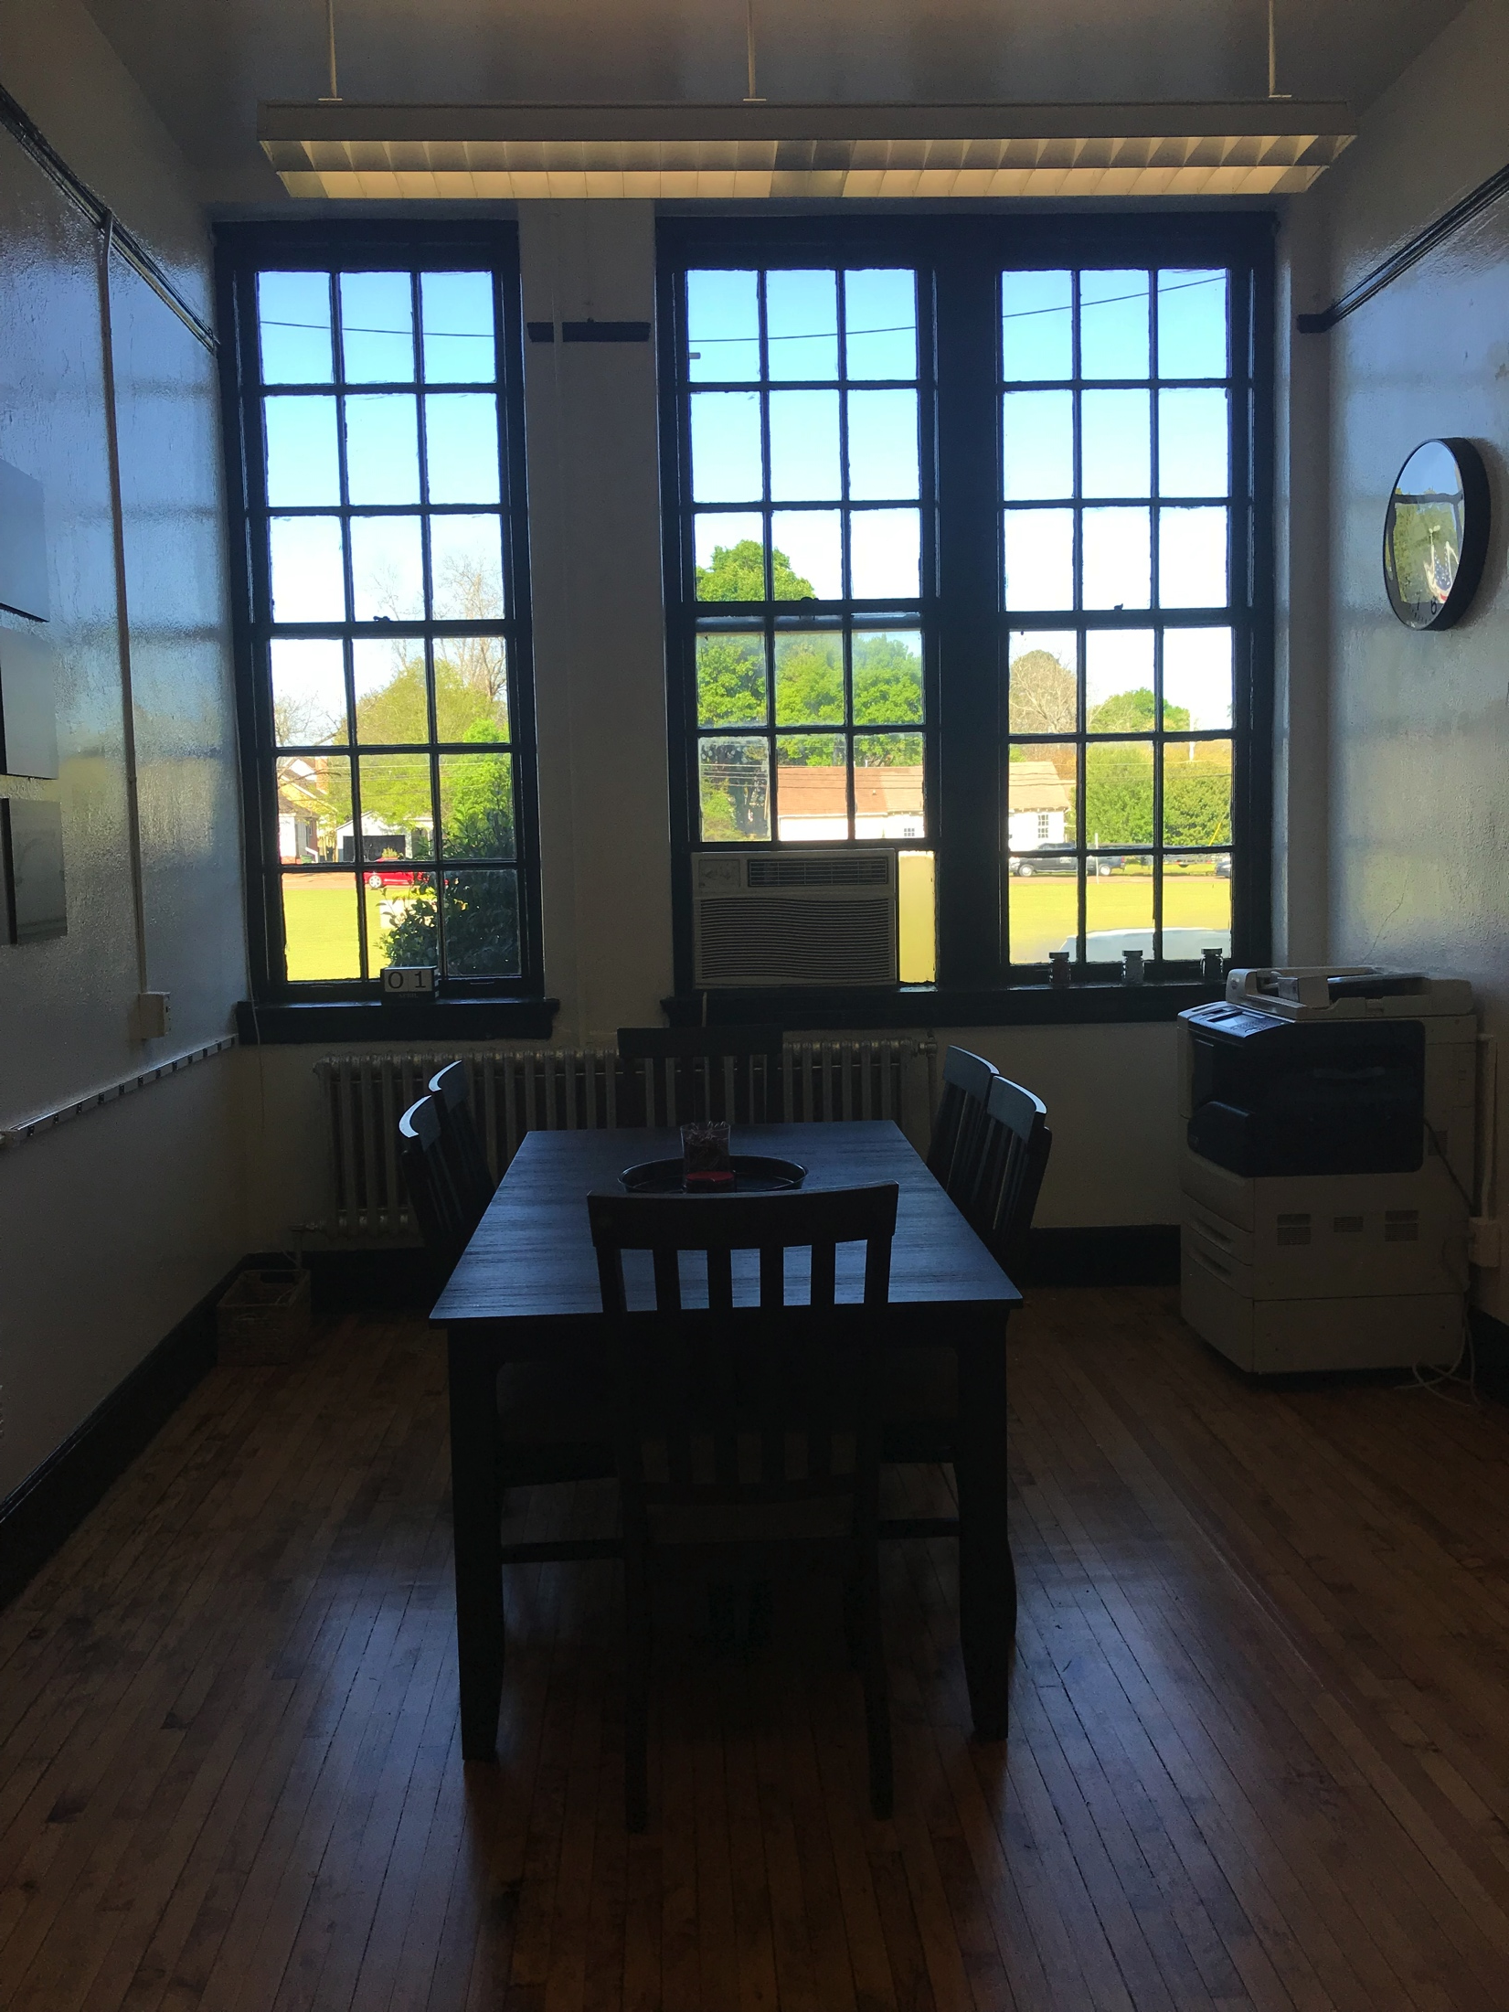
Before & After
Notes:
Mona 3 mins

Slide 27
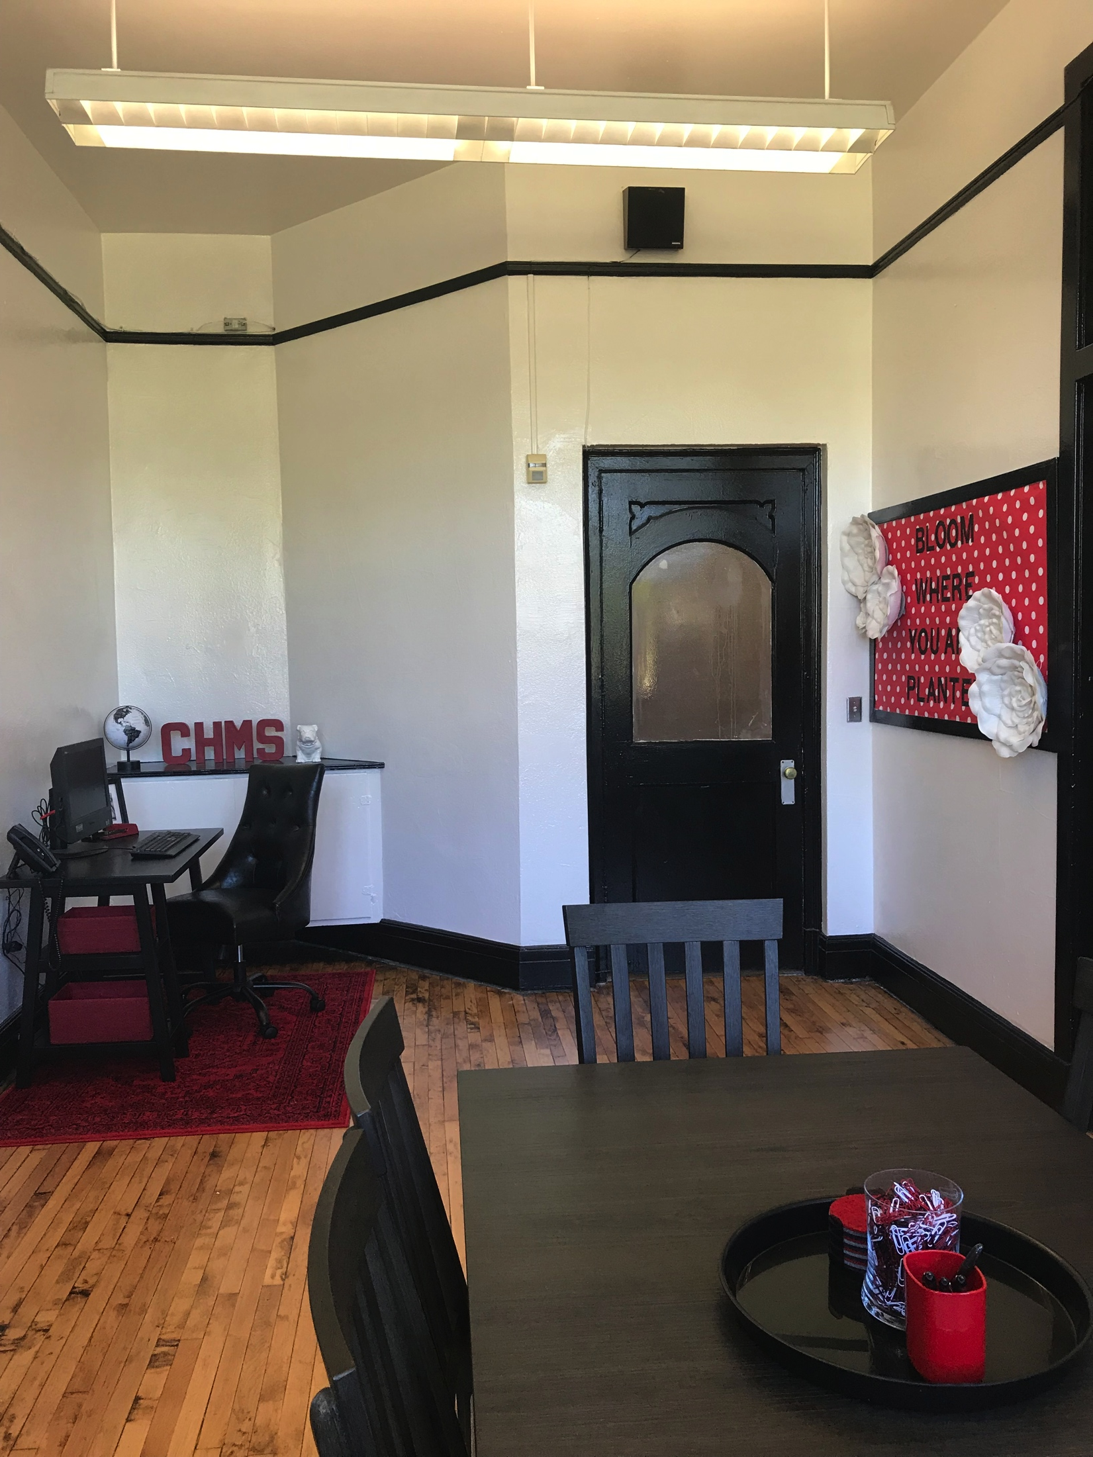
Before & After
Notes:
Mona 3 mins

Slide 28
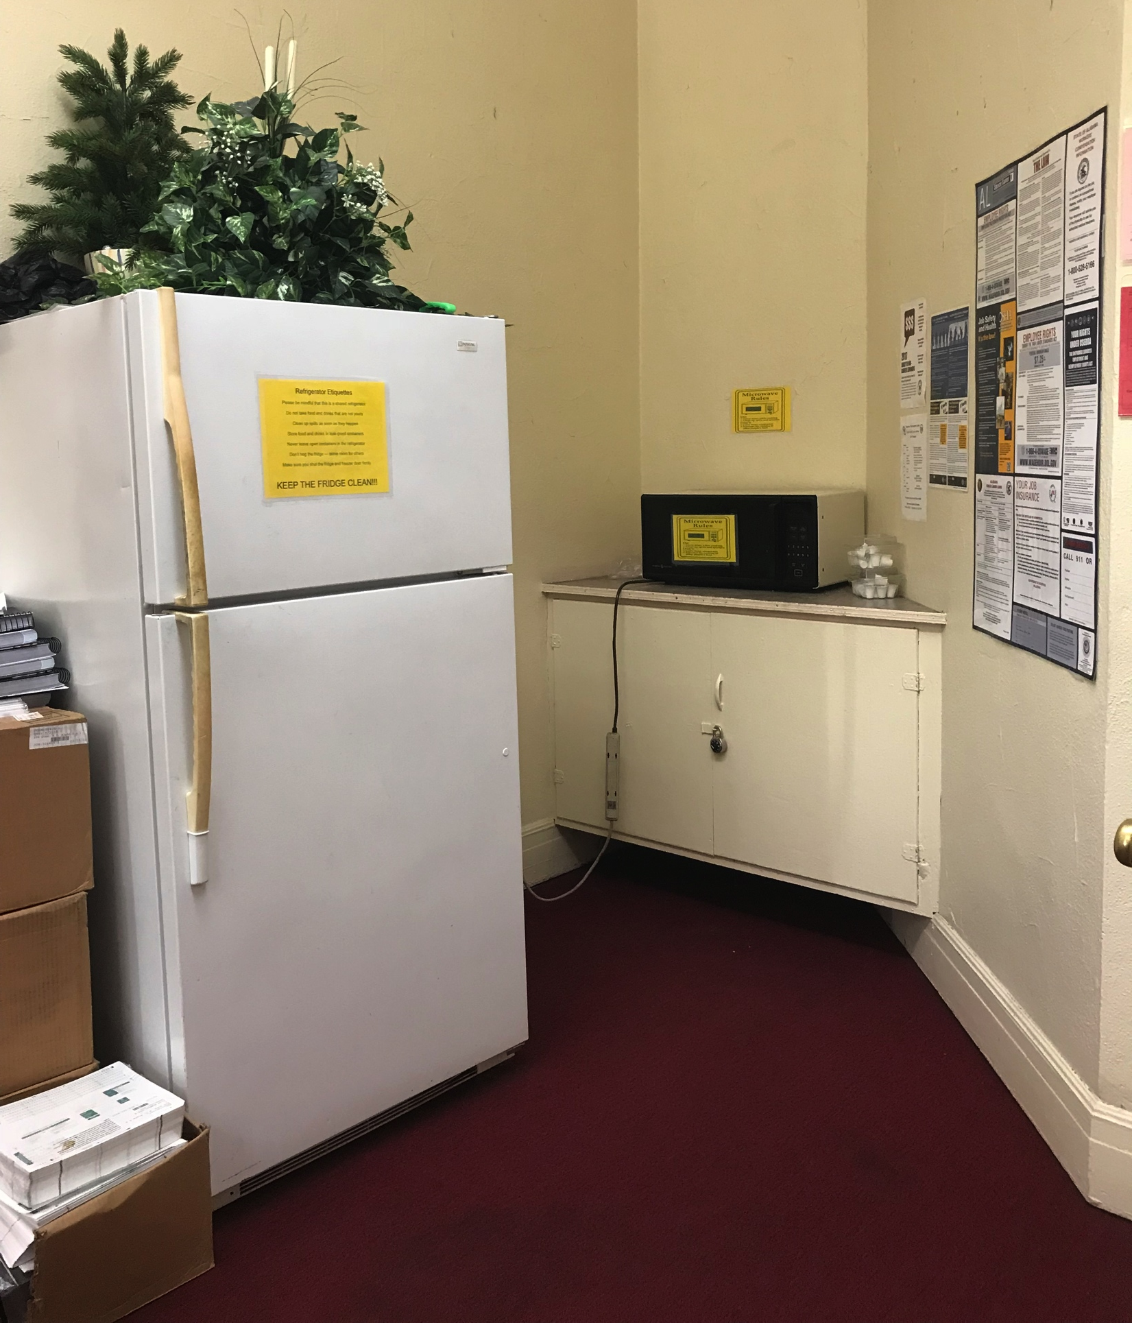
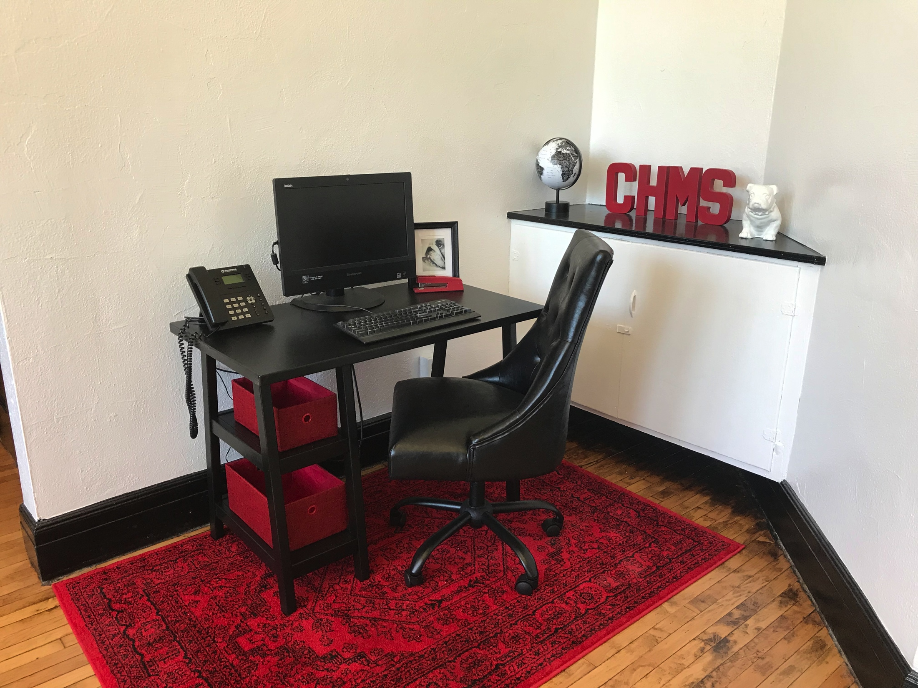
Before & After
Notes:
Mona 3 mins

Slide 29
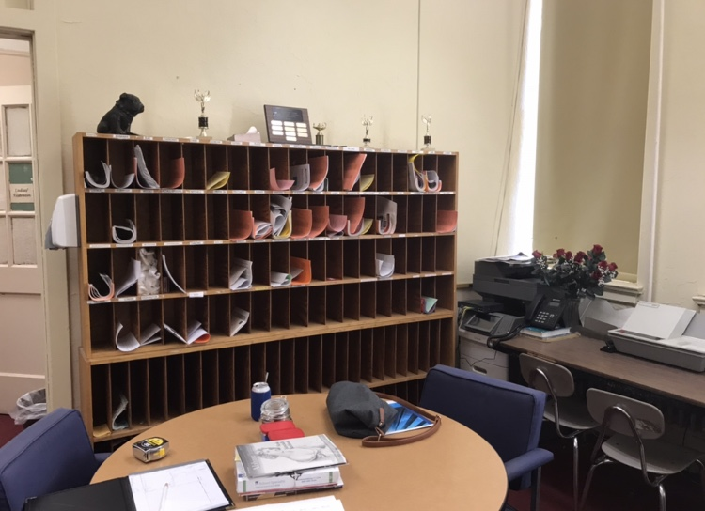
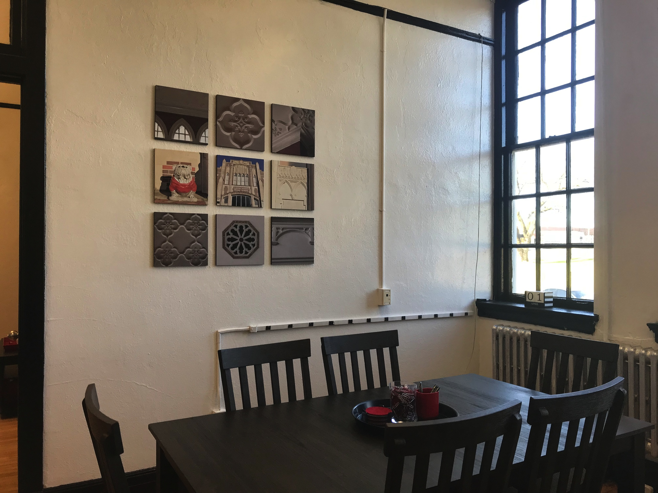
Before & After
Notes:
Mona 3 mins

Slide 30
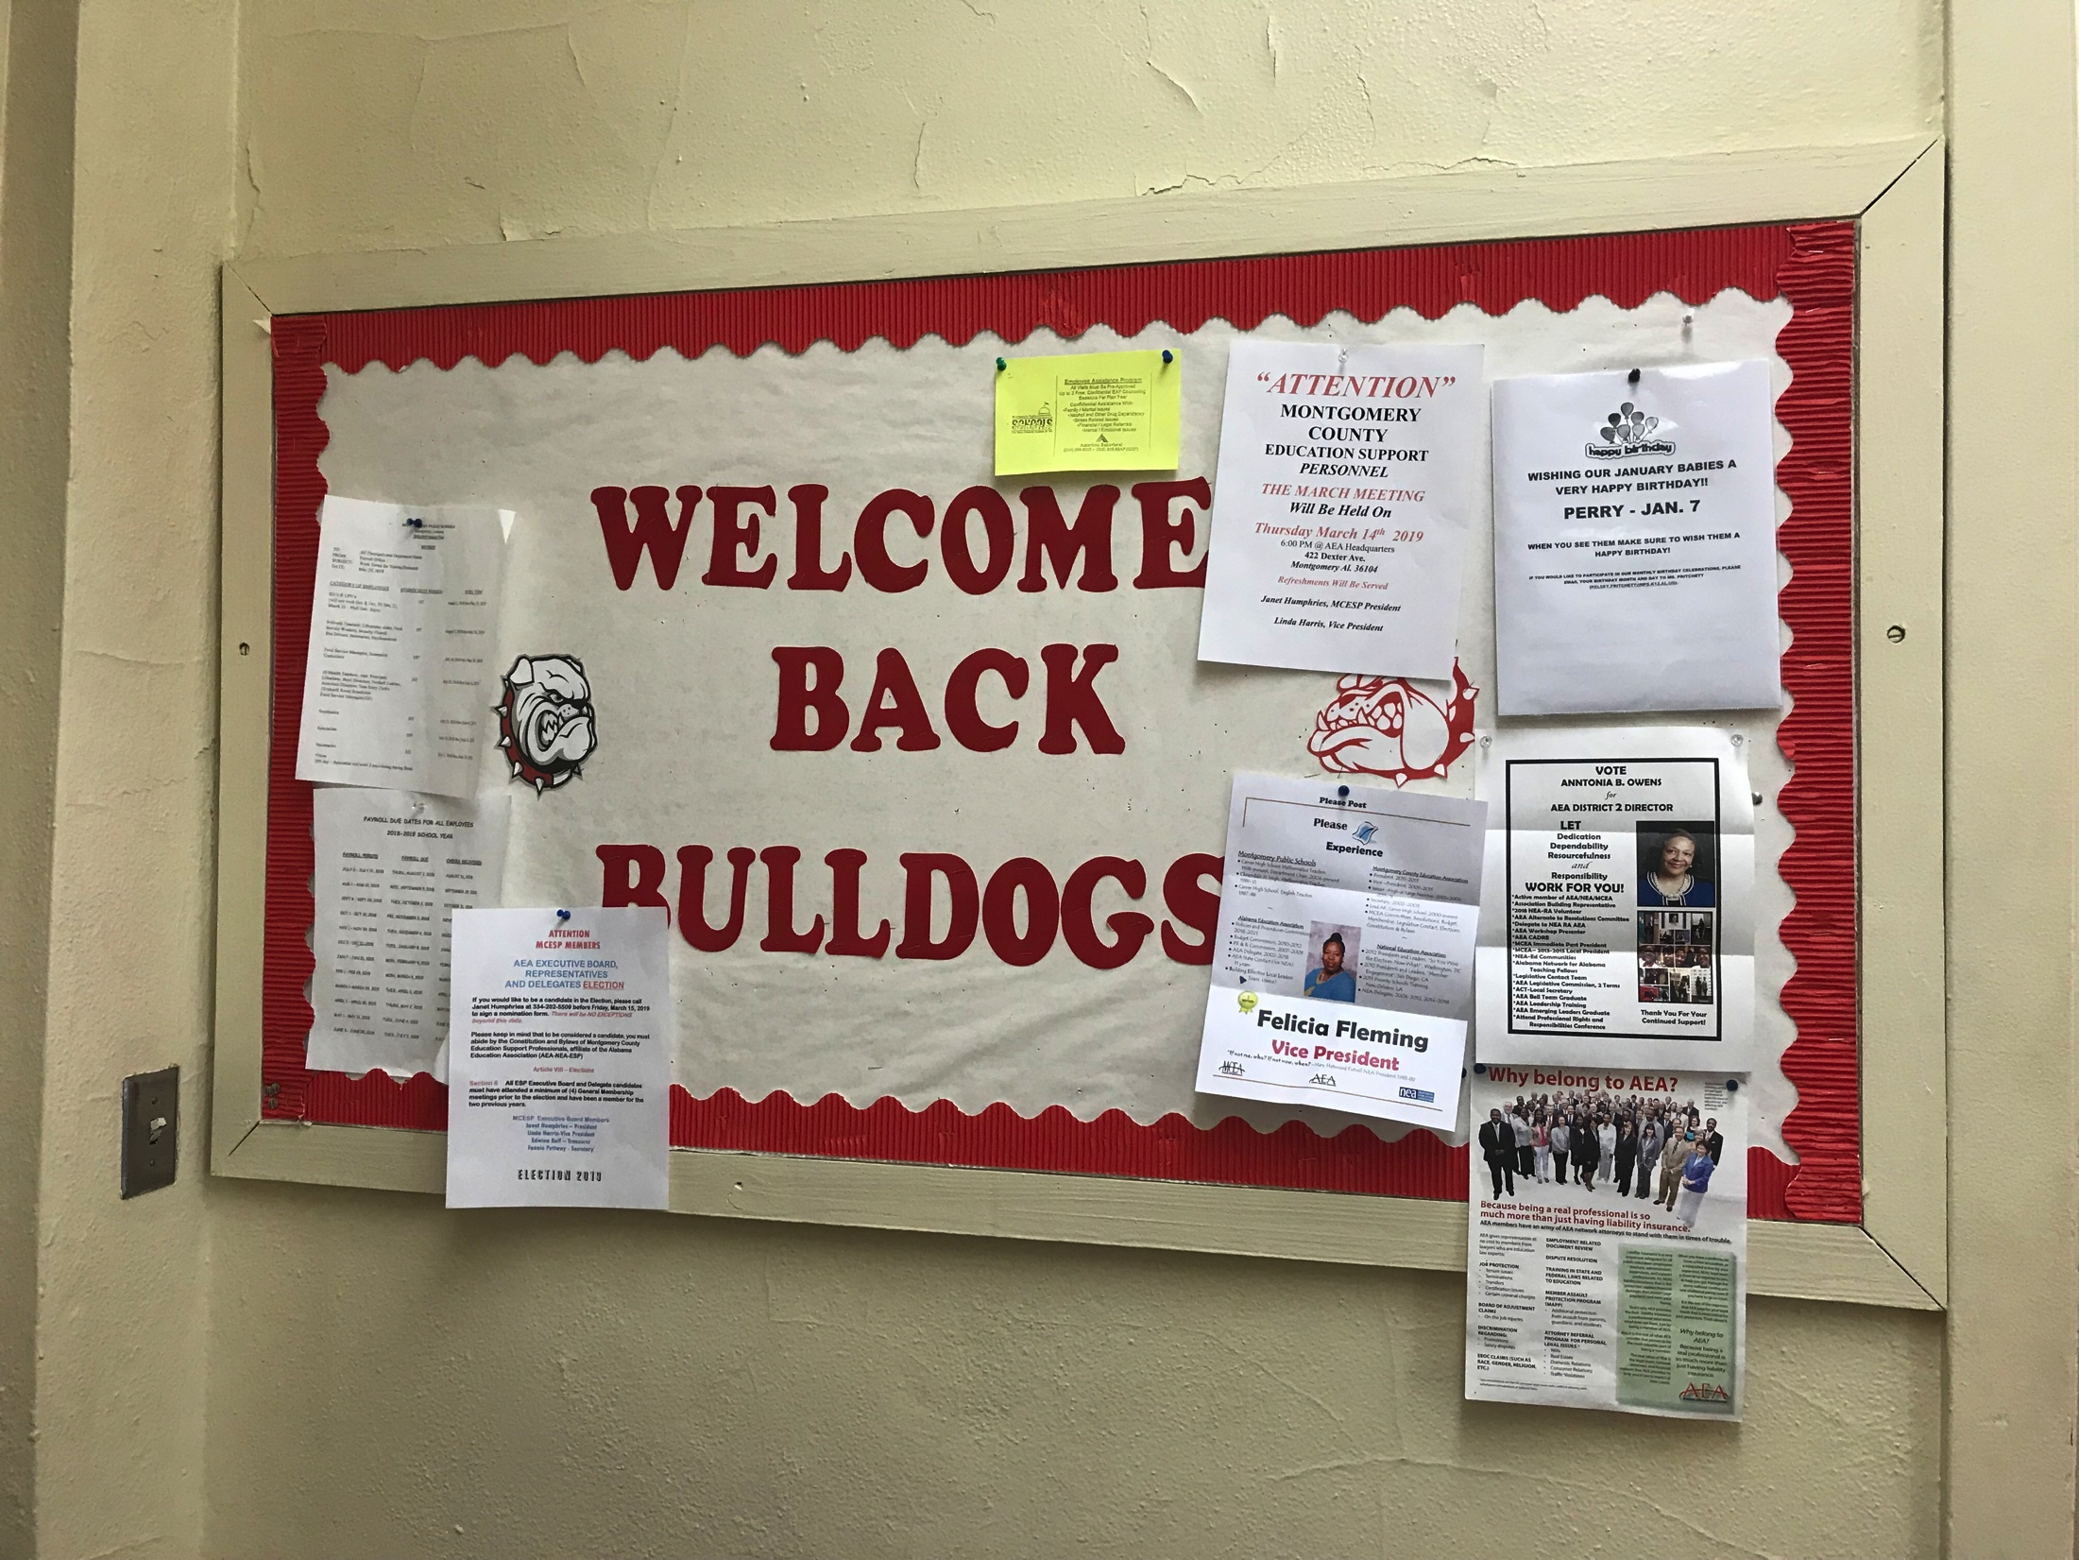
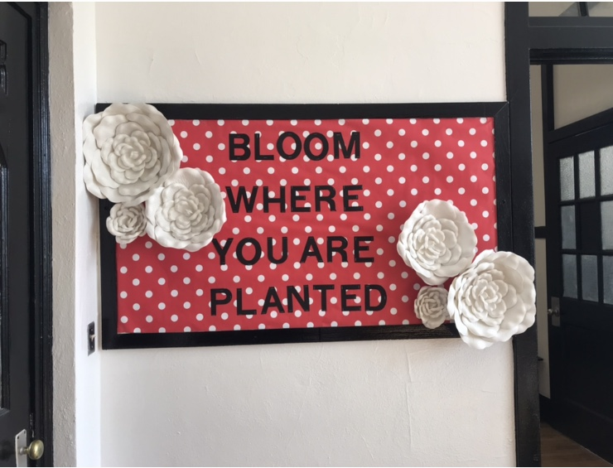
Before & After
Notes:
Mona 3 mins

Slide 31
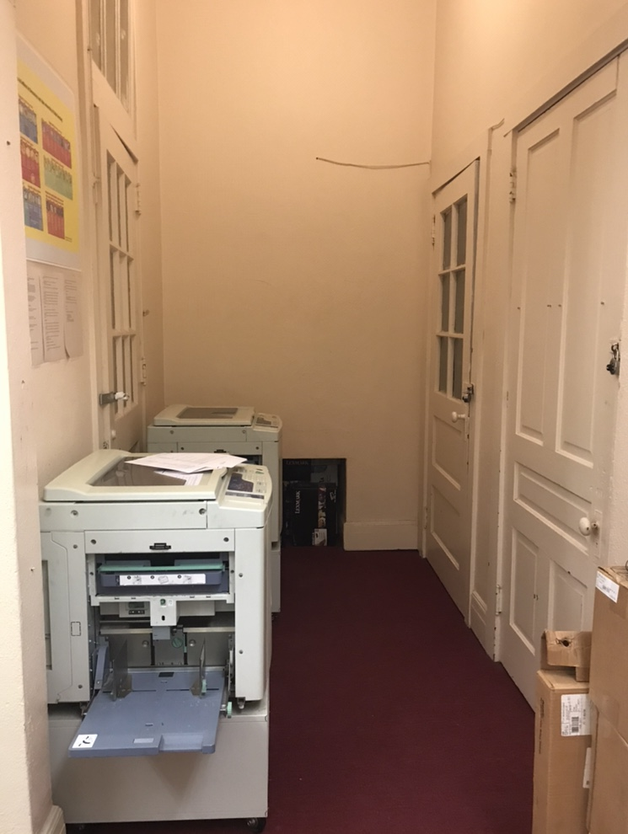
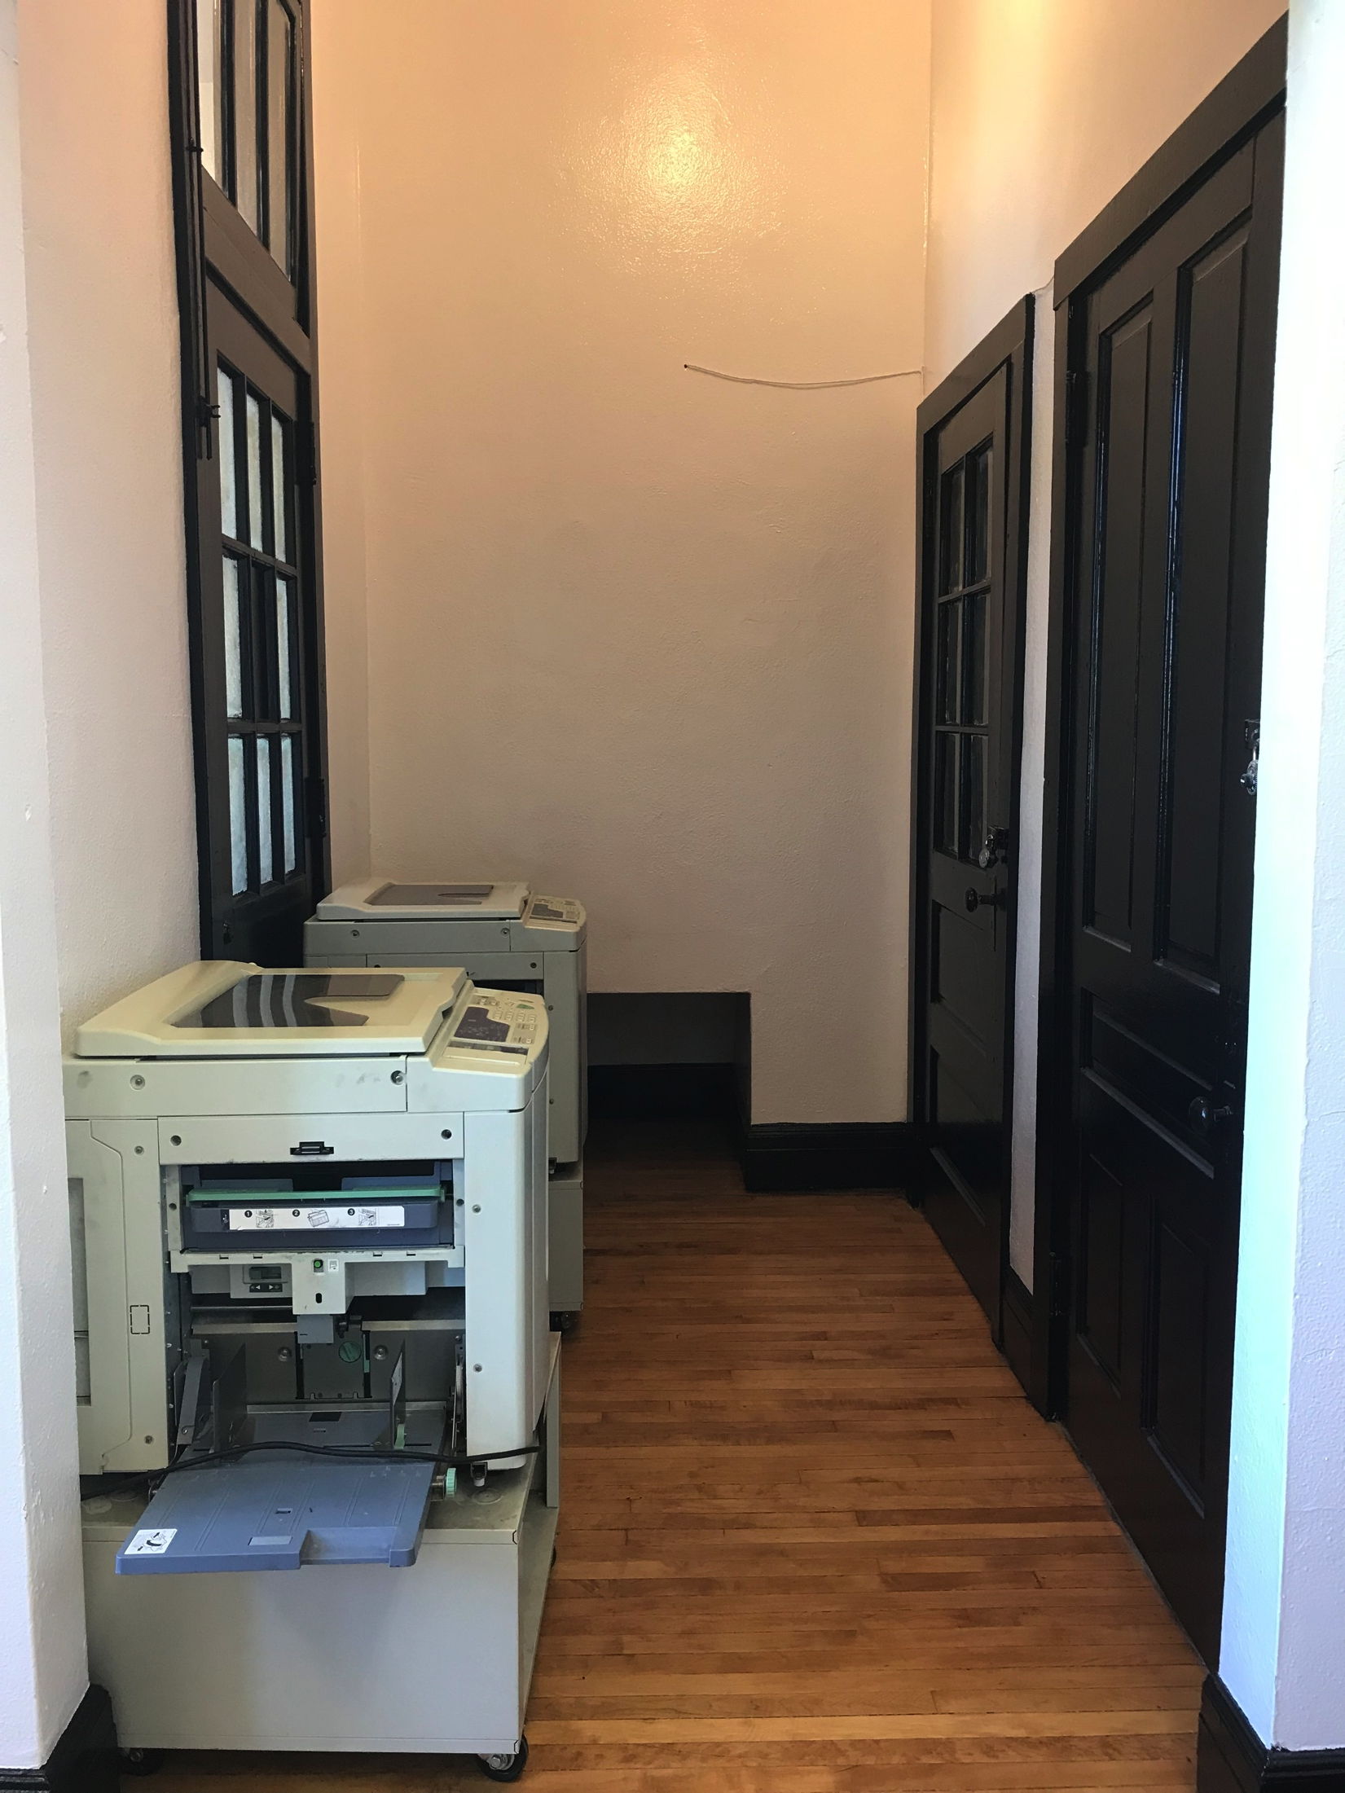
Before & After
Notes:
Mona 3 mins

Slide 32
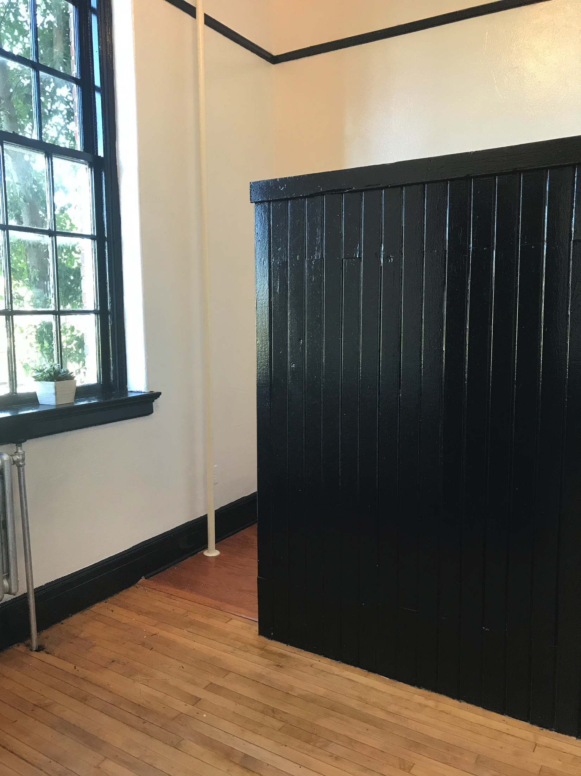
Before & After
Notes:
Mona 3 mins

Slide 33
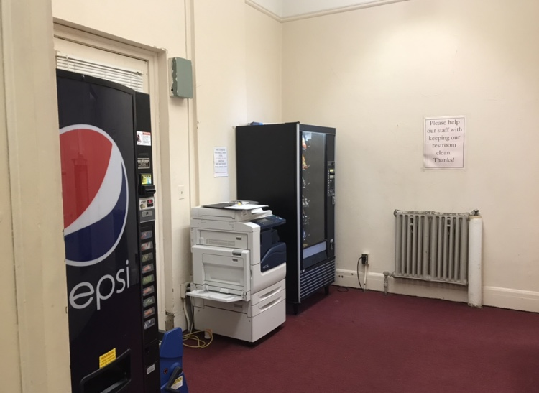
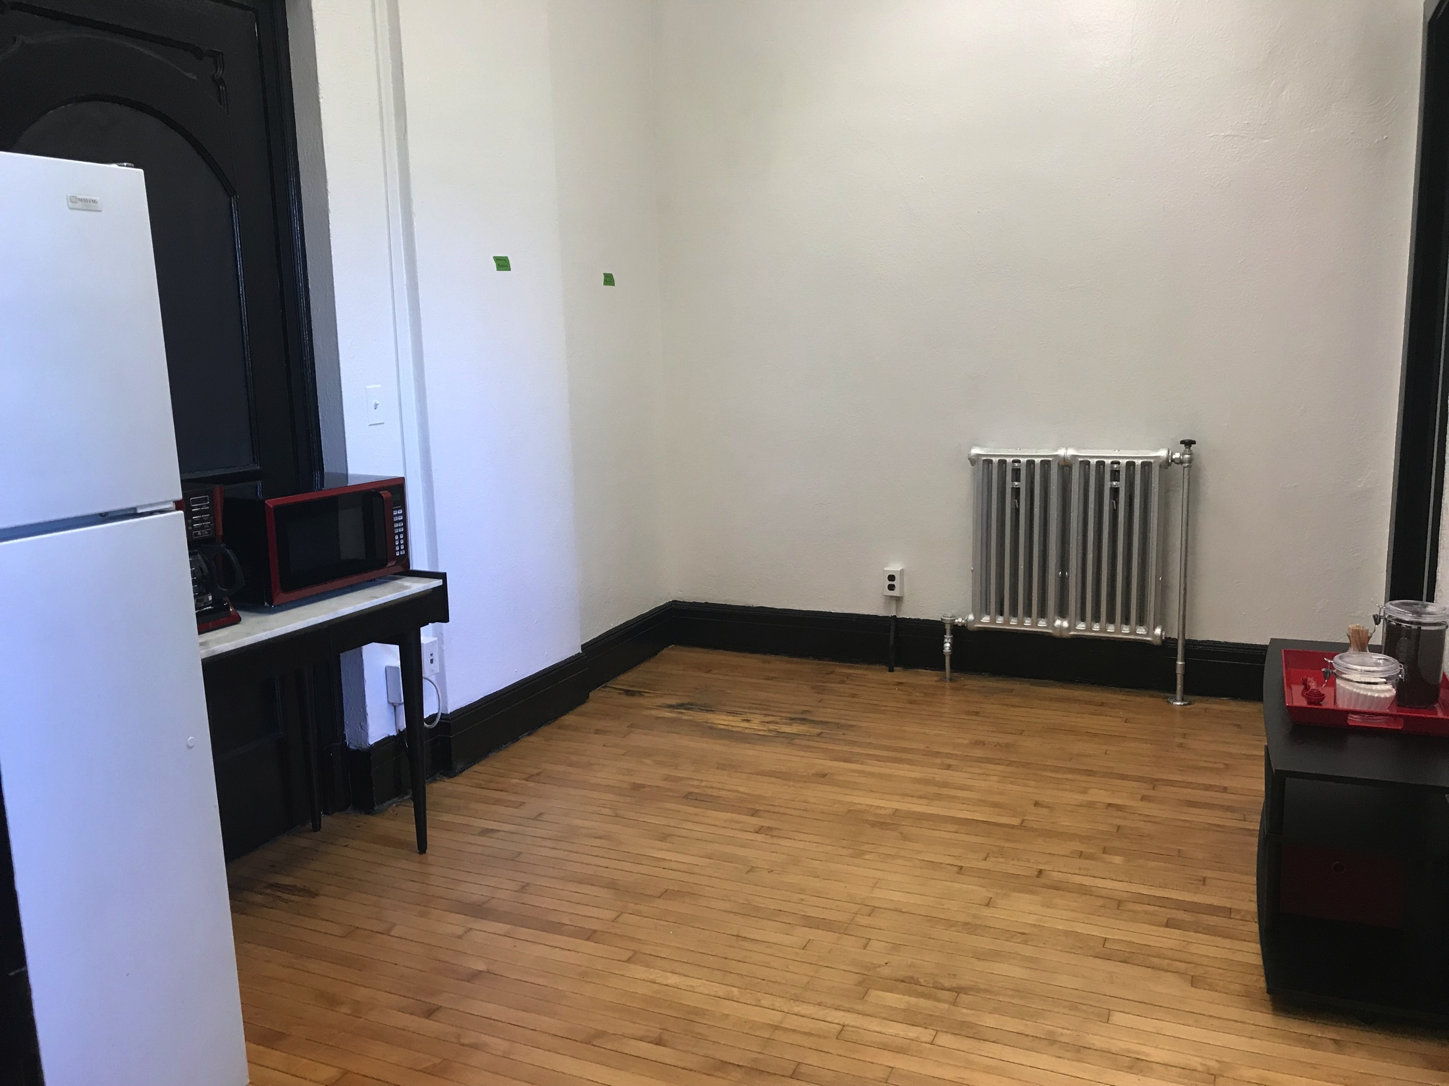
Before & After
Notes:
Mona 3 mins

Slide 34
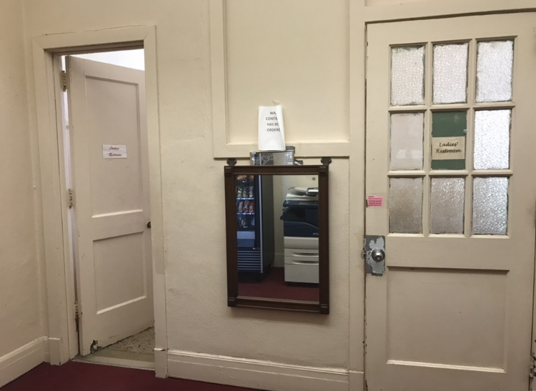
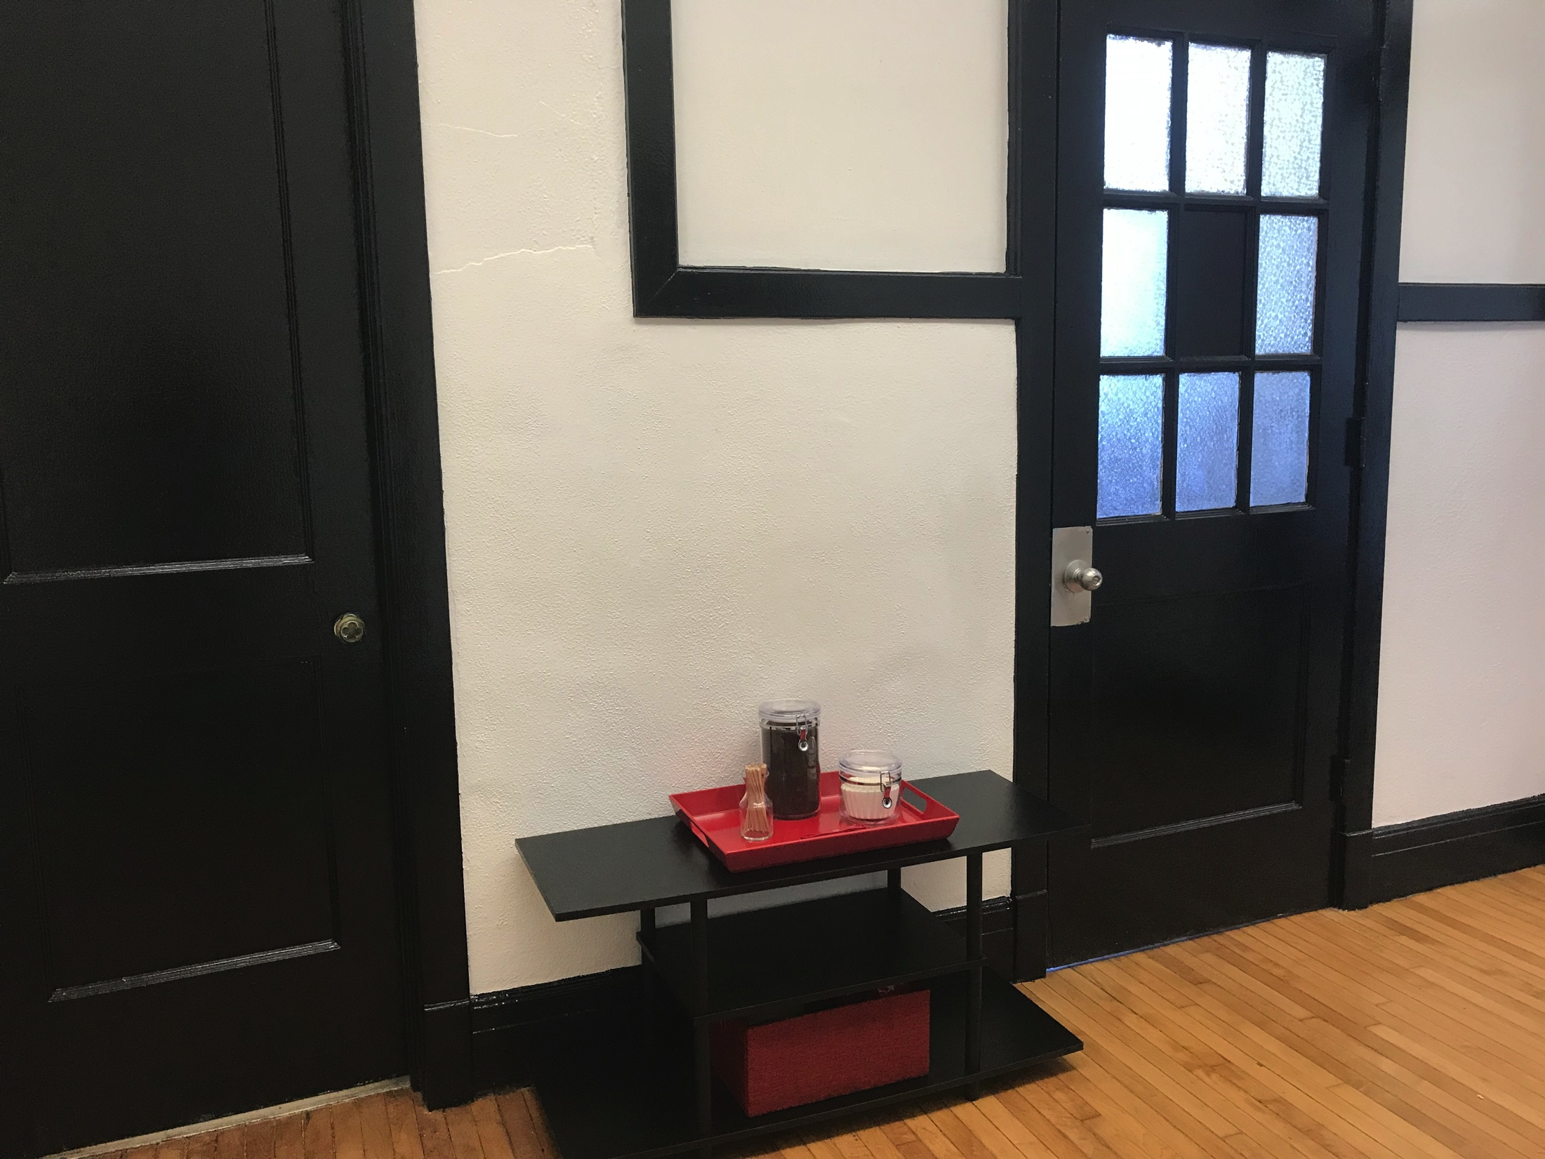
Before & After
Notes:
Mona 3 mins

Slide 35
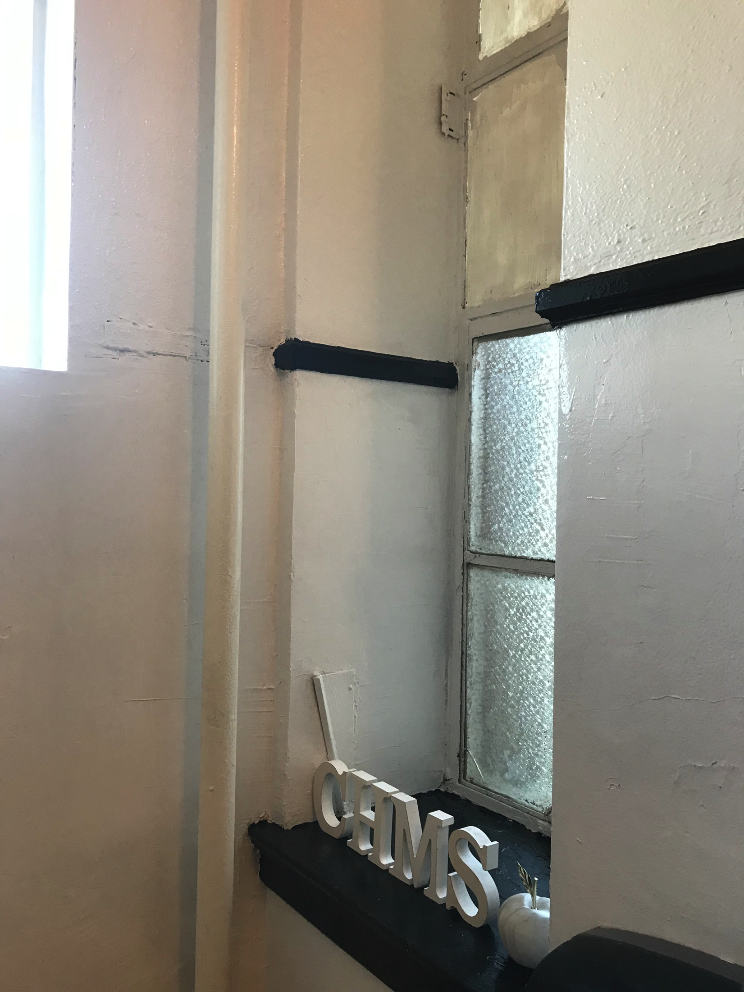
Before & After
Notes:
Mona 3 mins

Slide 36
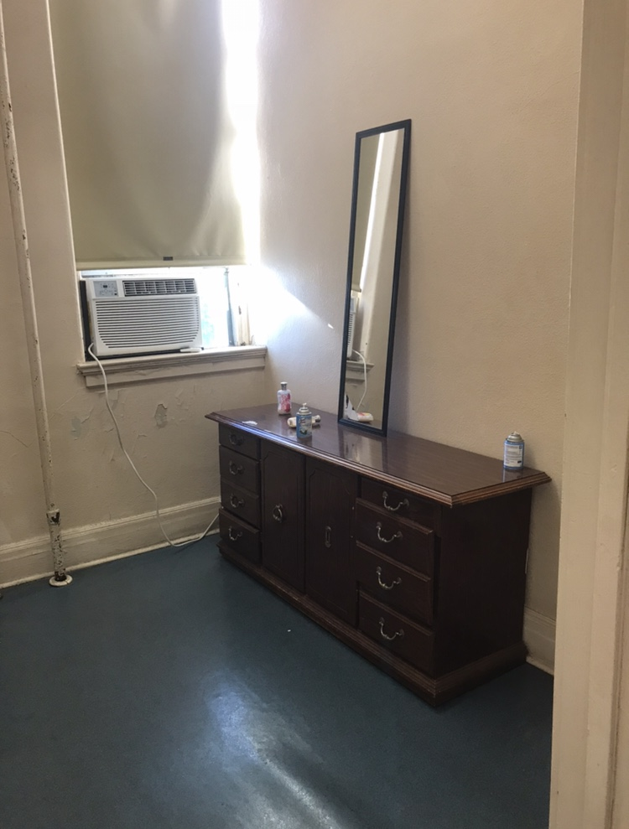
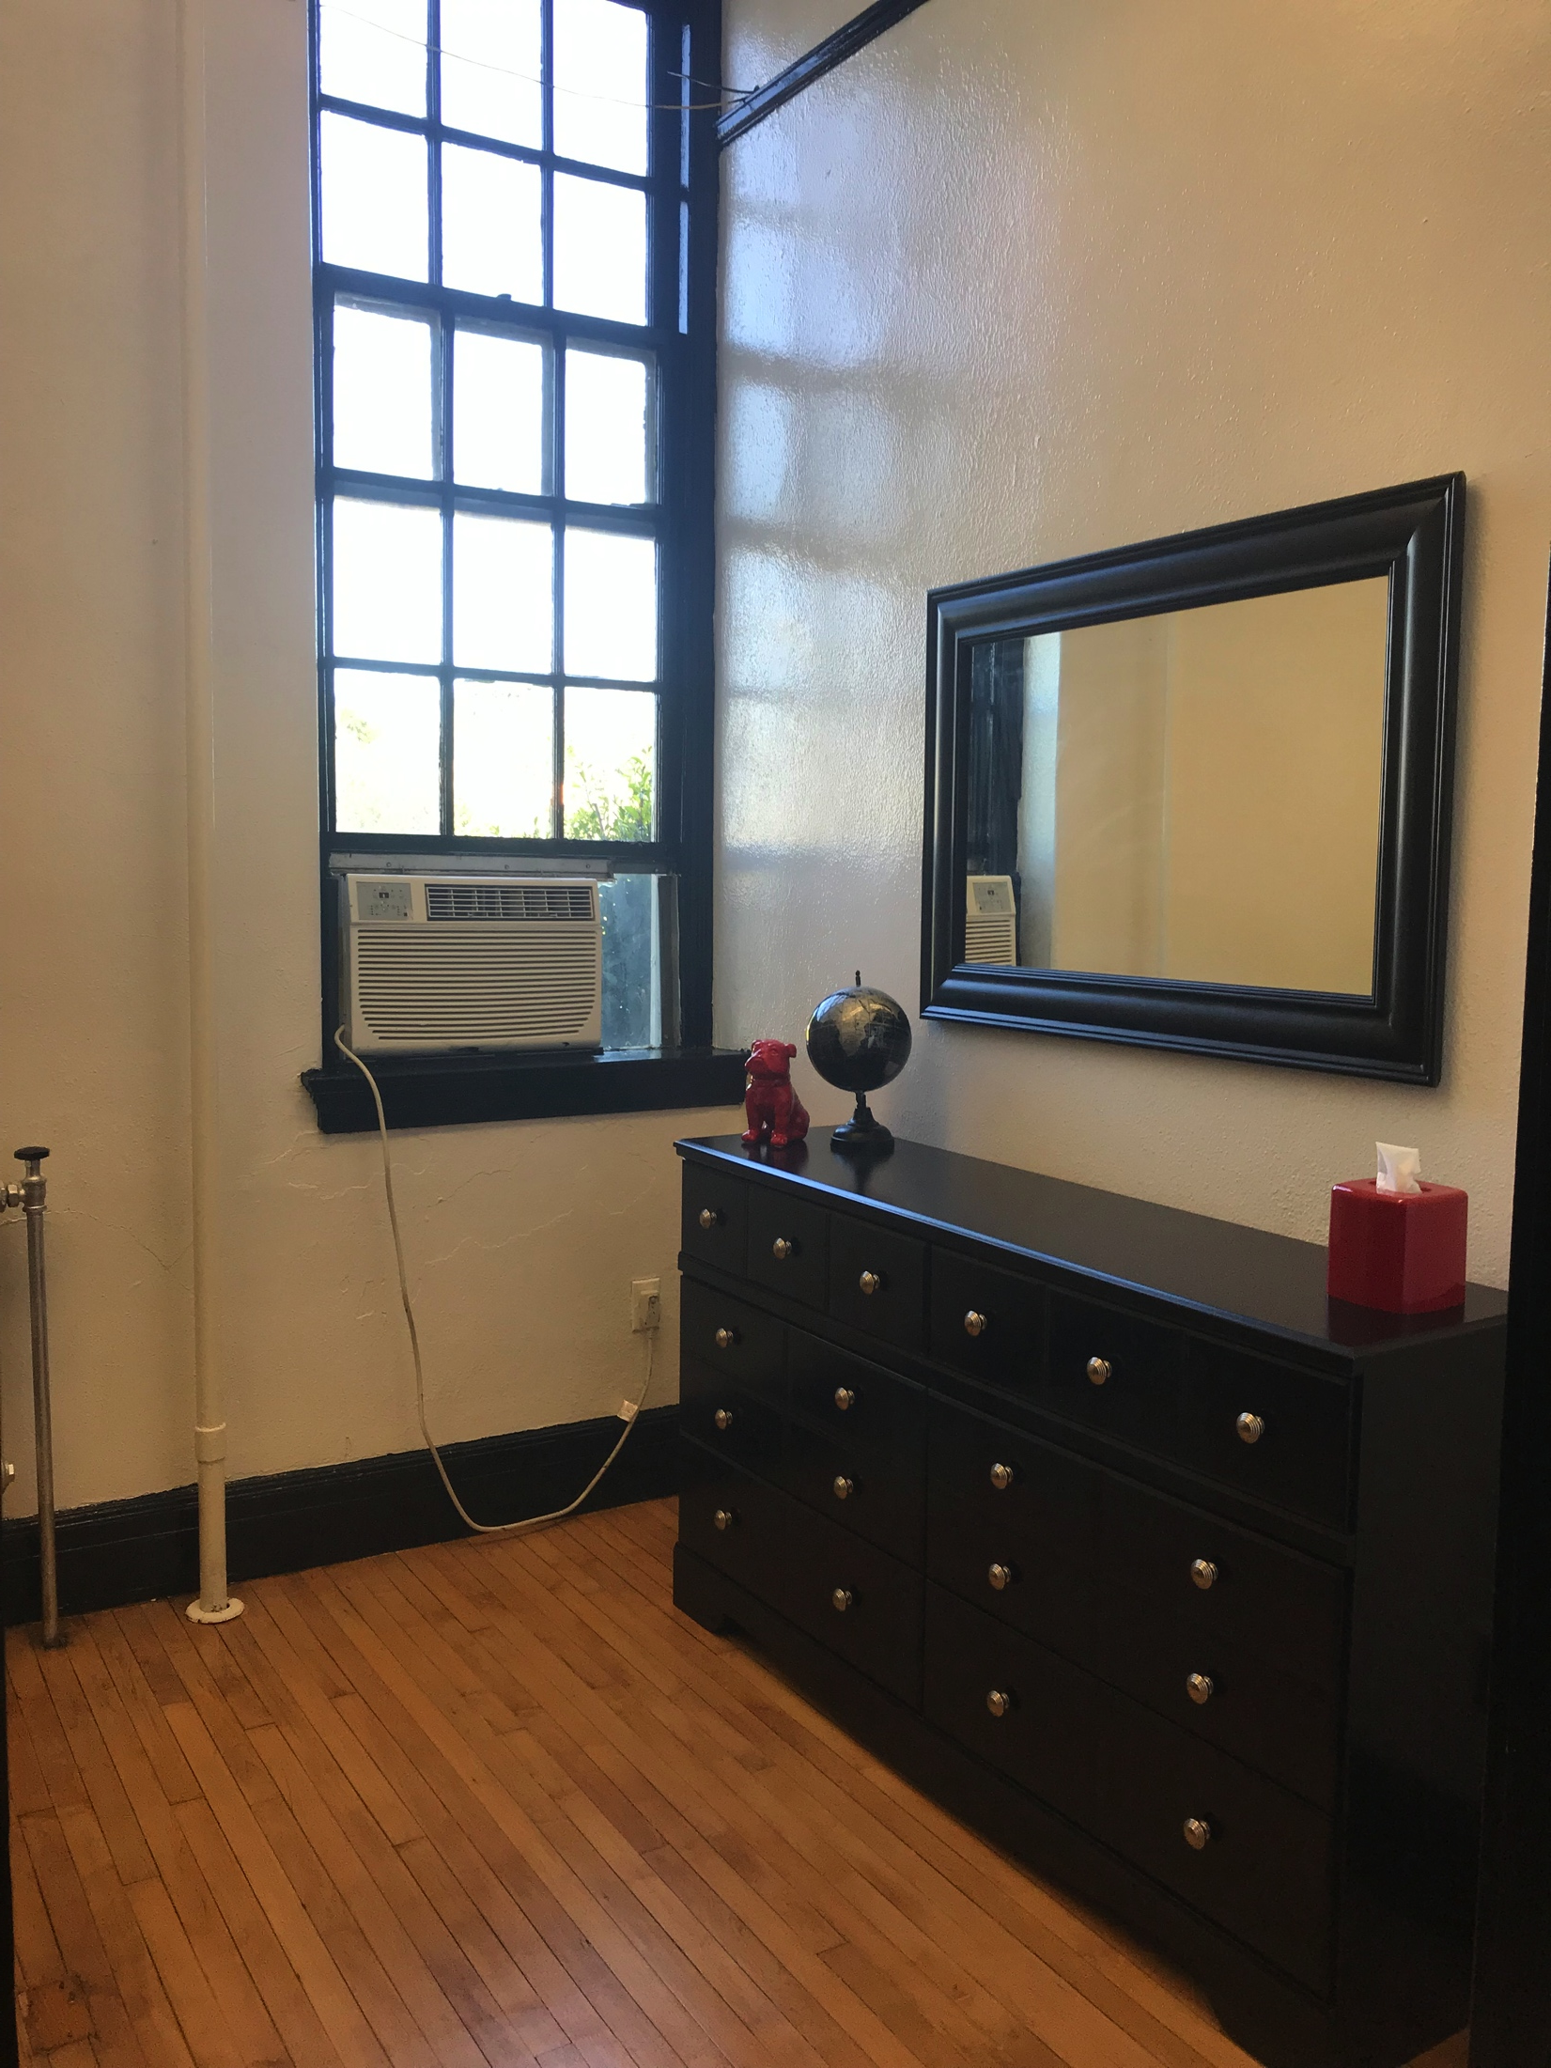
Before & After
Notes:
Mona 3 mins

Slide 37
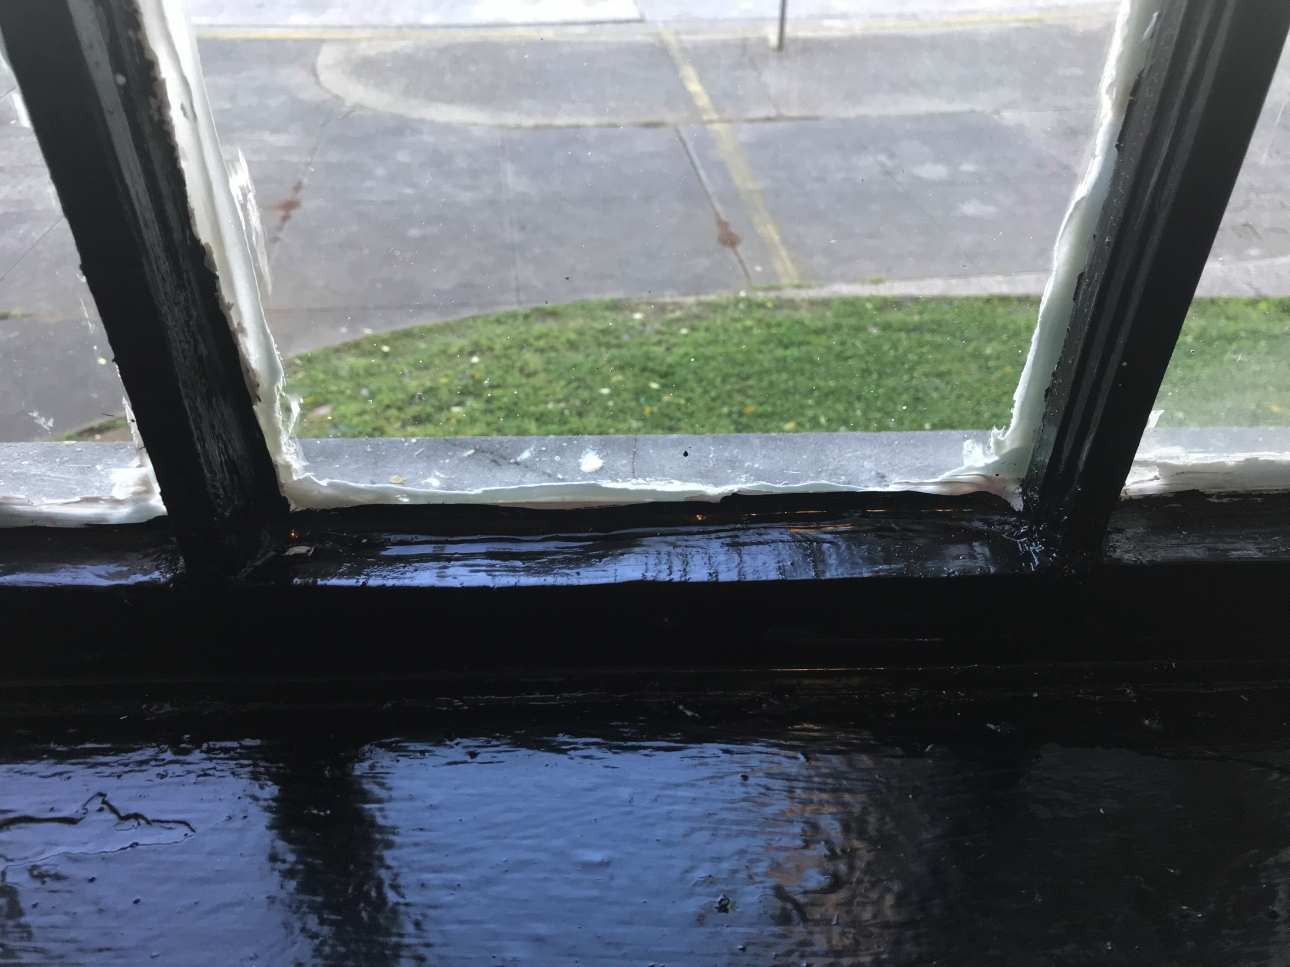
Before & After
Notes:
Mona 3 mins

Slide 38
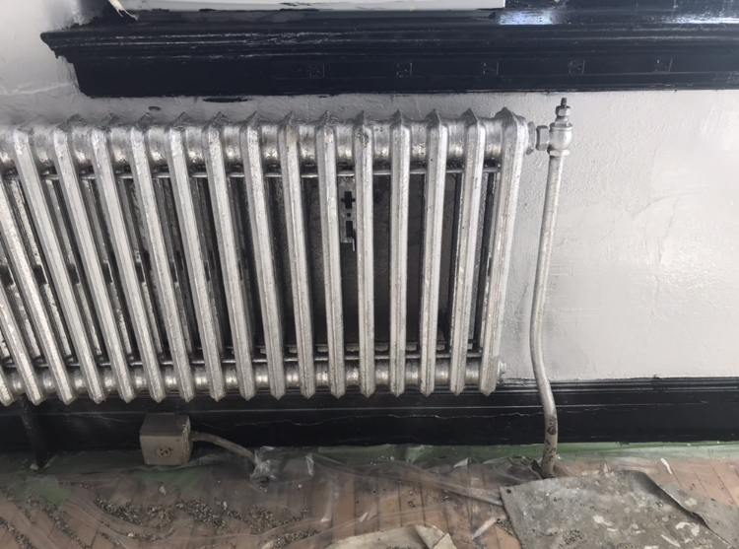
Before & After
Notes:
Mona 3 mins

Slide 39
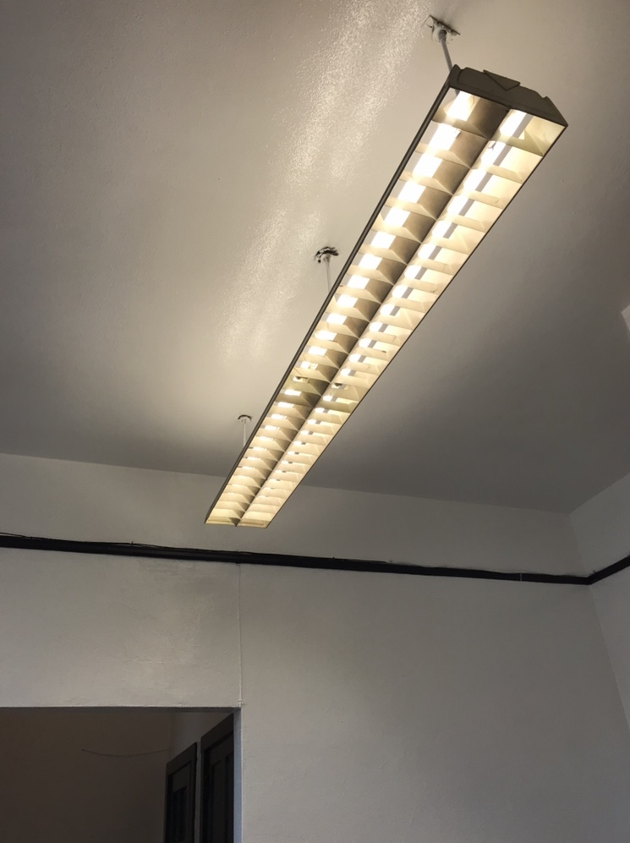
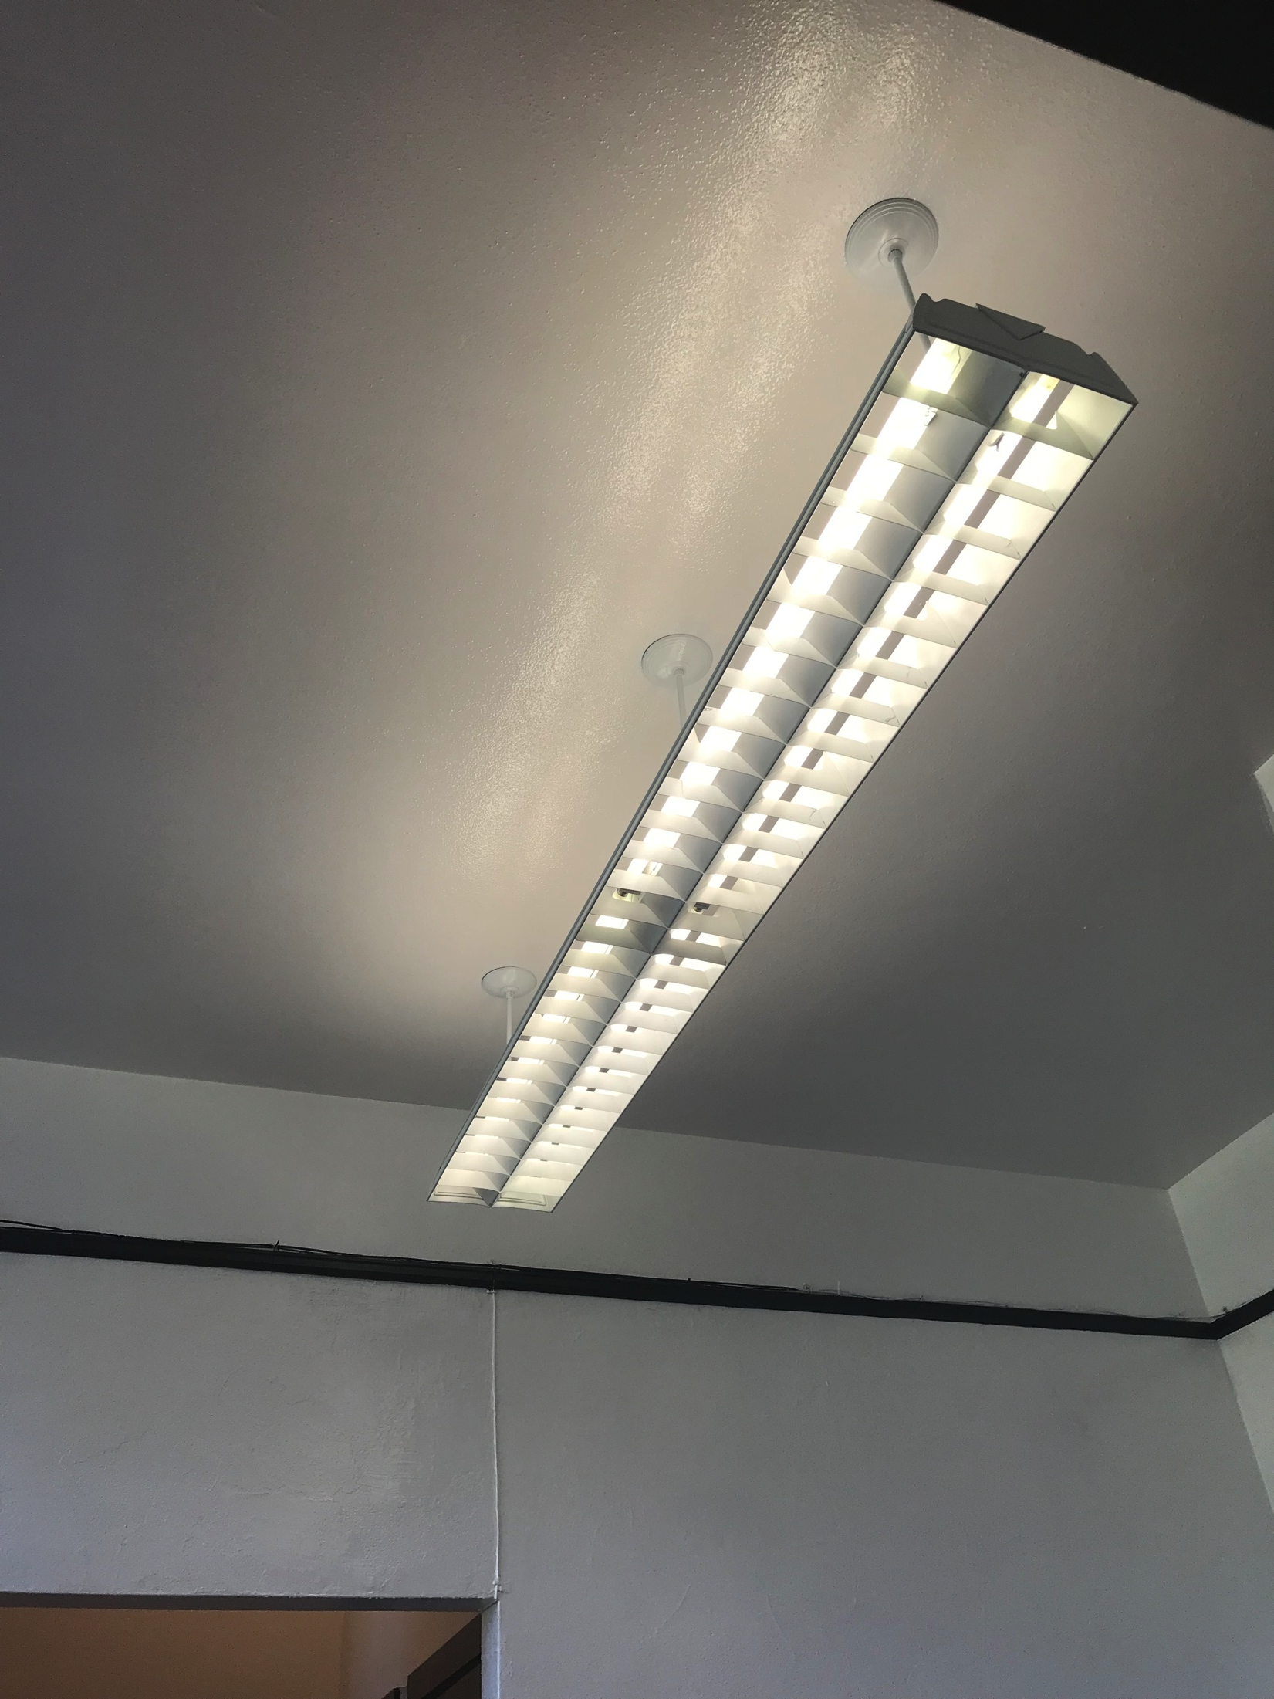
Before & After
Notes:
Mona 3 mins

Slide 40
Before & After
Notes:
Mona 3 mins

Slide 41
Before & After

Slide 42
The Open House – CHMS Staff

Slide 43
The Open House Donors & Community Partners

Slide 44
Final Thoughts & Challenge
We don’t want this renovation to stop in this room.
We don’t want this renovation to stop in this school.
Many people want change. How will we give them concrete ways to contribute?
How will you contribute?
Notes:
Brian 3 mins (These were a few thoughts we all discussed as a group. Feel free to add to it or change it.)
We should give thanks to people involve.

