Slide 1
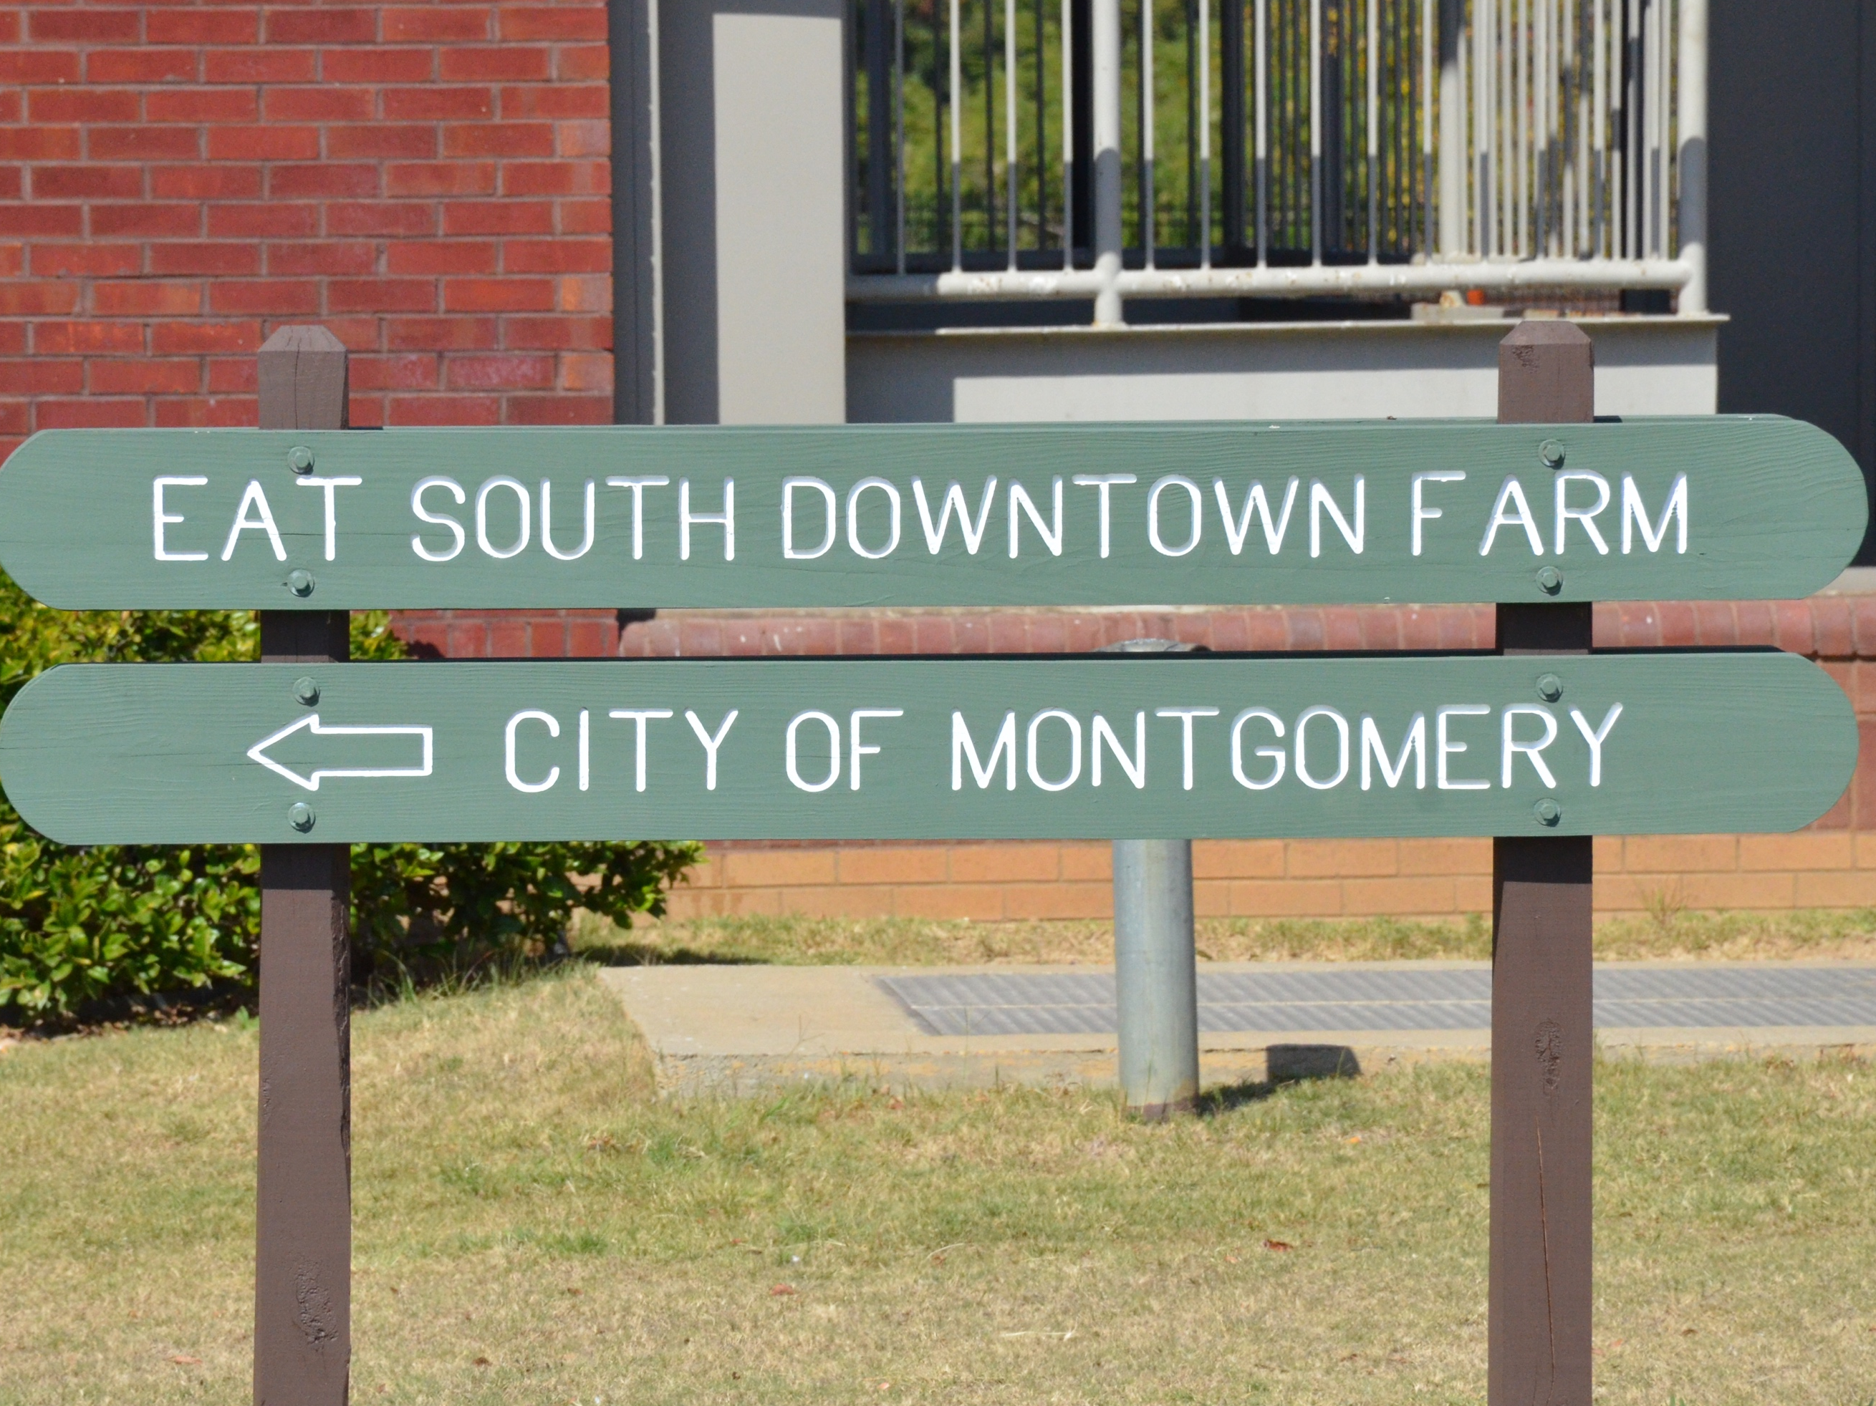
E.A.T South
Project Team 4

Slide 2
Aaron Ganey
Brian Matney
Carlton Avery
Chandalyn Chrzonowski
Cindy Sawyer
James Jackson
Kenny Ward, Jr.
Lindsey Baker
Tamara Hartley

Slide 3
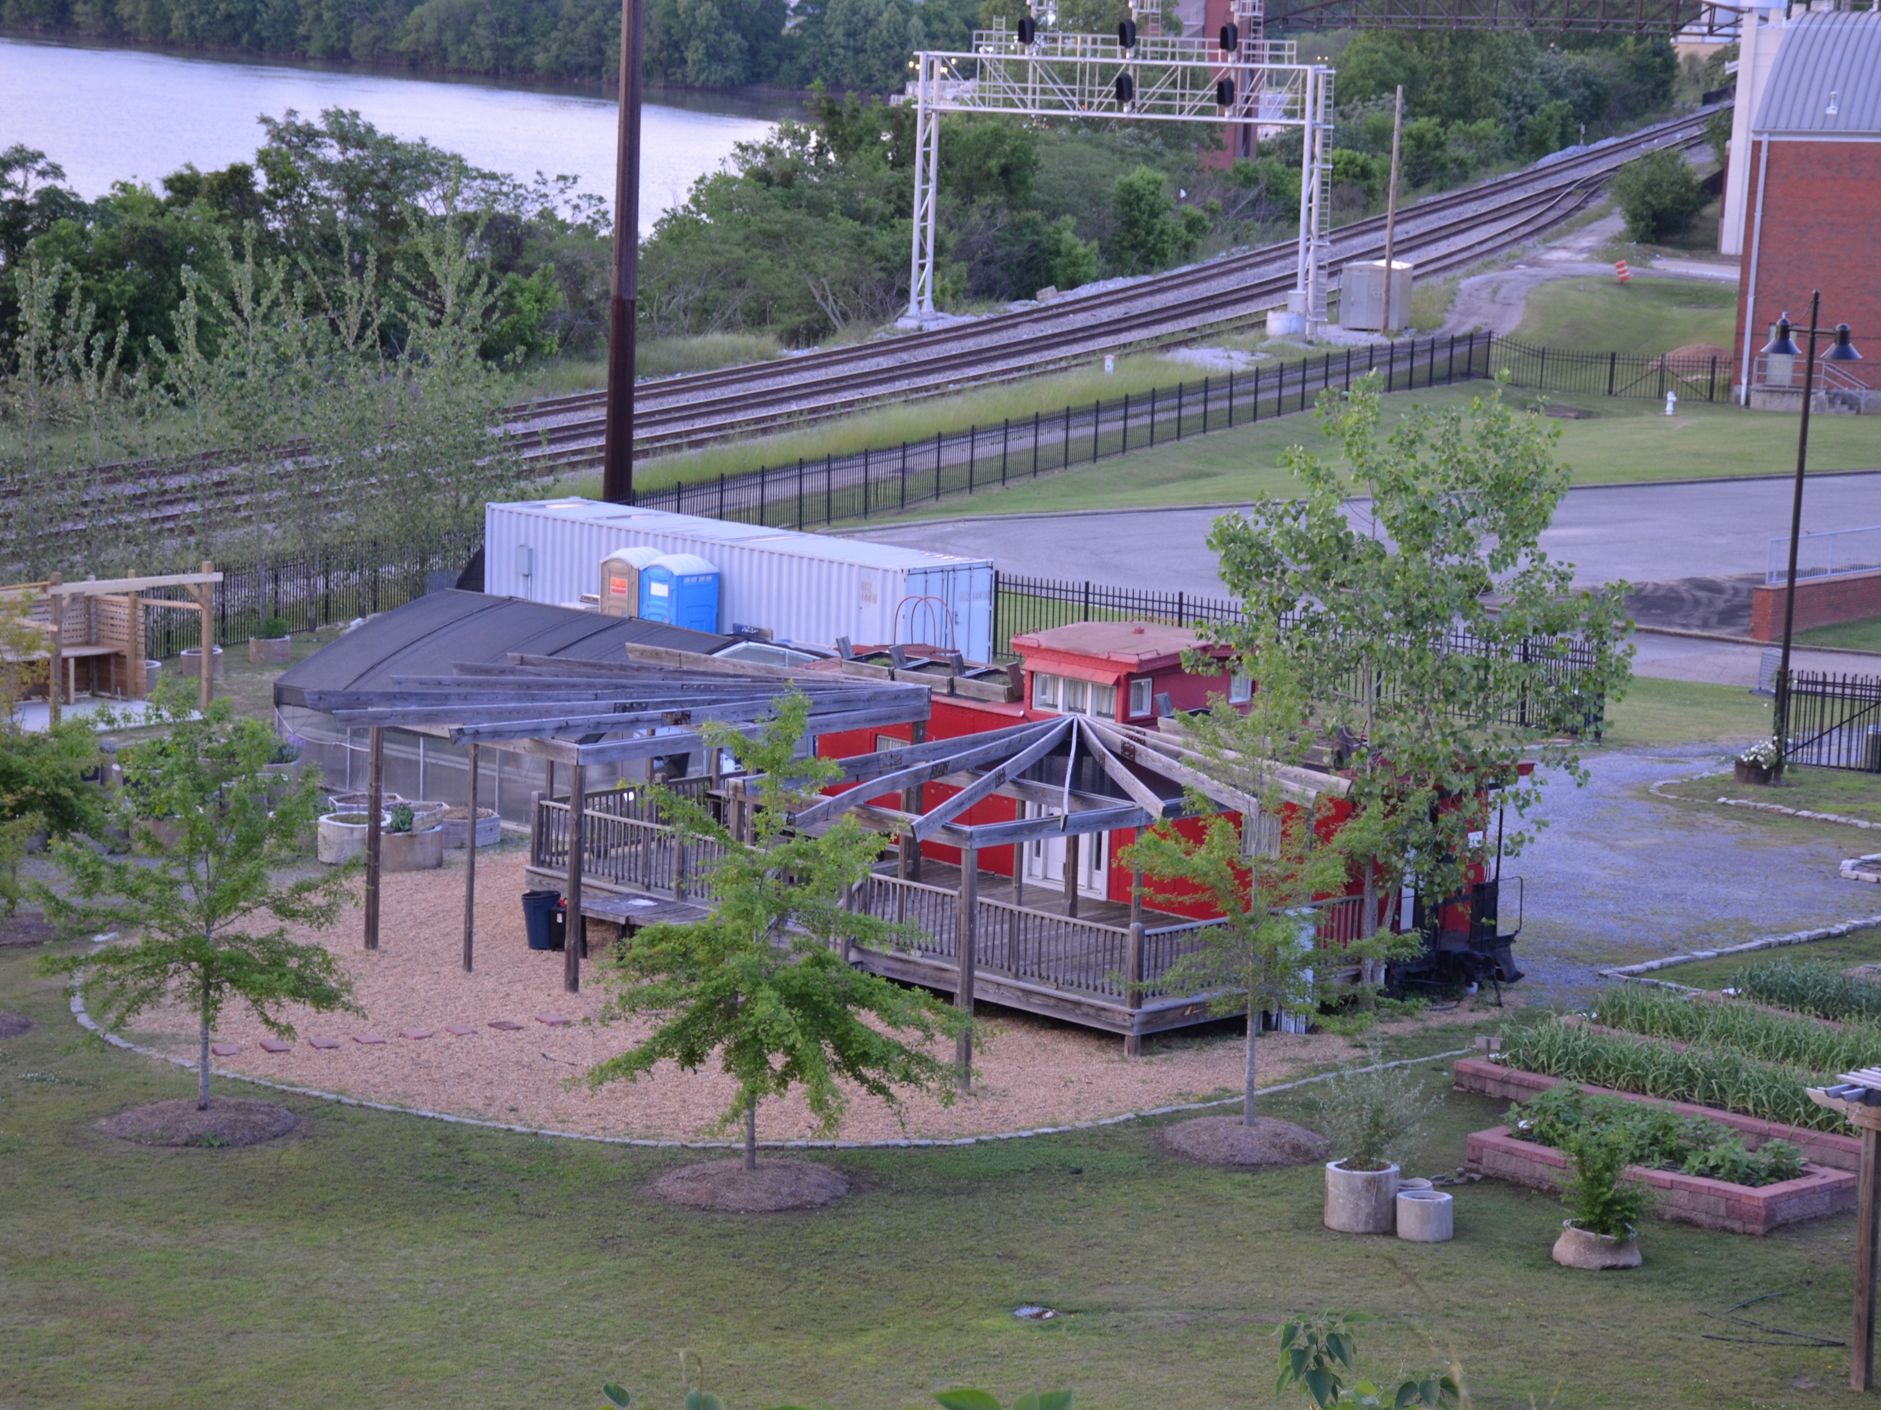
E.A.T South Overview
History
Mission

Slide 4
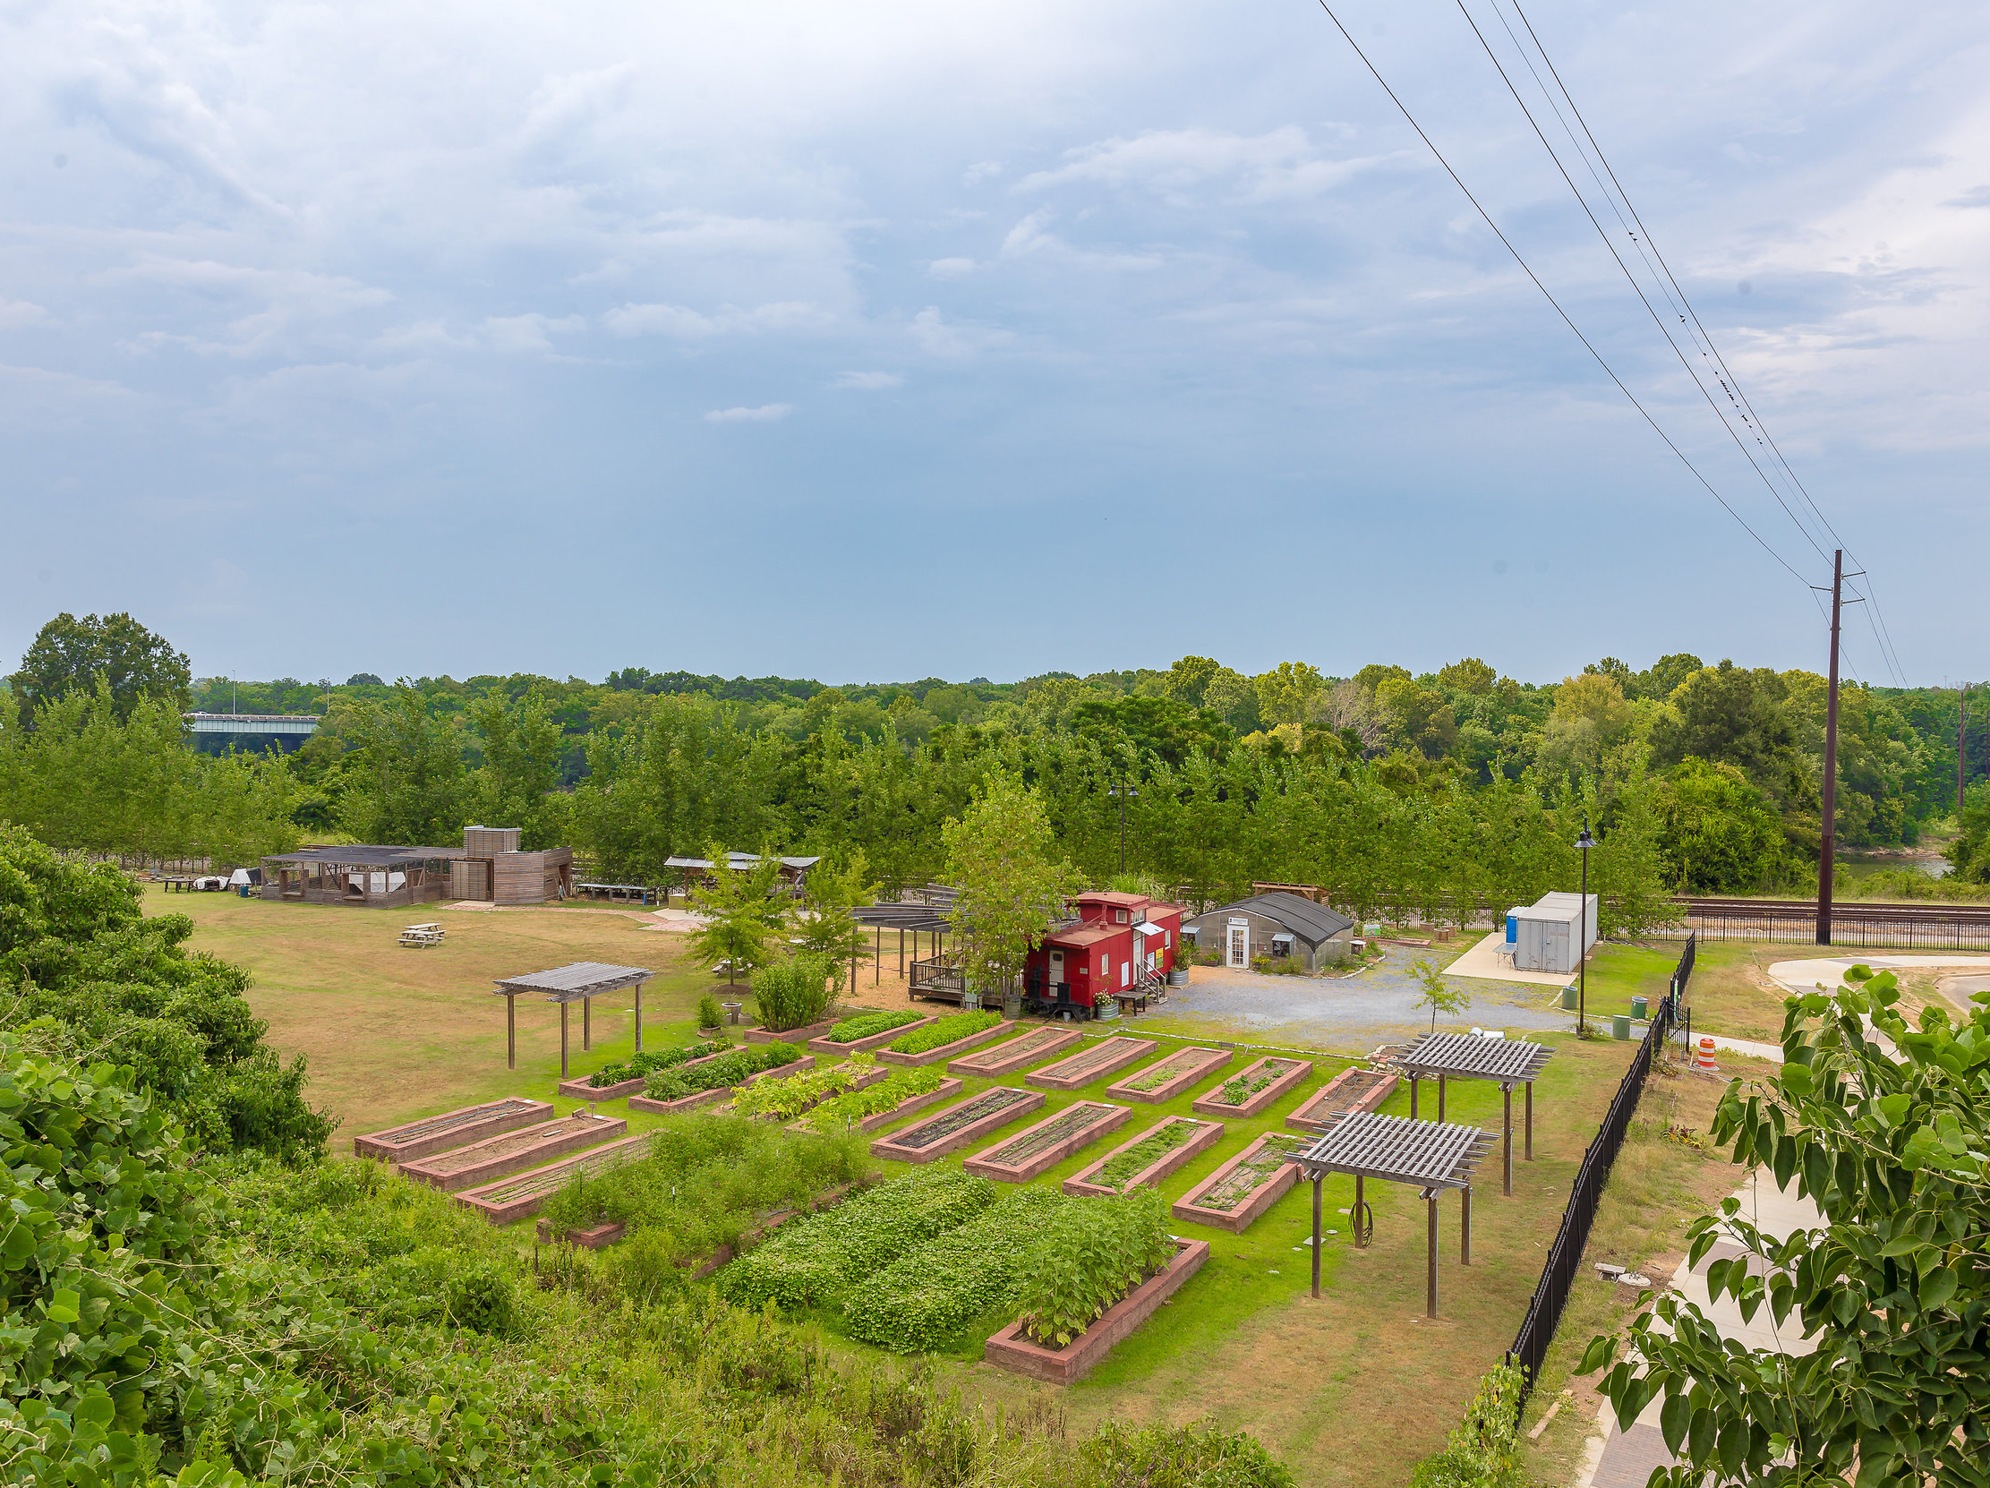
Initial Project Scope
Downtown Farm
Venue Rental
Drainage Issues
Organizational Sustainability

Slide 5
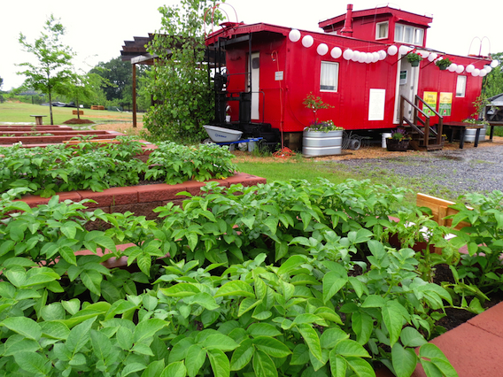
Turnover
Executive Director Change (x2)
Loss of AmeriCorp VISTA workers
Farmer Turnover

Slide 6
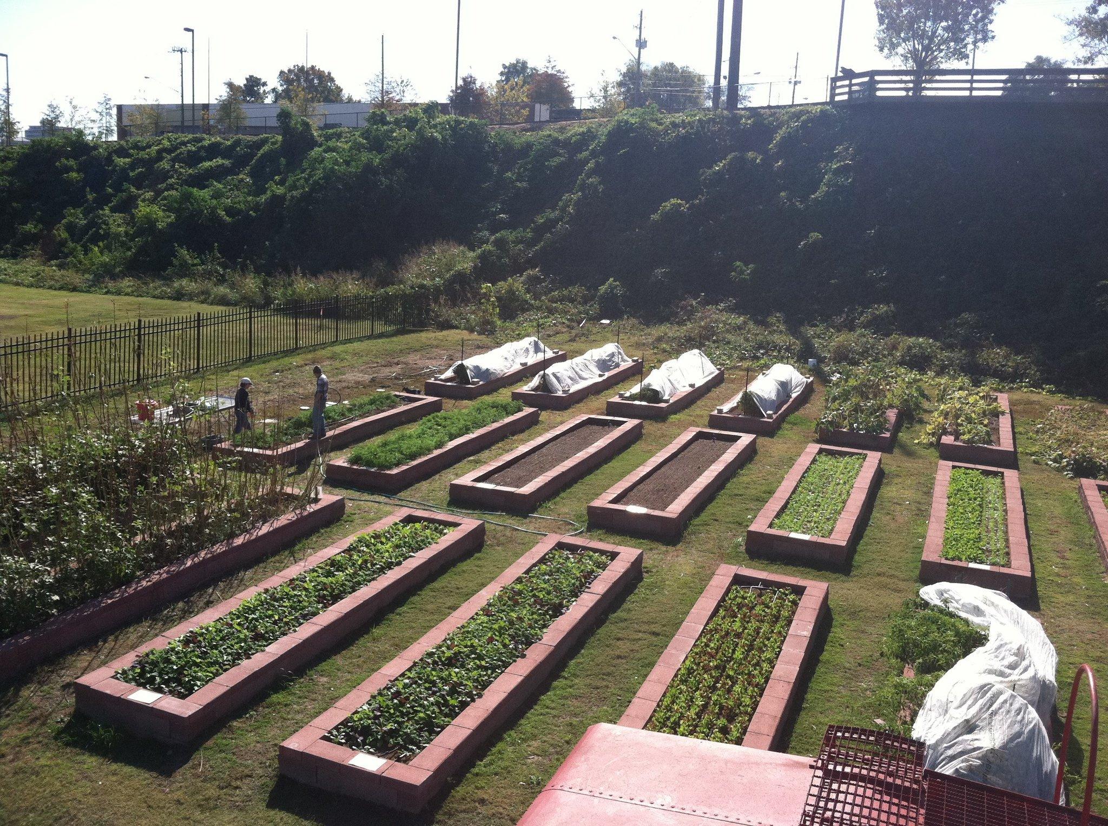
Impacts of Turnover
Less emphasis on becoming a venue space
Project transitioned to providing ideas for the future

Slide 7
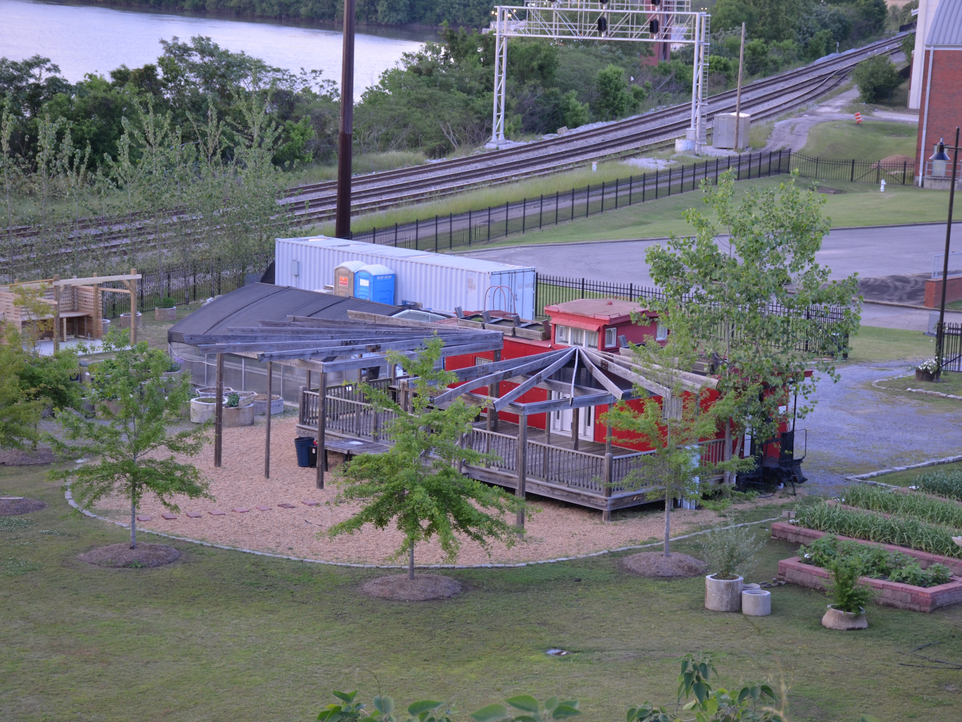
Project takes final shape
Rental agreement assessment
Drainage solutions
AUM Internship
Marketing project
Fundraisers @ the Farm

Slide 8
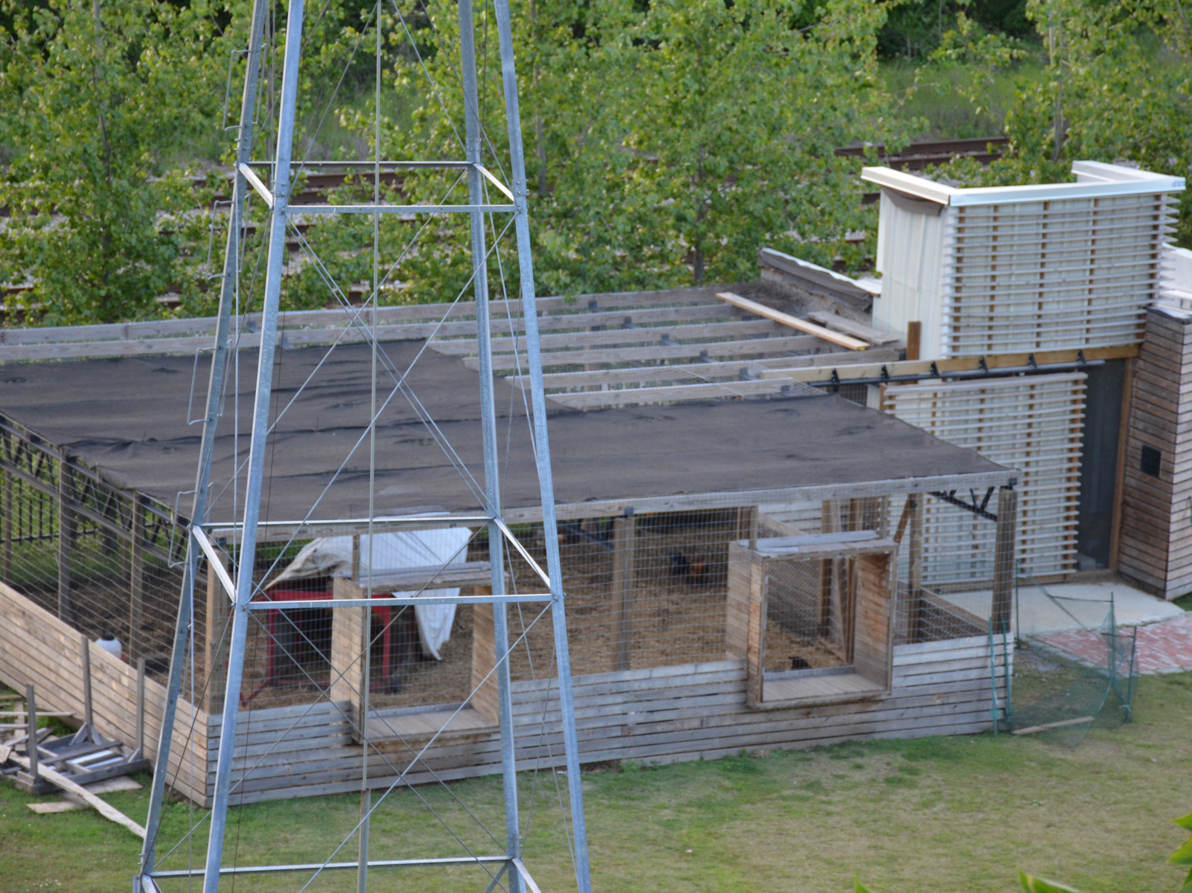
Venue Rental Rate and Analysis
Created a list of other venues with similar outside areas
Collected rental rates

Slide 9
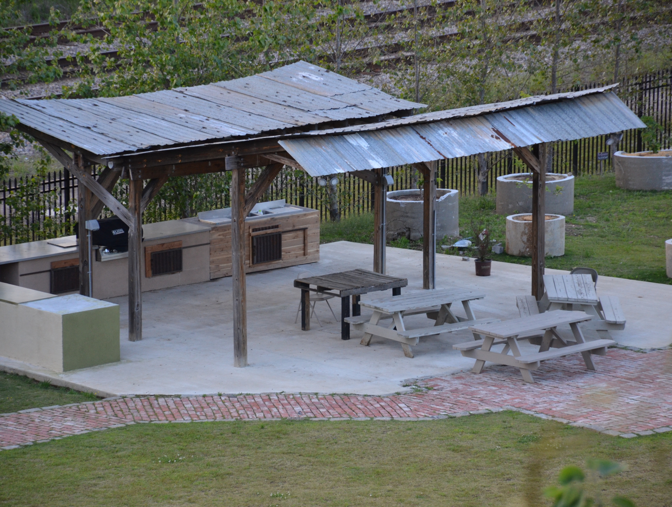
Venue Rental Rate and Analysis
New purposed rates
Weeknights rental $375- $500
Saturday or Sunday rental (full day) $800- $1,000
Saturday or Sunday rental (half day) $500- $750
Revisit rental rates once amenities have been added
Benefits to becoming a venue
Generate more exposure for there mission
Create revenue
Heighten awareness of there existence

Slide 10
Drainage Assessment
Attendees
Max Vaughn, PE – Goodwyn|Mills|Cawood
Clint Mitchell - Goodwyn|Mills|Cawood
Jetson Brown - E.A.T South
Sara Byard – E.A.T South
James P. Jackson – Torchbearers Class 8

Slide 11
Goodwyn|Mills|Cawood
Max Vaughn PE Civil Engineering
Initial assessment June 3, 2016
Recommendation Received 8/6/2016:
Installation of a 4” underdrain on a slight down grade within raised beds
Outlet into the ditch north of the facility.
Minimum installation depth of 12” for the line
Avoid the irrigation and electrical lines (Eat South pipe configuration not available)
Backfill the pipe with the pea gravel and cover with soil from digging the trench.
Projected Material Expense: $500

Slide 12
THE PLAN

Slide 13
Drainage Project Challenges
Water Flooding Beds
Underground Utilities Not Marked
Irrigation Schematic Unavailable
Geo Mat Installed 8 inches Deep
Mechanical Trencher may compromise Geo Mat (20+ shovel ready volunteers )
Soil Test Required
Environmental Concerns
Material to be Ordered by EAT South
Tabled by EAT South

Slide 14
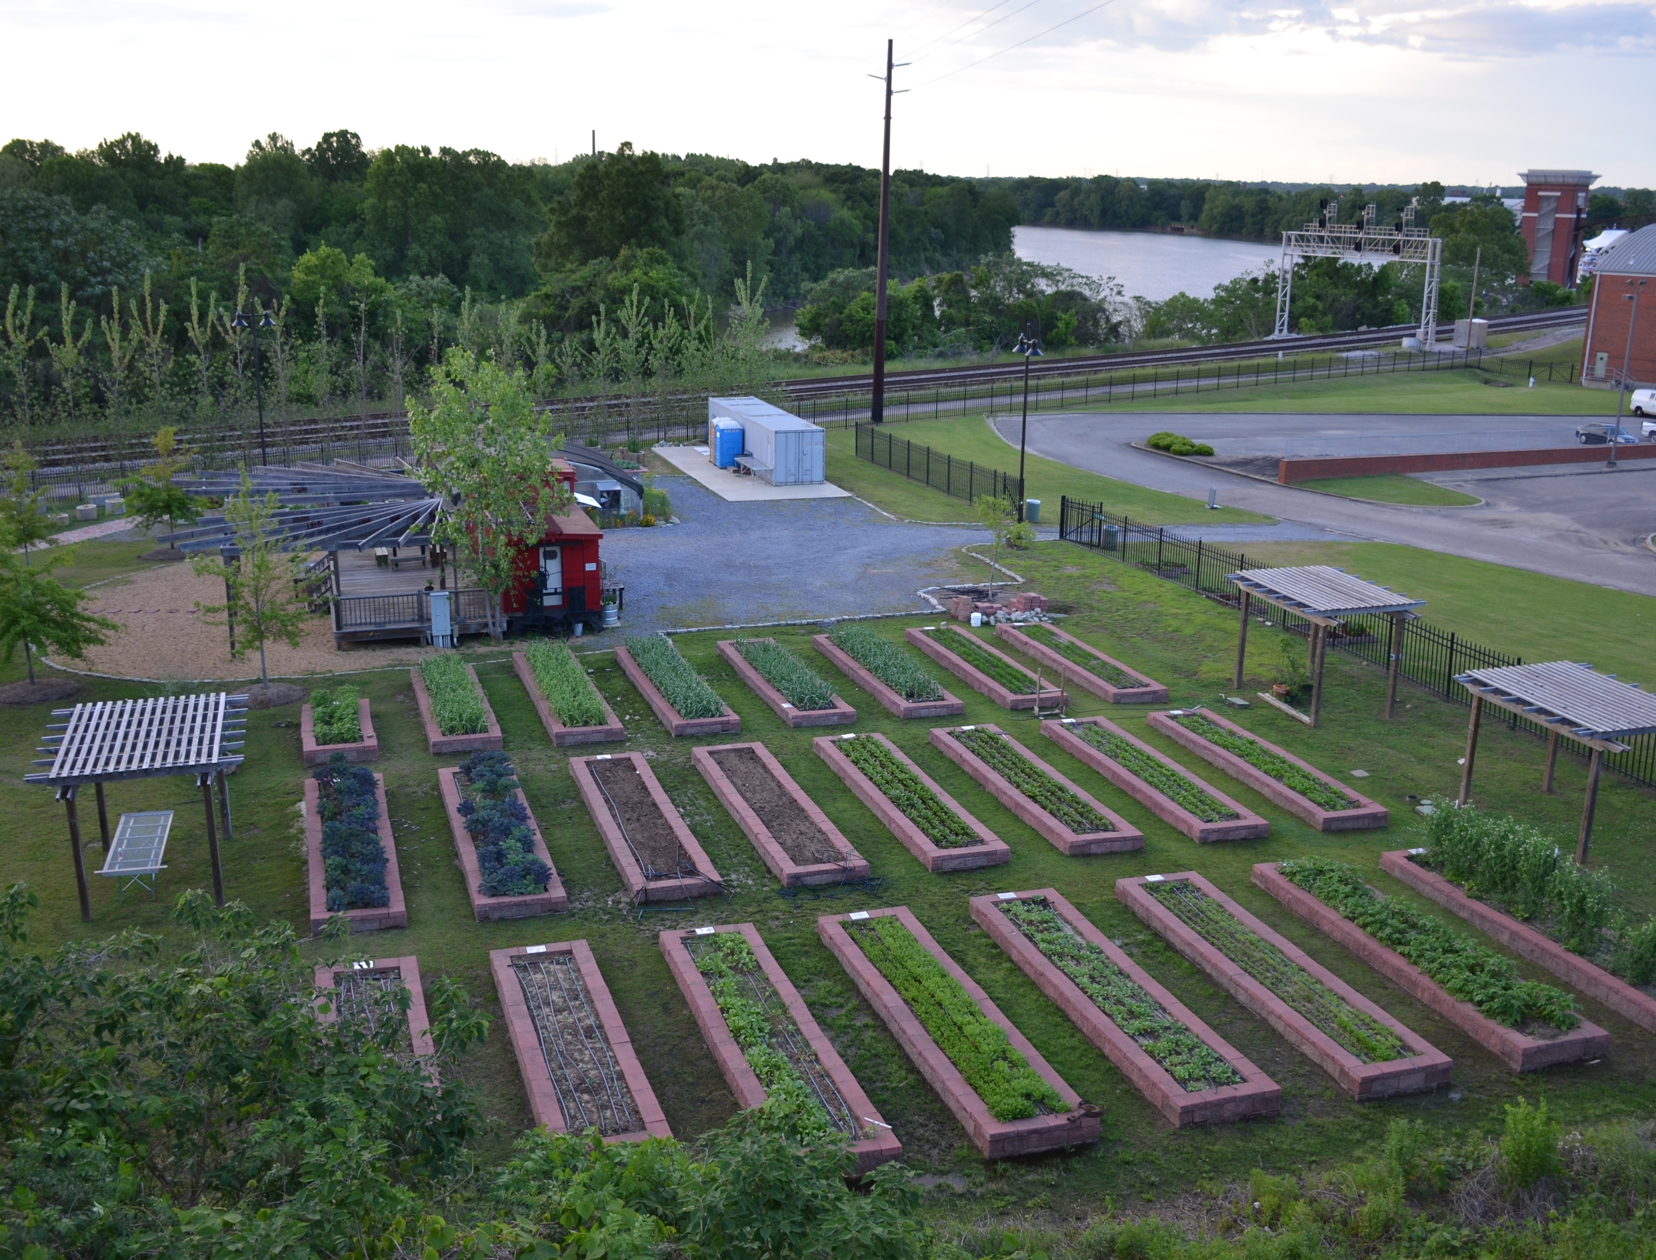
Internship
Internship created for student studying Marketing at Auburn Montgomery
Maintain Social Media accounts

Slide 15
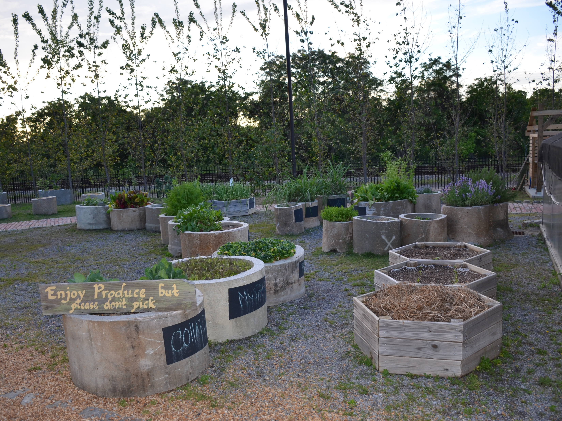
Internship
Benefits to interns
Work experience in a non-profit setting dependent on media outreach
3 hours of college credit
Participation/Invitation to all E.A.T. South events during internship
Certificate of completion recognizing details of service

Slide 16
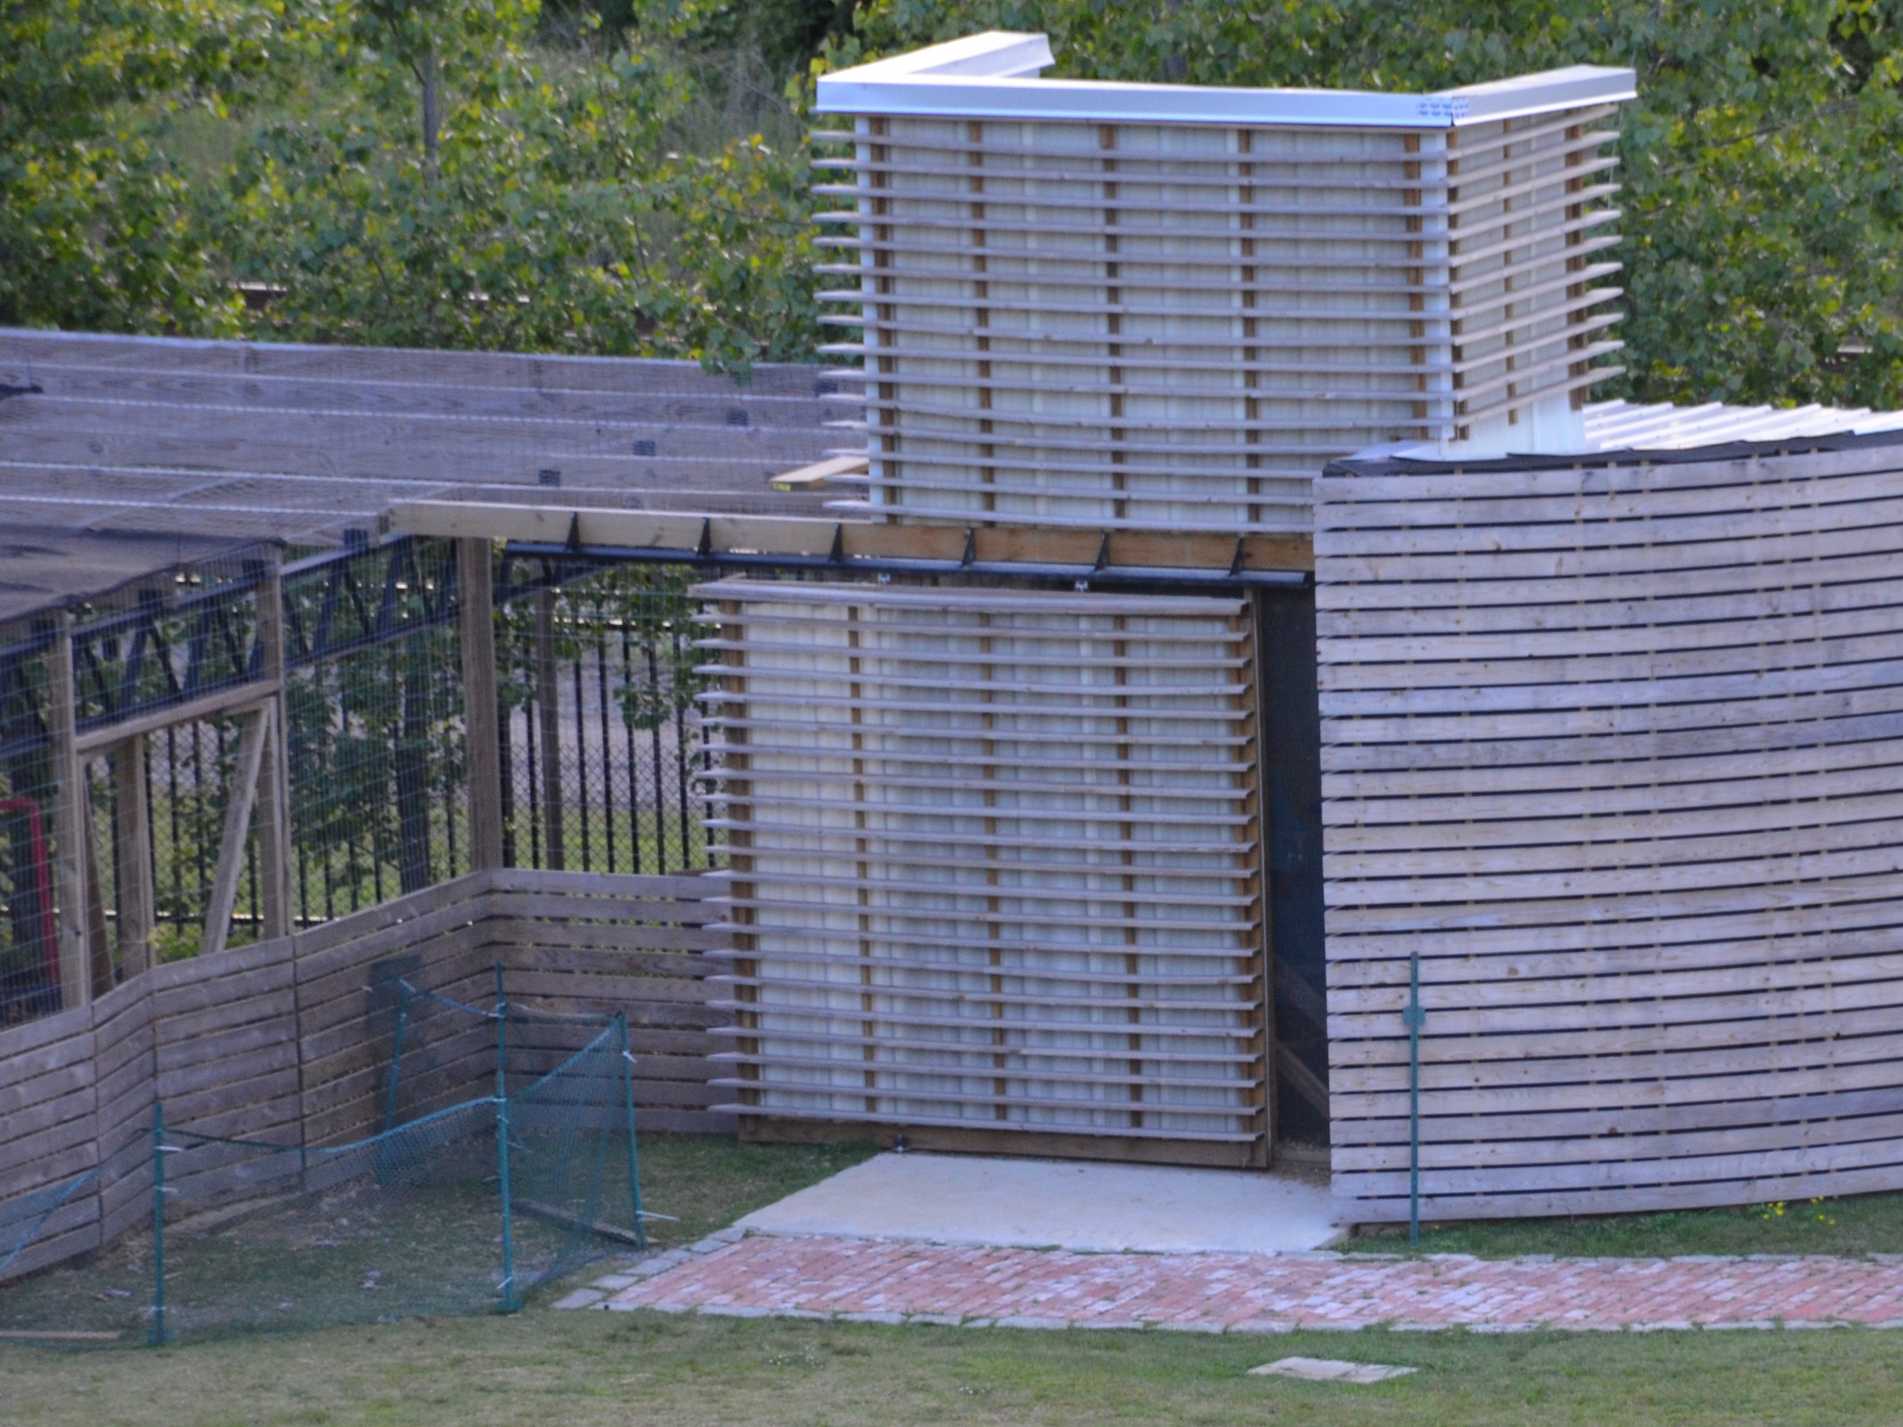
Internship
Benefits to E.A.T. South
Personnel dedicated to managing social media presence
Increased exposure among students at AUM and in the community

Slide 17
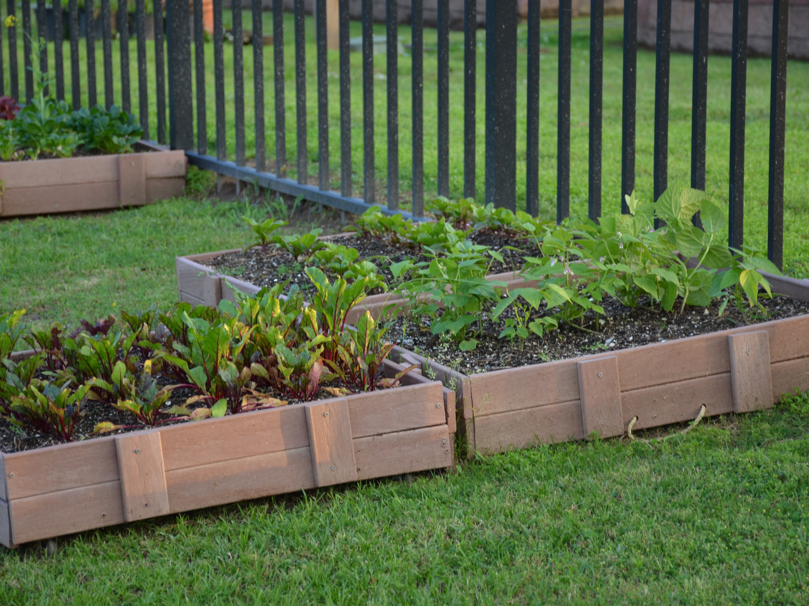
Internship
Position is being advertised
Students are in the process of being approved by the AUM College of Business
Once approved, their information will be sent to E.A.T. South
Projected start date: January 2017

Slide 18
Marketing Assessment
Assess Current Marketing Efforts
Strategize on Future Marketing Goals

Slide 19
Marketing Assessment
Develop List of Questions
Celebrate the Strengths
Evaluate Gaps in Marketing Strategy
Evolution of Brand

Slide 20
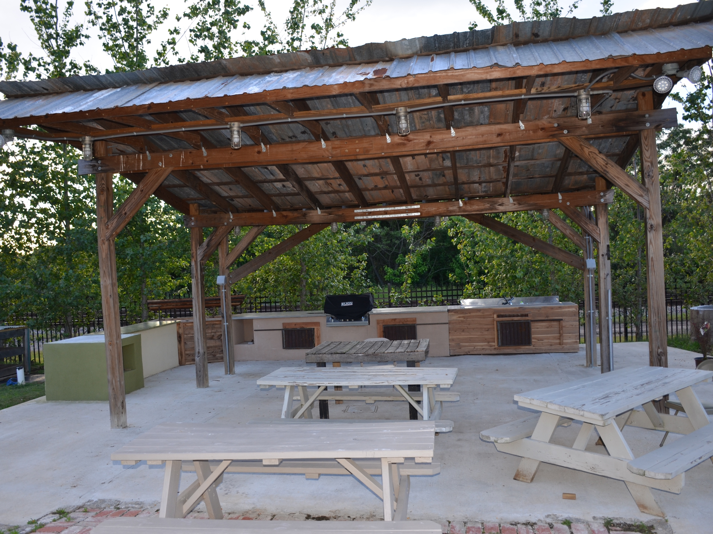
Fundraising and Promoting Public Awareness
E.A.T. South has 501 (c) (3) status and is mainly funded by donations and tax-deductible contributions. E.A.T. South will incentivize non-profit organizations in the River Region to host fundraisers at the E.A.T. South urban farm to increase revenue and promote overall public awareness of E.A.T. South’s purpose.

Slide 21
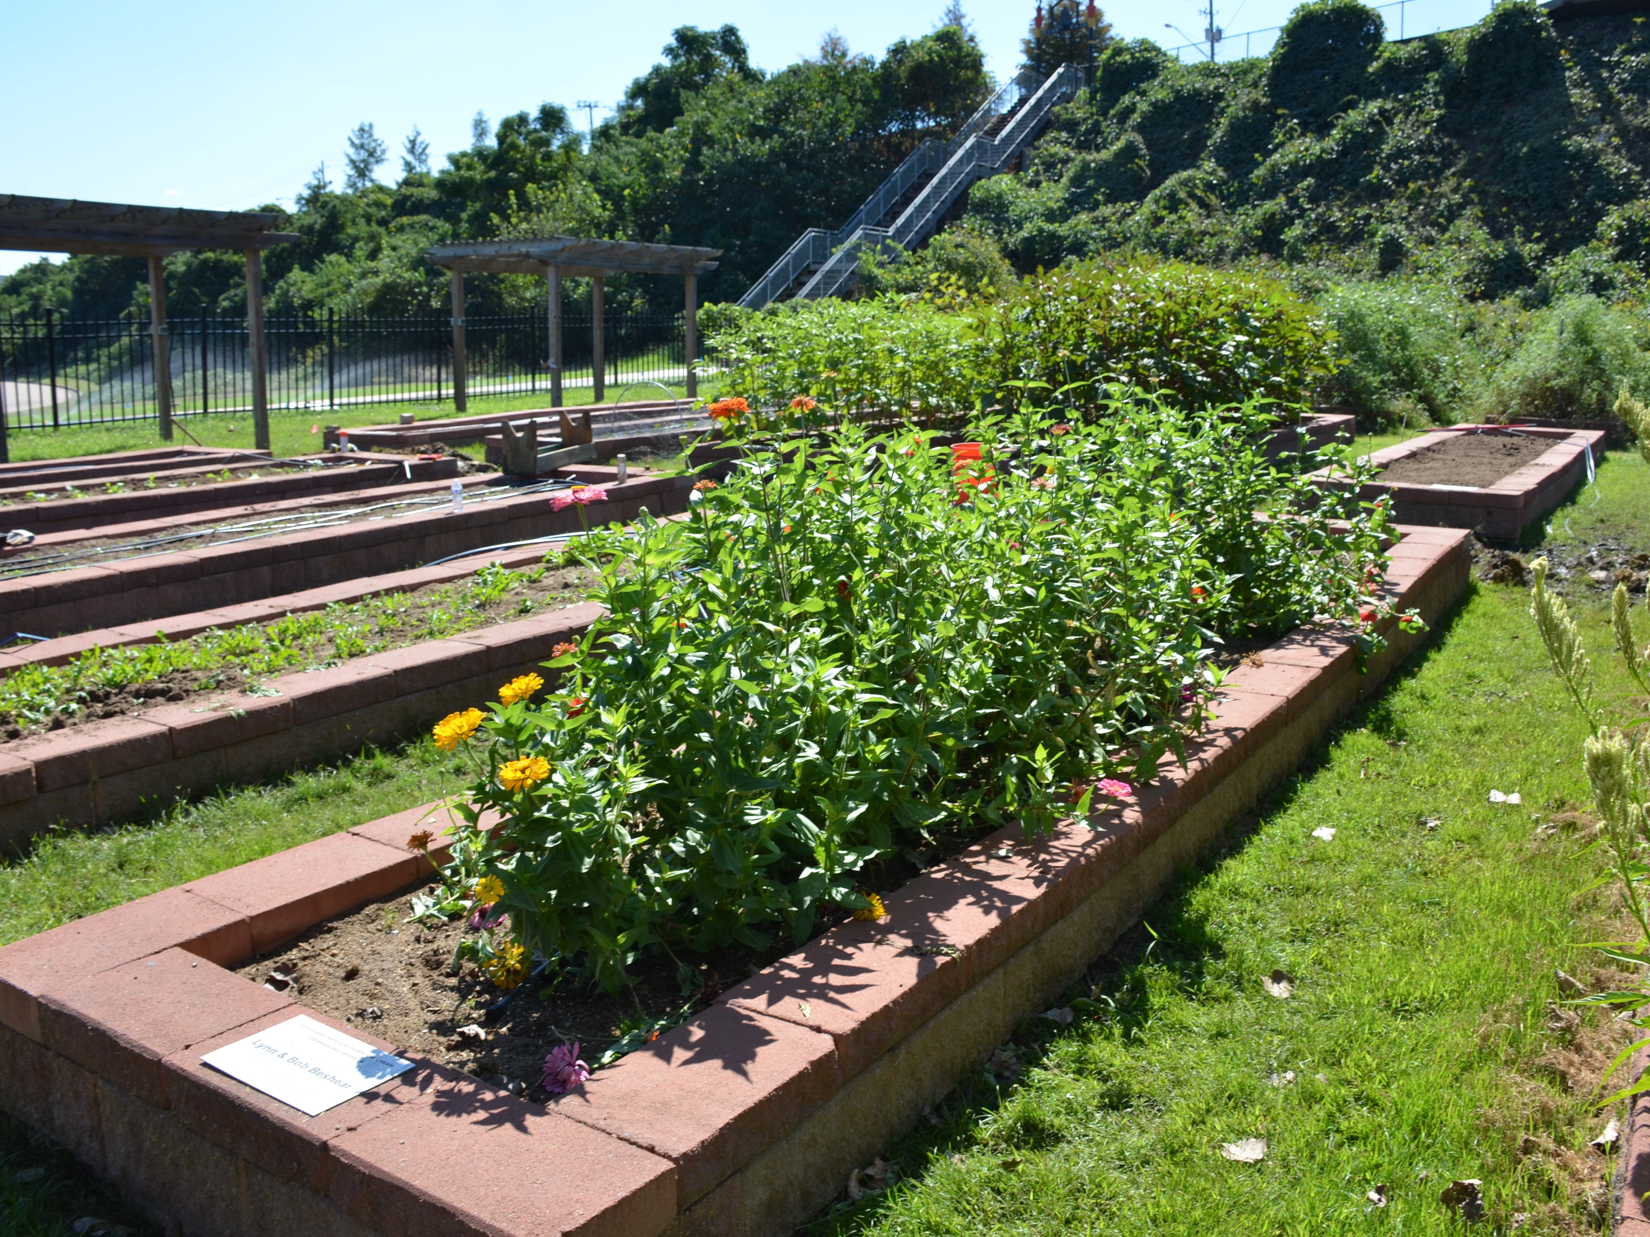
Fundraising and Promoting Public Awareness
Securing the E.A.T South urban farm facility
To secure the E.A.T. South facility, an individual or organization must complete an application which would include the following fields:
Through an addendum, the suggested contribution or donation to secure the premises is $500.
E.A.T. South will review the submitted application. After review, E.A.T. South may elect to reduce or waive the suggested contribution or donation for 501 (c) (3) organizations.
A signed application and signed addendum are required to complete the request.

Slide 22
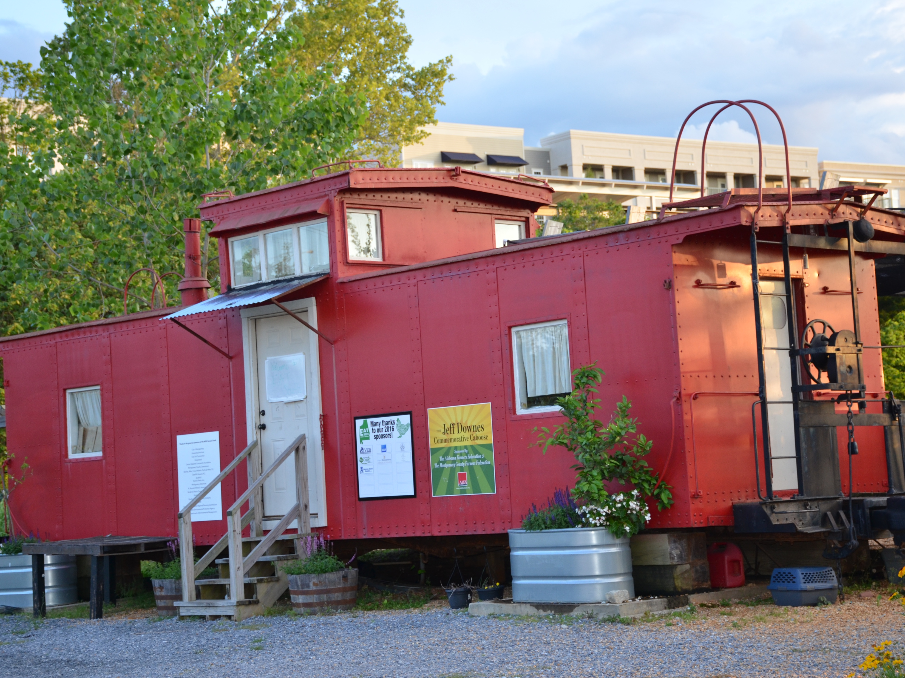
Fundraising and Promoting Public Awareness
Any event held at E.A.T. South will be subjected to a co-branding agreement

Slide 23
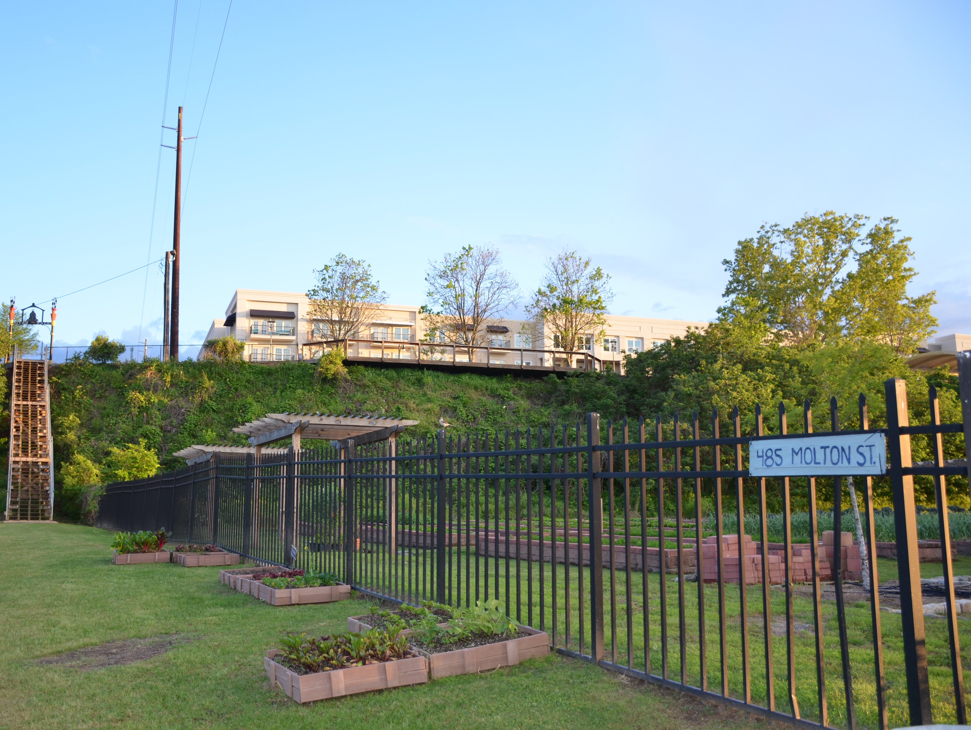
Fundraising and Promoting Public Awareness
Action Items:
Create an E.A.T. South online application

Slide 24
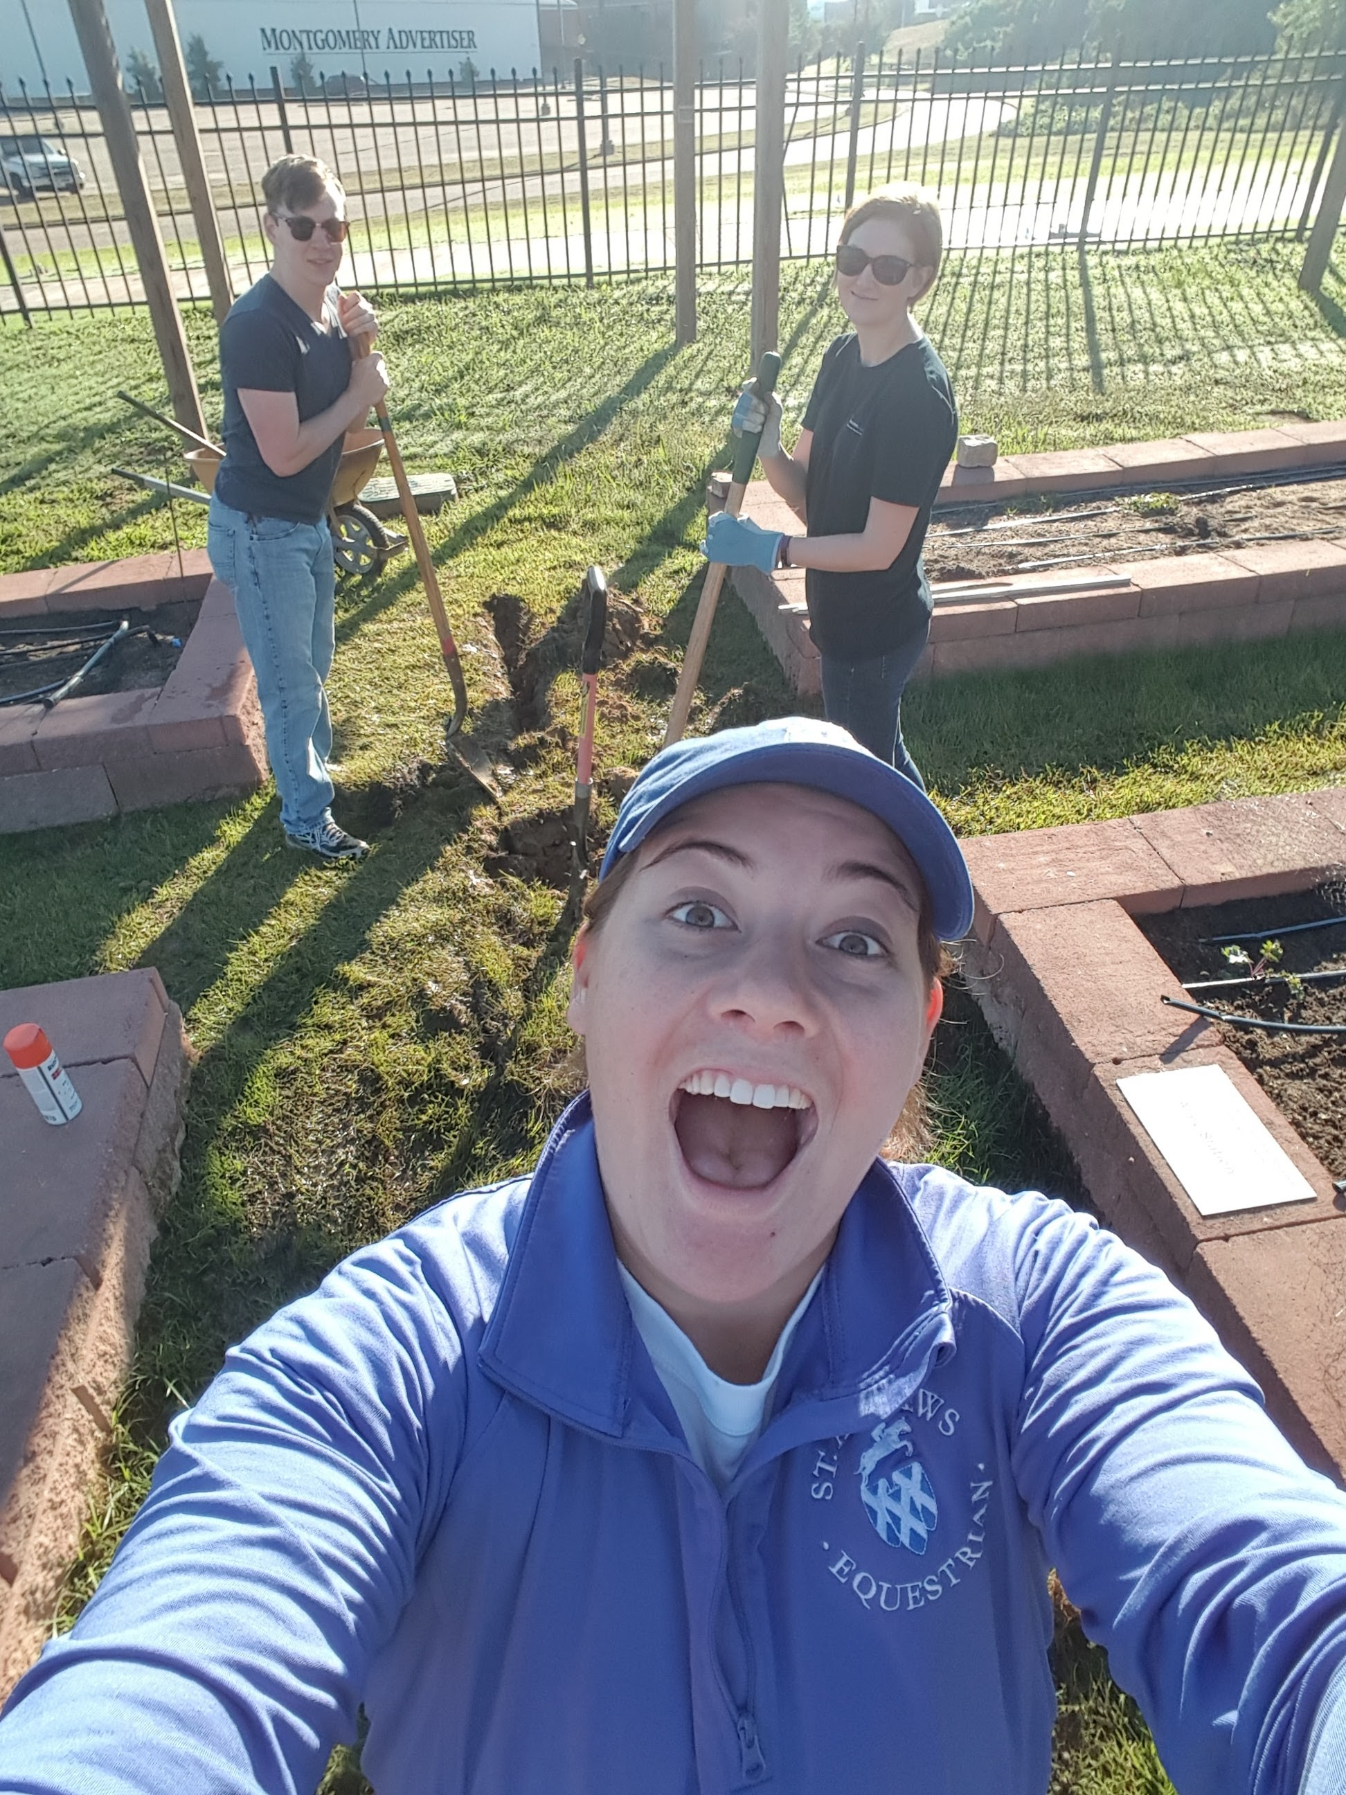
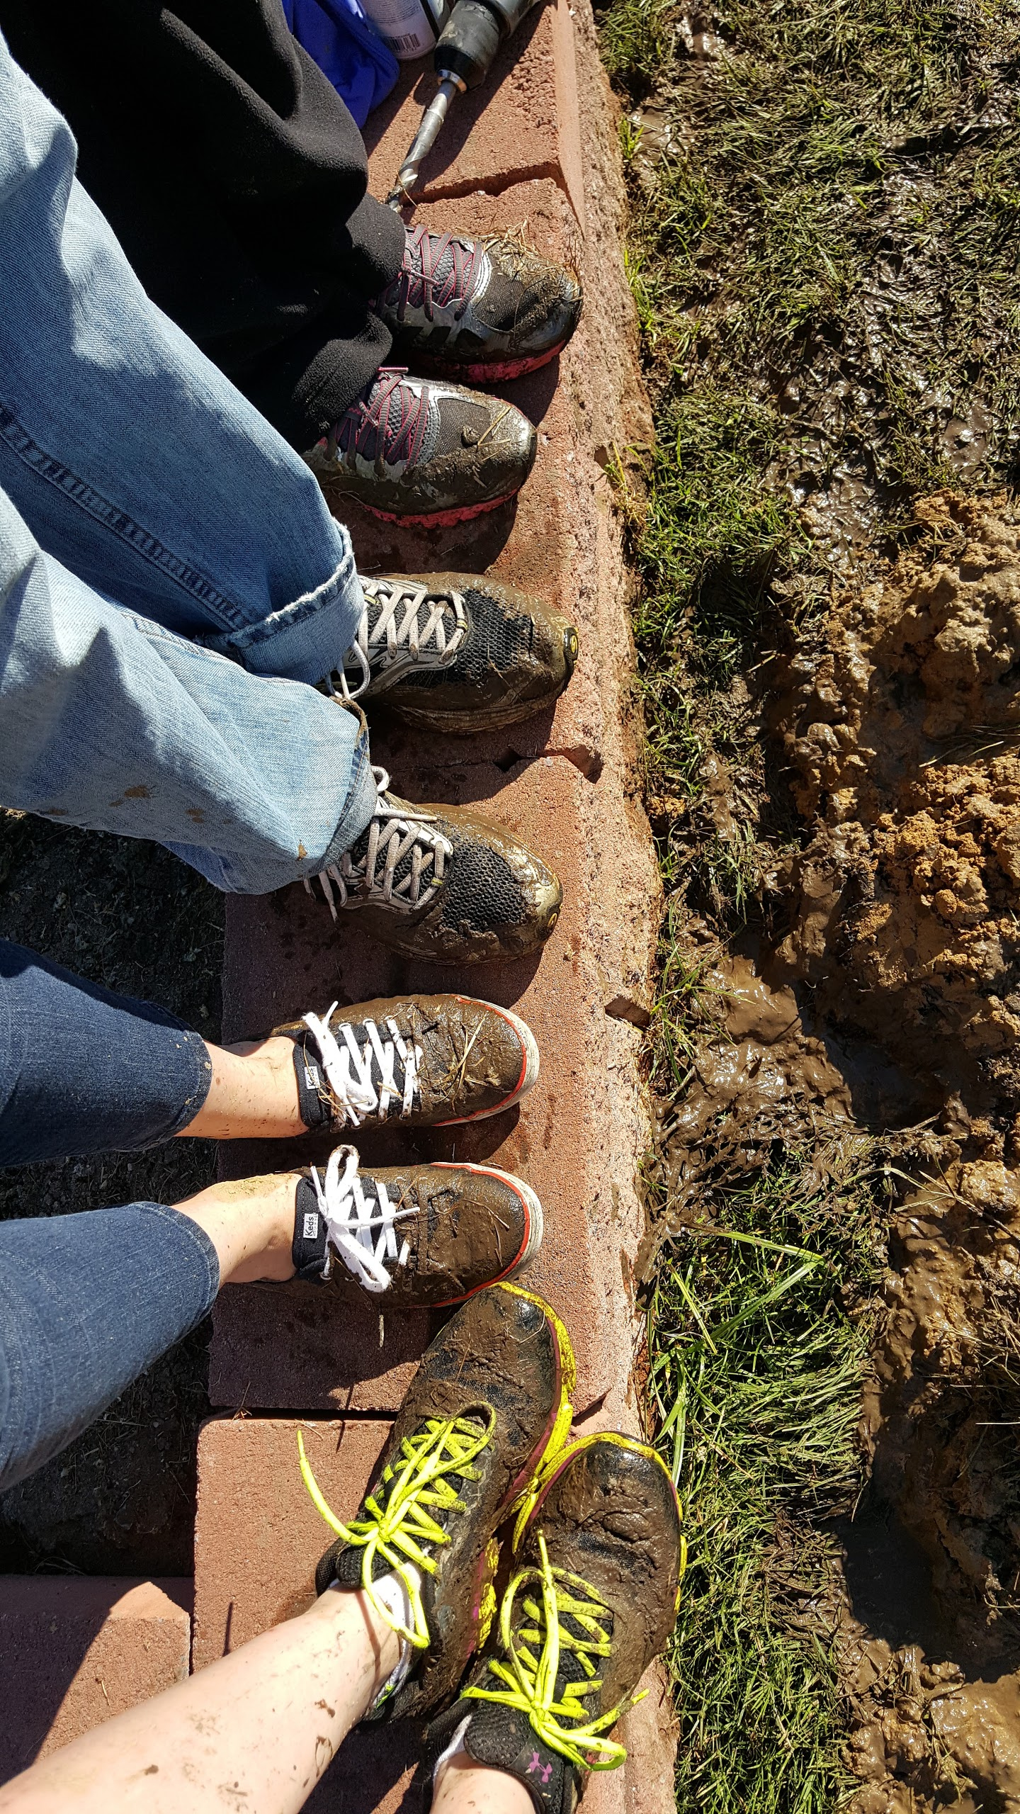

Slide 25
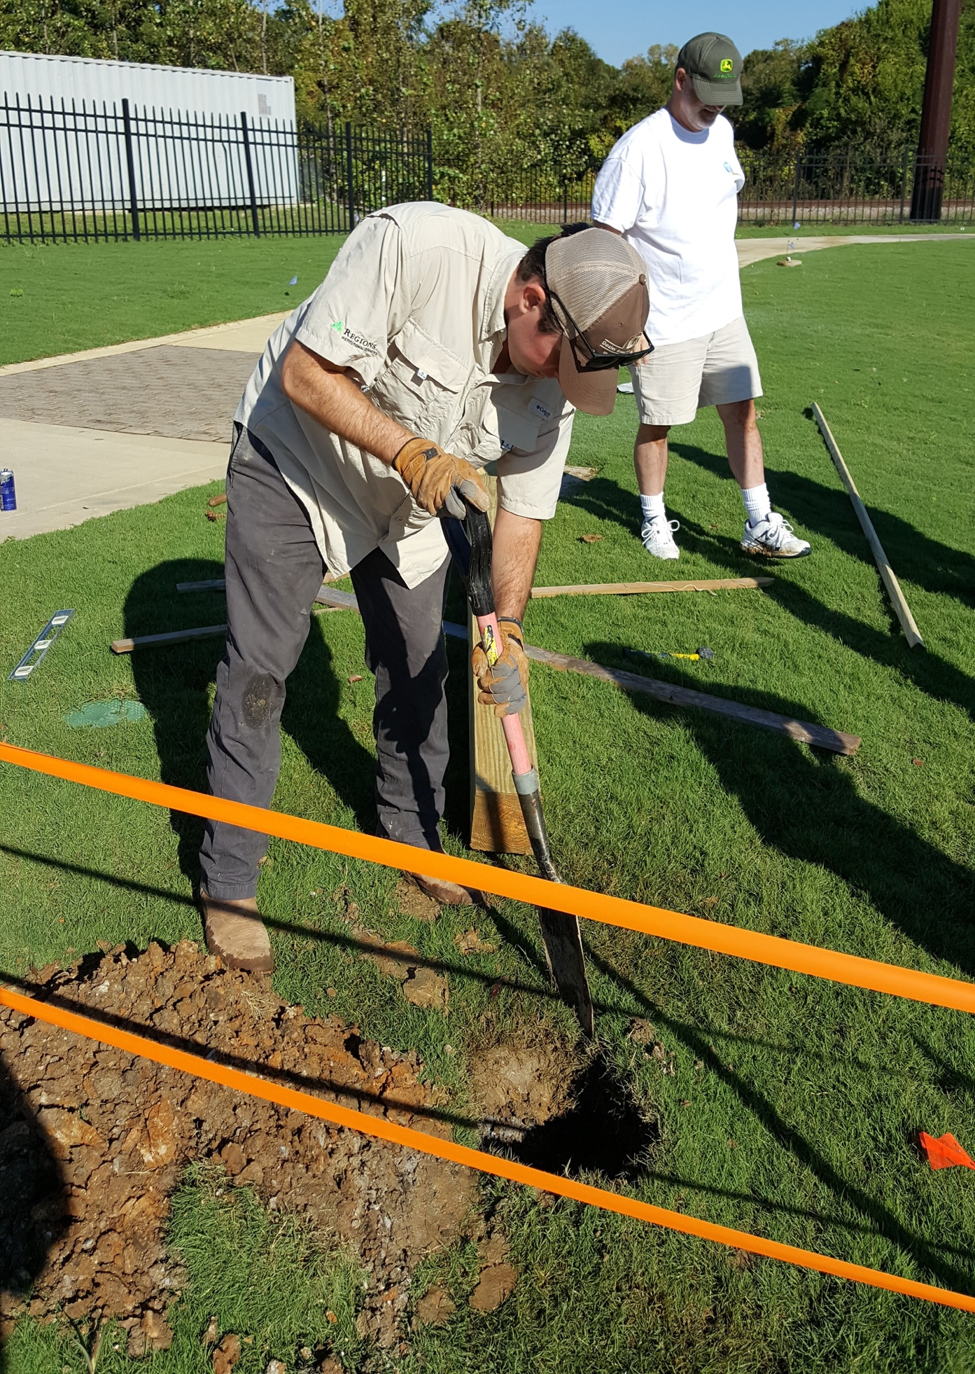
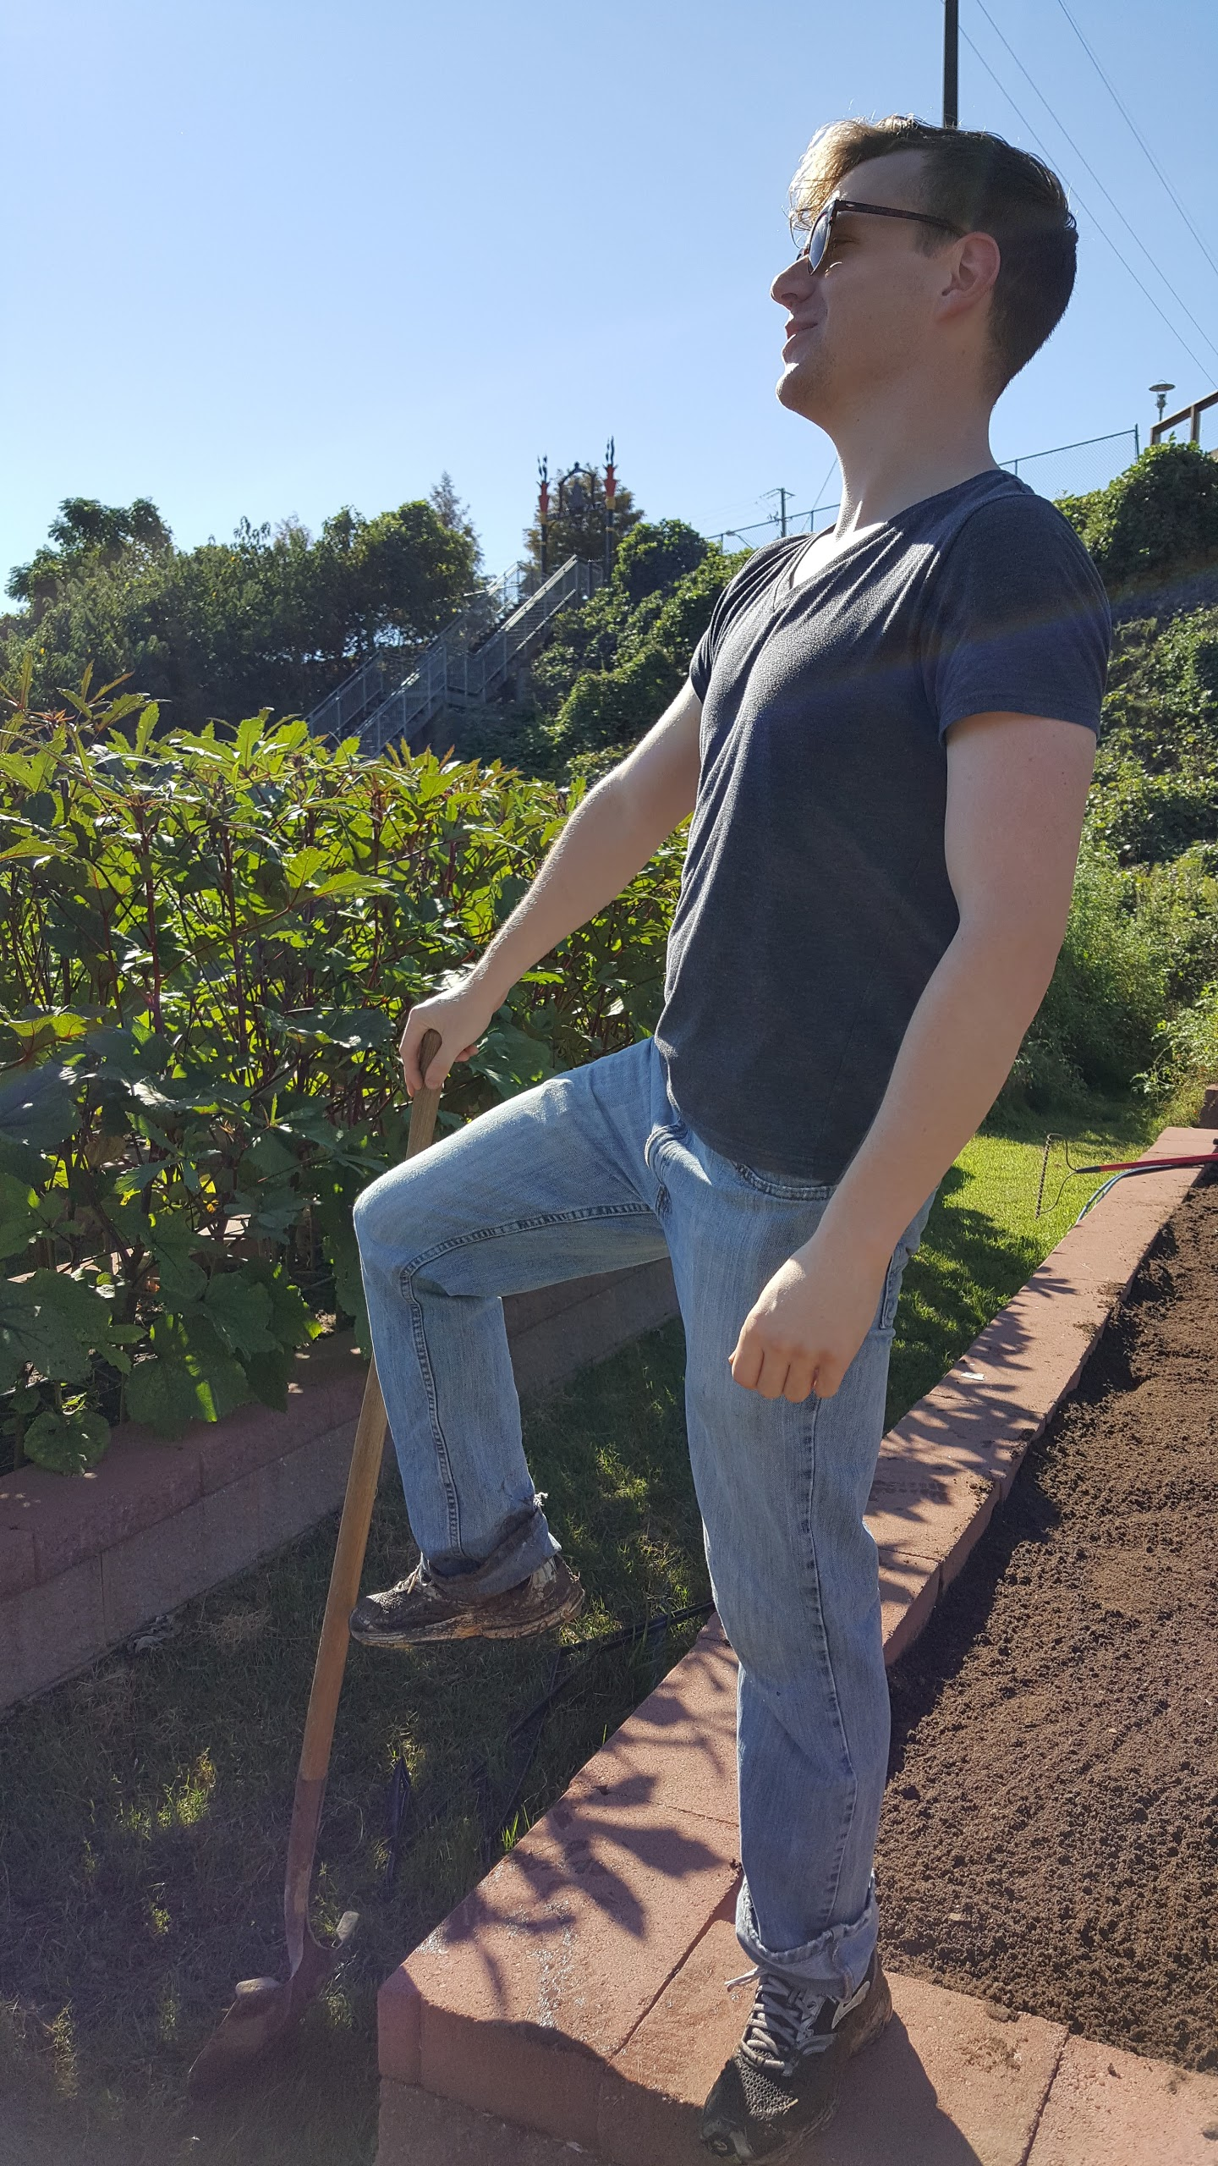

Slide 26
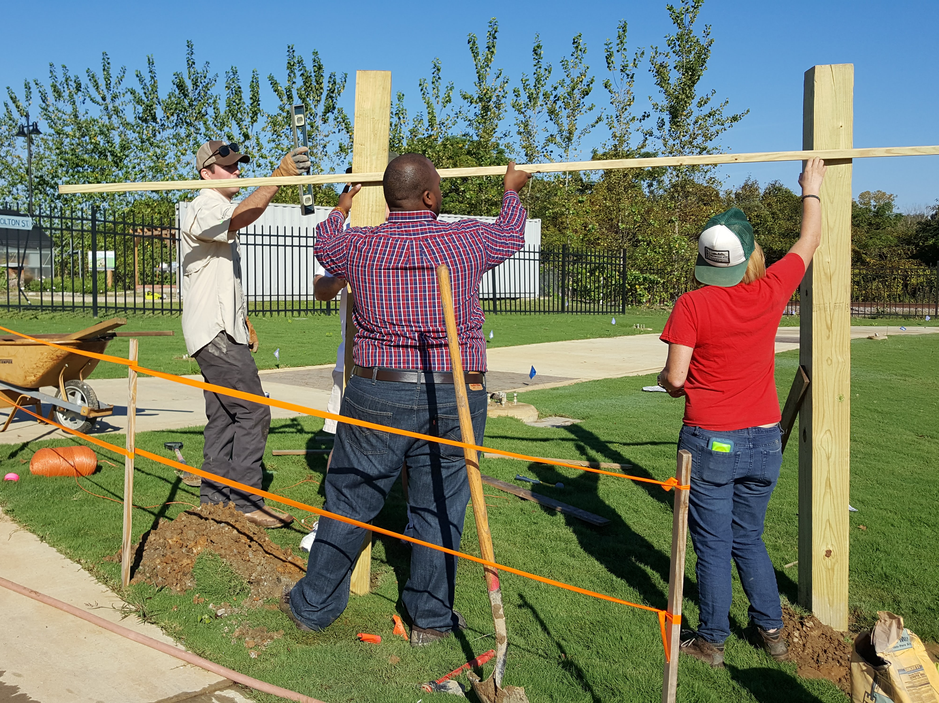

Slide 27
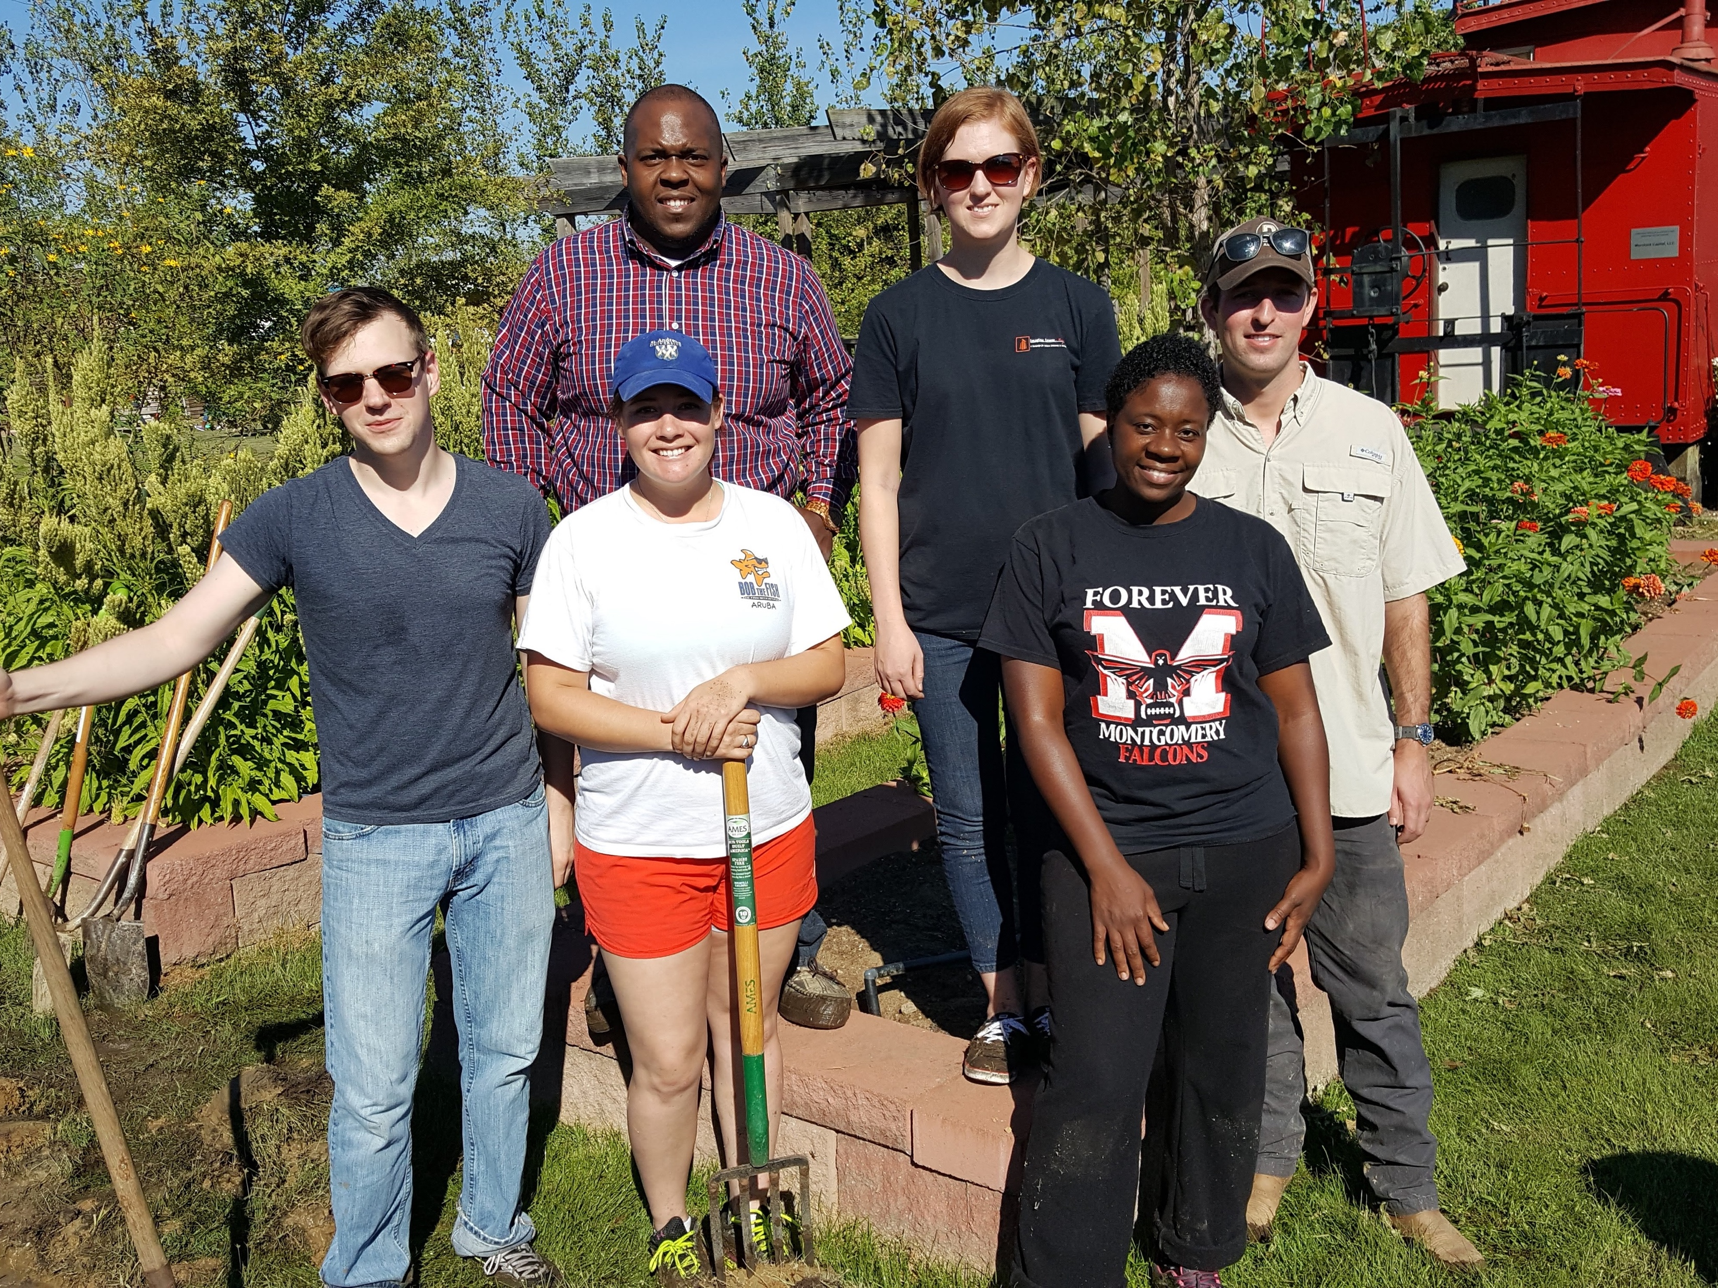

Slide 28
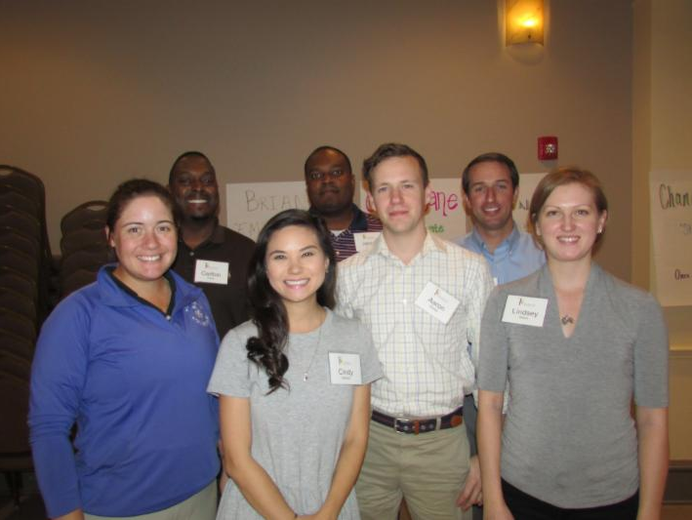
E.A.T South
Project Team 4

