Slide 1
Transformation Montgomery
The Path out of Poverty

Slide 2
One neighborhood at a time

Slide 3
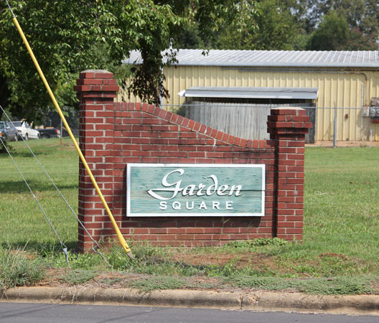

Slide 4
One family at a time

Slide 5
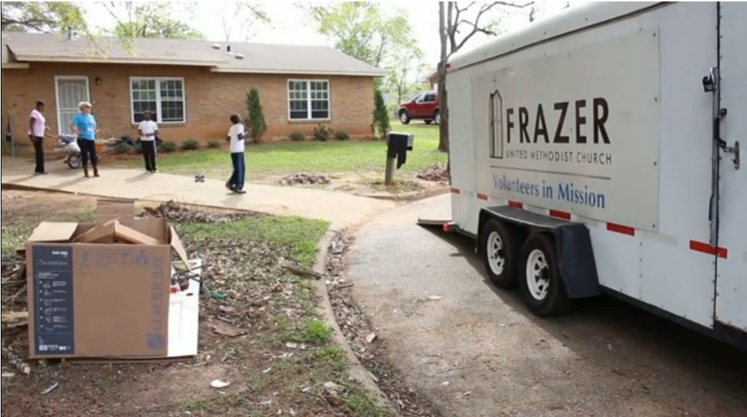
Insert image from TM website?

Slide 6
One child at a time

Slide 7
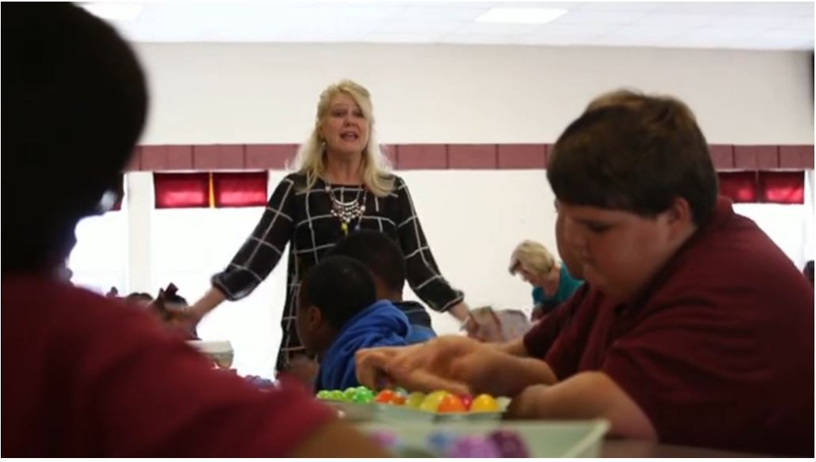
Insert image from TM website

Slide 8
One room at a time

Slide 9
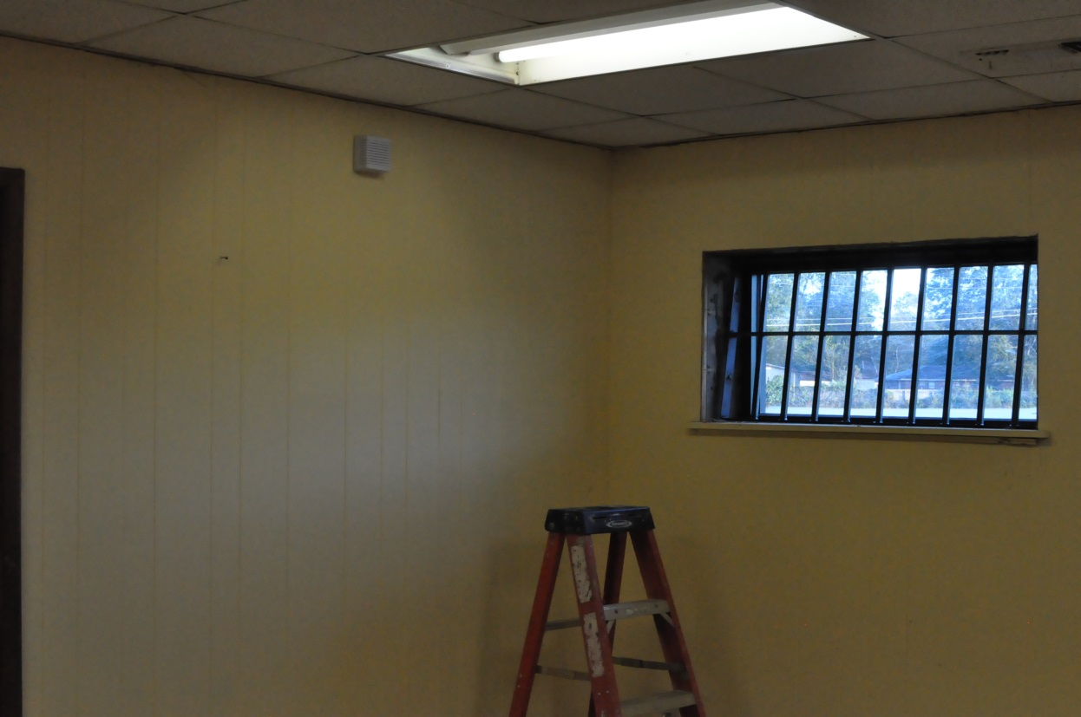

Slide 10
The Art Room
Leadership Montgomery Class XXXII
Group 6

Slide 11
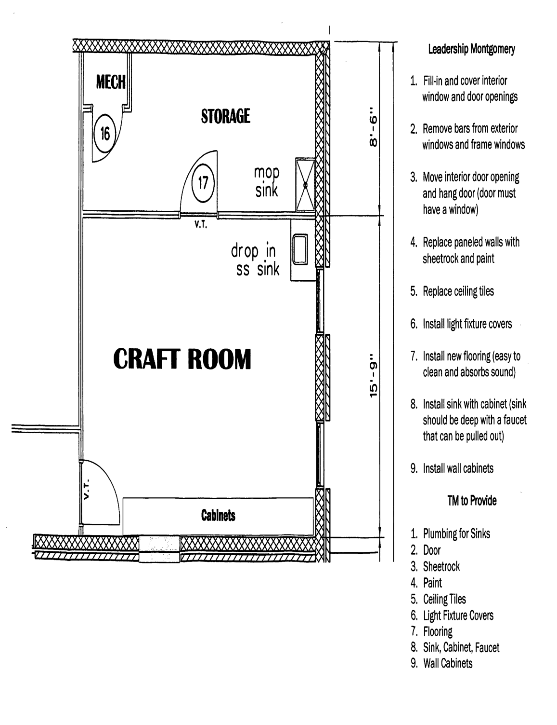

Slide 12
One of Transformation Montgomery’s outreach initiatives focuses on after school and summer enrichment programs for the children of Garden Square and Chisholm Elementary School.

Slide 13
The goal of the enrichment programs is to introduce the children to experiences and opportunities which are not normally received through the traditional educational process.

Slide 14
In order to be successful, Transformation Montgomery identified the need to have a community center for these activities to take place.

Slide 15
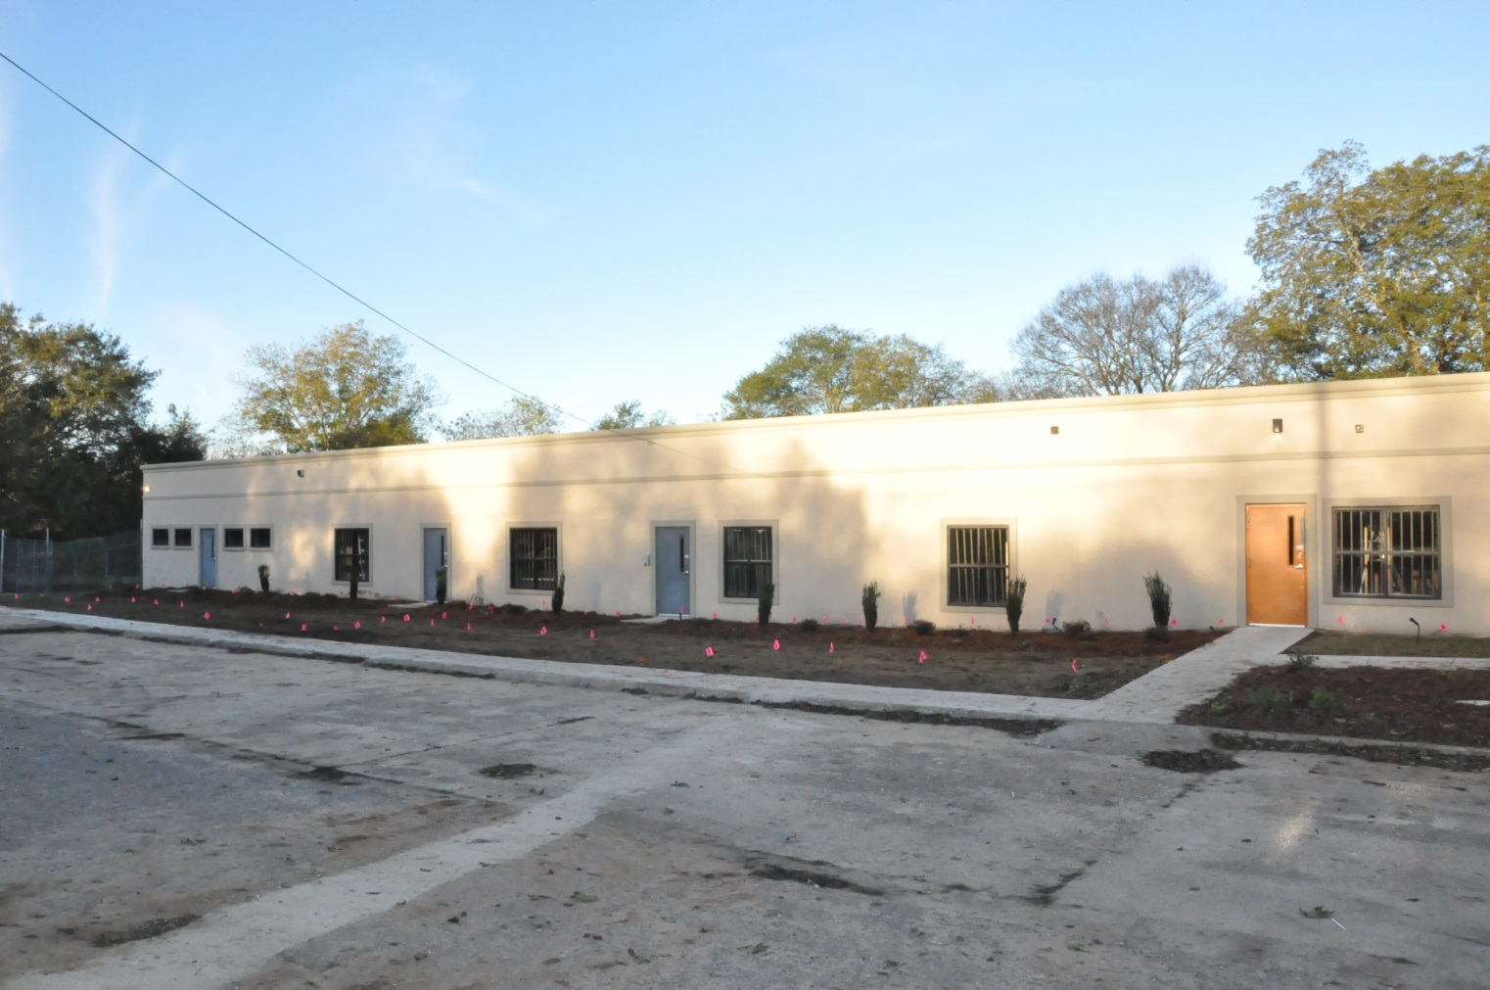
From this need, the idea of the Transformation Center developed.

Slide 16
A need to provide arts and music enrichment for the children of the community was identified; subsequently, a classroom in the new Transformation Center was designated for this purpose.

Slide 17
Our band of rugged individualists, with nothing more than our wits and good looks, accepted the monumental task of renovating and “transforming” one of the classrooms into an arts and music room.

Slide 18
The
Brain Trust

Slide 19
Christy & Adam

Slide 20
Russ & Ed Just happy to be part of Team 6!

Slide 21
Duane & Damon Researching Hydroponics

Slide 22
Stacy Photographer Extraordinaire!

Slide 23
“Before” Looks a little like a jail cell

Slide 25
Or maybe just a storage room

Slide 26
After a long, hard day….success!

Slide 27
Wait, that’s not right….

Slide 31
Adam the Observer He warned us he was no handyman.

Slide 32
“With a ho-heave-ho and lusty yell, They swung a beam and a sidewall fell.”
— Carmelo Benvenga

Slide 33
Why yes, there was a wall there.

Slide 34
Nasty stuff up there!

Slide 35
Duane’s testing Transformation Montgomery’s new transporter… Beam me up!

Slide 36
Now THAT’S a hard day’s work!

Slide 37
“Am I a builder who works with care,
Measuring life by the rule and square?”
— Carmelo Benvenga

Slide 38
Ed drew the short roller.

Slide 39
Long smooth strokes

Slide 40
Russ and Ed have mad skills!

Slide 41
Duane drew the short brush.

Slide 42
Teamwork makes the dream work!

Slide 43
Stacy making sure she was present and accounted for

Slide 44
Look at those walls….4 coats of paint!!!!!

Slide 45
Cold weather cleanup…brrrr

Slide 46
Christy’s porch and the beginning of shelves

Slide 47
Christy’s cat and shelves looking more like shelves

Slide 48
Stacy’s dogs….because Christy’s cat got a cameo

Slide 49
Sanding and sweating

Slide 50
Russ lost cutting in privileges; Damon took charge.

Slide 51
Not a plumber but(t)…..

Slide 52
Admiring her work….girl has serious talent!

Slide 53
Russ before he lost cutting in privileges.

Slide 54
NOT 4 coats of paint for the shelves

Slide 55
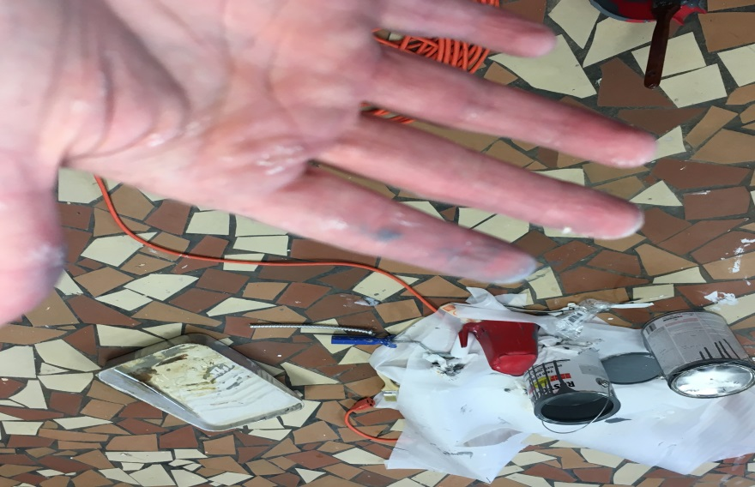
Stacy’s hand…again making sure she was accounted for

Slide 56
Ooooohhhh Ahhhhhhh

Slide 57
Thanks to Jackson Thornton for their donation to the project!

Slide 58
“Am I shaping my deeds by a well-made plan,
Patiently doing the best I can?
Or am I a wrecker who walks the town,
Content with the labor of tearing down?”
— Carmelo Benvenga

Slide 60
